Slide 1
Understand ethical and operational issues and threats to computer systems
LO5
Unit 1: Fundamentals of IT

Slide 2
LEARNING OUTCOME (LO) WEIGHTINGS
Each learning outcome in this unit has been given a percentage weighting.
This reflects the size and demand of the content you need to cover and its contribution to the overall understanding of this unit.
LO5 = 10-20%

Slide 3
Understand ethical and operational issues and threats to computer systems
Ethical issues
Operational issues
Threats
Physical security
Digital security
Safe disposal of data and computer equipment

Slide 4
5.4 Physical security
Locks
Biometrics
RFID
Tokens
Privacy screens
Shredding
Characteristics

Slide 5
5.5 Digital security
Anti-virus
Firewalls
Anti-spyware
Username/passwords
Permissions
Encryption
Characteristics

Slide 6
5.6 Safe disposal of data and computer equipment
Legislation
Overwrite data
Electromagnetic wipe
Physical destruction

Slide 7
LO5 Spec Overview
Learners should know about different ethical and operational issues.
This should lead to an understanding of how these issues can be addressed.
Learners should know about different threats to computer systems.
Learners should know about physical and digital security methods and their characteristics.
This should lead to an understanding of why different security methods are used in different contexts and a justification for their use

Slide 8
Objectives
Identify a range of ethical/operational issues and threats to computer systems.
Describe how these issues can be addressed.
Justify different security methods used in different contexts.

Slide 9
Define the different types of threats
Phishing
Hacking
Virus
Trojan
Interception
Eavesdropping
Data theft
Social engineering
Check your understanding using the web page: http://www.itscolumn.com/2012/03/28-types-of-computer-security-threats-and-risks/
Type up in Yacapaca

Slide 10
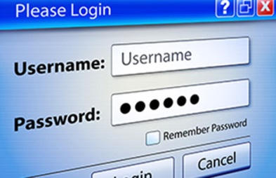
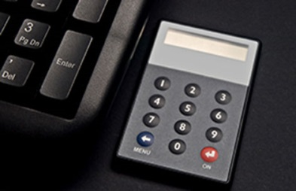
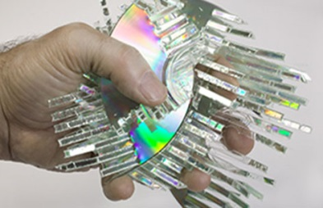
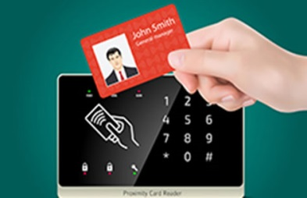
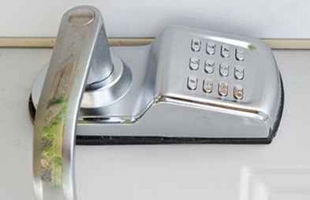
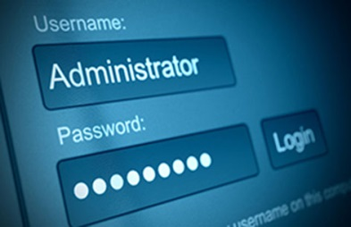
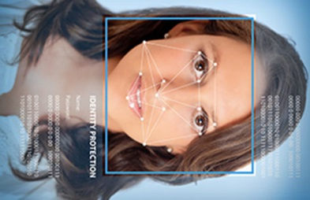
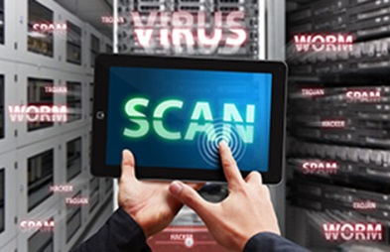
Security Memory Game
Notes:
LOCKS
BIOMETRICS
RFID - Radio-Frequency IDentification.
TOKENS
PRIVACY FILTER
SHREDDING
ANTI-VIRUS
FIREWALL
ANTI-SPYWARE
USERNAME PASSWORD
PERMISSIONS
ENCRYPTION

Slide 11
Security Examples
For each of the following suggest a scenario for use and where you would see them.
Locks, Biometrics, RFID, Tokens, Privacy filters, Shredding, Anti-virus, Firewalls, Anti-spyware, Username/password, Permissions, Encryption.
Type up on the PC or make notes in your book

Slide 12
Physical security and Digital security
Organise the identified security methods into two groups:
Physical security
Digital security
Physical security | Digital security
Notes:
LOCKS
BIOMETRICS
RFID
TOKENS
PRIVACY FILTER
SHREDDING
ANTI-VIRUS
FIREWALL
ANTI-SPYWARE
USERNAME PASSWORD
PERMISSIONS
ENCRYPTION

Slide 13
Security Methods
For the identified threats:
Phishing, Hacking, Virus, Trojan, Interception, Eavesdropping, Data Theft, Social Engineering;
Give justified reasons for security methods you would use to combat the threats.
Locks, Biometrics, RFID, Tokens, Privacy filters, Shredding, Anti-virus, Firewalls, Anti-spyware, Username/password, Permissions, Encryption.

Slide 14
Tesco bank attack: What do we know?
Read this news story then answer the questions below:
http://www.bbc.co.uk/news/technology-37896273
Note that you will have to undertake further research to provide an adequate answer.

Slide 15
Network Threats
http://www.teach-ict.com/2016/GCSE_Computing/OCR_J276/1_6_network_security/network_threats/miniweb/index.php
Complete the booklet.

Slide 16
Exam Qs
Complete the Exam Questions.

Slide 17
Health and Safety
What factors can affect Health and Safety?

Slide 18
Health and Safety
http://www.teach-ict.com/as_a2_ict_new/ocr/AS_G061/317_role_impact_ict/health_safety/miniweb/index.htm
Complete the booklet.

Slide 19
Staying Safe Online
What factors can affect your safety online?

Slide 20
Staying Safe Online
http://www.teach-ict.com/ks3/internet_safety/staying_safe/stayingsafe1.htm
Complete the booklet Staying Safe Online.

Slide 21
Agony Aunt
As Anne the ICT agony aunt you receive a lot of letters asking for your help and advice about technology related issues.
There are just three letters left that you need to answer before you can go home for the evening.

Slide 22
Agony Aunt

Slide 23
Safe disposal of data and computer equipment
Research the following. Create a document that describes each and explains what they are.
Legislation
Overwrite data
Electromagnetic wipe
Physical destruction

Slide 24
Change Management
http://www.teach-ict.com/as_a2_ict_new/ocr/A2_G063/336_implications_ict/change_management/miniweb/index.htm
What is change management?
What is the purpose of it?
What are they stages?
In what situations might it be employed?
What issues with staff might there be and why? How could these issues be resolved?

