Slide 1
starter
Open books & add a new title:
‘5.6 Safe disposal of computer equipment’ date 6/4/2017
List: All pieces of computer equipment you’ve used and thrown away.
Notes:
10mins

Slide 2
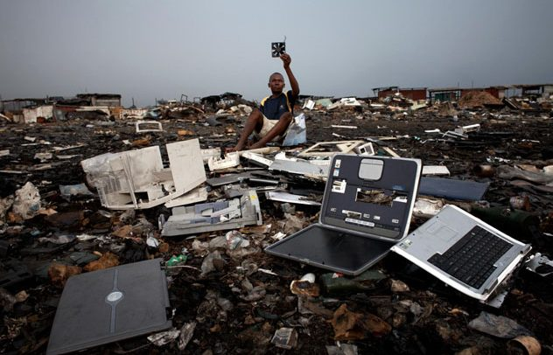
Warning: Next image, bit nasty.
Unsafe disposal: http://www.news.com.au/technology/worlds-worst-dump-hellish-agbogbloshie-tip-where-poor-children-live-among-australias-ewaste-illegally-shipped-to-africa/news-story/067b66d57793b2b569f934f99939a4c2

Slide 3
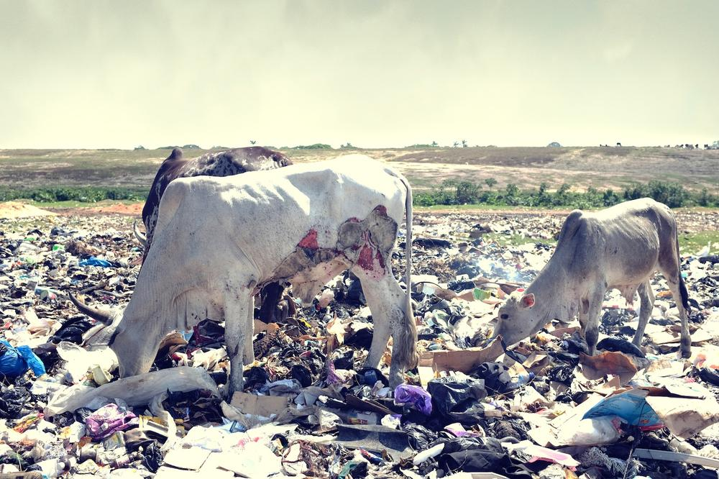
Toxins affect the soil & Grass

Slide 4
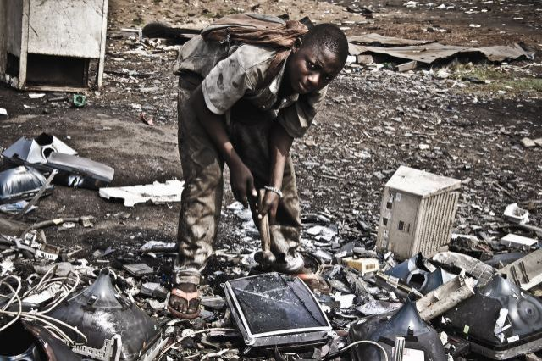
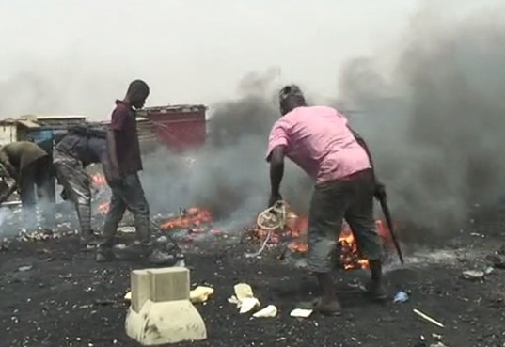
Locals disposing of the waste.

Slide 5
Safe disposal:
https://www.youtube.com/watch?v=lq3o4p8tpZE

Slide 6
New learning goals
All will: Understand legislation for safe disposal of computers
Most will: Understand why different ones are used in different contexts
Notes:
1mins

Slide 7
Main task: Legislation
Answer these questions in your book, use the internet to research
1. What does the Waste Electonic and Electrical Equipment (WEEE) directive say is needed for safe disposal/dismantling.
2. What does the WAC (UK’s waste Acceptance Criteria) Deal with.
3. What does the Hazardous Waste (England and wales) Regulation of 2005 apply to (toxins/chemicals).
4. What does the freedom of information act (200) and the Data Protection act (1998) have to do with safe disposal?

Slide 8
Main task: Data protection
Answer these questions in your book, use the internet to research
1. What is the difference between overwriting and wiping (with an electromagnet)?
2. How can data/hard ware be physically destroyed.

Slide 9
Partner discuss
1. What is a whistle blower?
2. An Organisation is concerned that if the server was to break down, they may lose their data. What operational issue would they need to consider?
3. What does RFID stand for?
4. Give two examples of how permission could be used as a digital security method on a network.
5. Identify two ways in which data can be securely removed from a hard-disc.

