Slide 1
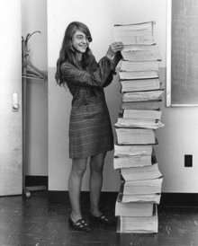
starter
Open Publisher 4.1 Leaflet from Communication skills lesson.
Add a new page called ‘4.5 Job Roles’
Think: What would be your dream IT Job? Network manager? Animatior? Programmer? Web Designer?
Notes:
10mins

Slide 2
New learning goals
All will: Understand job roles in IT
Most will: Find Roles and consider suitable Skills and Attributes for each
https://www.youtube.com/watch?v=VkGeAJD5R2U
Notes:
1mins

Slide 3
Jobs available
Using TotalJob or Monster find examples of each job, screenshot and paste to your document.
Network manager
IT Technician
Programmer
Web Designer
Animator
Below each list 2 attributes and two communication skills required for each job. (Be prepared to justify why)

Slide 4
What skills have you given for…
Network manager
IT Technician
Programmer
Web Designer
Animator

Slide 5
Question the class
Question the other side of the class on topic 4 inc :
Communication Skills: Interpersonal Skills/Verbal Communication/Questioning Techniques/Written Communication/Barriers to Communication
Personal Attributes:
Decisiveness/Punctuality/Self-Motivation/Leadership/Respect/Dependability/Problem Solving/Determination/Independence/Time Management/Team working/Written Skills/Planning Skills
Ready for work: Dress Code / Presentation / Attitude

