Slide 1
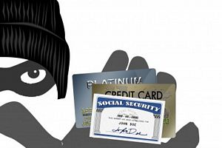
starter
Create a new .ppt & save as ‘5.1 Ethical Issues’
Add 5 slides and a picture for each, guess the titles by these pictures.
Notes:
10mins

Slide 2
Titles are:
Whistle blowing
Disability/gender/sexuality discrimination
Use of information
Codes of Practice
Staying safe online
Add title and a suitable image for each slide.

Slide 3
New learning goals
All will: Understand a range of ethical issues
Most will: Research one or two in detail with examples and share with the class
Can you think of a famous whistleblower?
https://www.youtube.com/watch?v=QlSAiI3xMh4
Notes:
1mins

Slide 4
Main task:
Research your given ethical issue & find out:
1. Define the term.
2. Give an example of when it has happened.
3. Find out which law protects people from the ethical issue.
When complete, move on to another of the ethical issue slides.
Be prepared to share at least one with the class and take down notes from then on that section.

Slide 5
Sharing is caring
Share what you researched on each:
Define, Example, Law protecting it.
Whistle blowing
Disability/gender/sexuality discrimination
Use of information
Codes of Practice
Staying safe online
Take down notes on these when shared with class.

Slide 6
Ethical issues
Which of the examples do you think is most serious and why?
Whistleblowing – Ed Snowden now a fugitive
Discrimination – Not wearing heals in work? Sent home
Use of information – Fraud
Codes of practice – Not treating information as confidential.
Staying safe online – effect of hackers and blackmailers.

