Slide 1
starter
Open Skills sheet in book & Publisher 4.1 Leaflet from last lesson.
Think: Of a question Regarding Communication Skills expected by a company to ask another person…
Ref:
Verbal Comms
Interpersonal Skills
Questioning techniques
Written Comms
Barries to Comms
Notes:
10mins

Slide 2
New learning goals
All will: Understand a range of Written Skills
Most will: Explain suitable examples in scenarios
Notes:
1mins

Slide 3
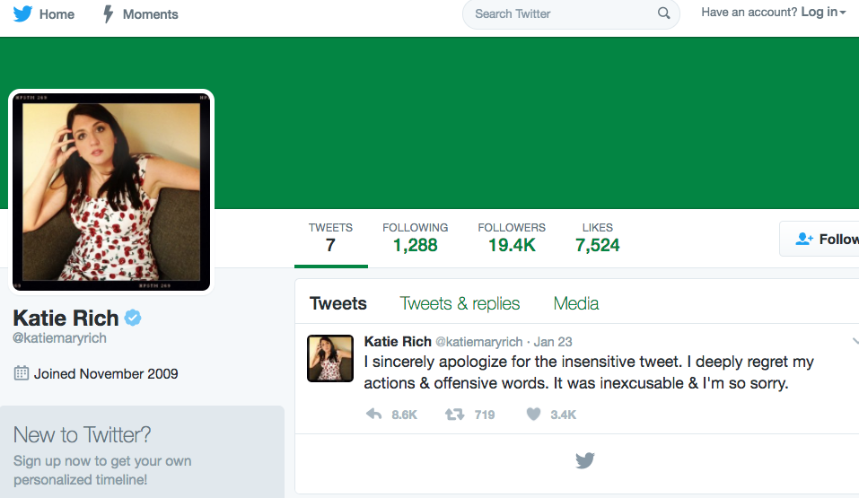
Written skills can make/break a job
Suspended from Saturday Night Live Writing Staff, following a joke tweet….

Slide 4
Task: add to leaflet
Add another page
To your leaflet.
Discuss company policy on:
E-mail
Letters
Reports
Social networking
For each list what: Is Expected/Not allowed.
Use of language (formal/not formal)
Research real
Company written
Policies online for examples.
Notes:
4mins demo, 20mins – create logo, then export together. 15mins – Add to PPT and Callout, show each others logos.

Slide 5
Mime a skill or Barrier….
Can you draw a cryptic clue to a barrier of your choice: Rest of the class guess…
Could be: ……………………Verbal Comms
Interpersonal Skills
Questioning techniques
Written Comms(email/social media/letter)
Barries to Comms
= Interpersonal Skills

