Slide 1
Theory 3 software
Monday, 29 October 2012

Slide 2
Write title & revise protocols
Open your : Books
Title: Virtualisation (Date: 15/12/2016)
THINK: Revise the Types of Server questioned/question the other half of the class.
Notes:
10min copy files and answer

Slide 3
New learning goals
All will: Understand Virtualisation
Most will: Research the Advantages/disadvantages of virtualisation
Few will: Evaluate when to use it for a business
AIMS:
Research and understand virtualisation
Take down key points on it.
Discuss with the class pro’s & con’s.
Notes:
1min

Slide 4
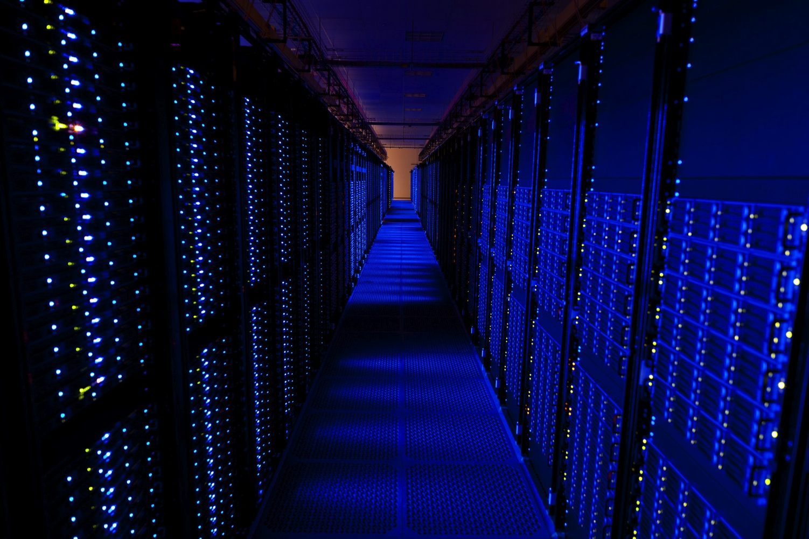
What is virtualization?
https://www.youtube.com/watch?v=V9AiN7oJaIM
Amazon server room

Slide 5
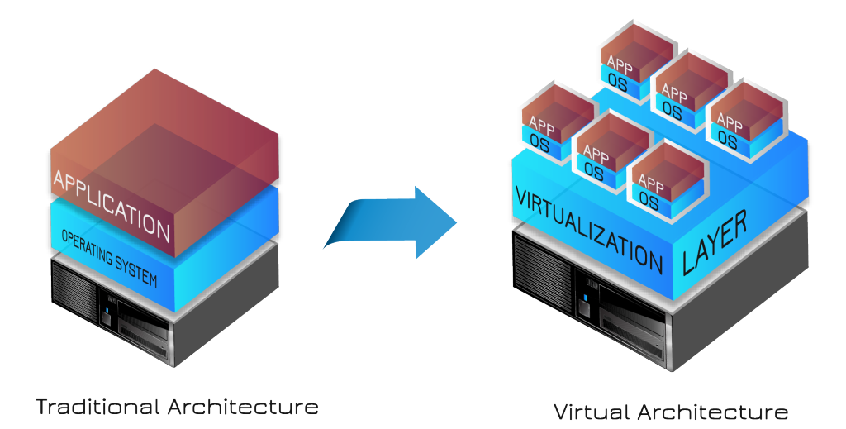
What is virtualization?

Slide 6
Key points to write down
Virtualization is to create a simulated, or virtual network, computer or server using computer software. For example, VM-Ware.
It allows a single physical sever to run several applications, each appearing to have its own server.
Storage virtualization is similar:
Block level allows a storage area network (SAN) to use a range of storages arrays as if they were one.
Flie-Level, allows network attached storage (NAS) and removes the link between the data items and physical locations. On a particular file server.

Slide 7
Task 1: Advantages/Disadvantages
Draw a line down the center of your page, title each ‘advantages/disadvantages’.
Find 2 Advantages/ Disadvantages yourself.
Share and add yours to the list
Be prepared to share to the class.

Slide 8
Share pro’s and con’s

