Slide 1
First Teaching September 2016

Slide 2
Why Cambridge Technicals?
Simple processes and admin
Designed to allow flexible delivery
Minimal paperwork – can use existing internal processes
Designed with employers for a vocational emphasis
Face to face moderation available
Ability to give on-going feedback throughout the course
Assess students when they’re ready
Opportunity for students to improve and resubmit work

Slide 3
Overview
Available for first teaching from September 2016
Suite allows learners to top up and drop down
2 are Applied General Qualifications and 3 are Tech Levels
All qualifications graded Pass, Merit, Distinction, Distinction*
All units graded Pass, Merit, Distinction
All units MUST be passed
An Extended Diploma (1080 GLH) is planned for first teaching in September 2016
Certificate
180glh
Extended Certificate
360glh
Introductory Diploma
360glh
Foundation Diploma
540glh
Diploma
720glh
Extended Diploma
1080glh
DRAFT

Slide 4
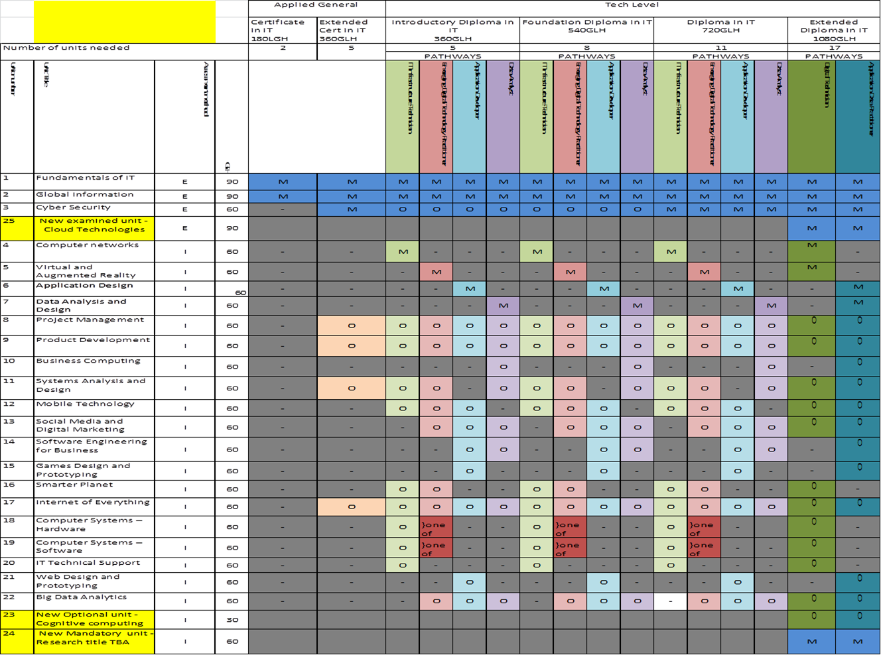

Slide 5
Assessment
Resources and Support
Employer Engagement
Qualification Structure

Slide 6
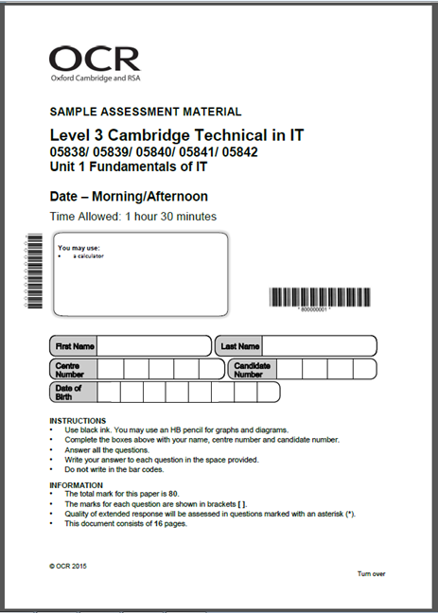
Assessment
External Assessment
Internal Assessment

Slide 7
External Assessment
All external assessment takes the form of a written examination
Two exam series each year:
January & June
Dates are set by OCR
Opportunity for one resit per unit
At additional cost
Best result will be used

Slide 8
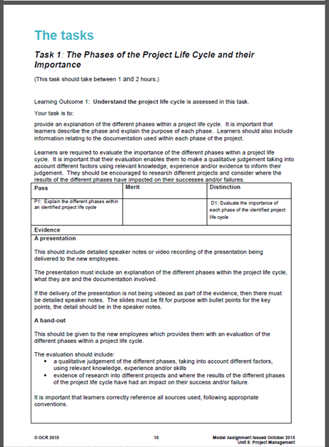
Internal Assessment
All internal assessment takes the form of assignments
Model assignments will be available for mandatory units
Assignment Checking Service is available
Delivered to suit centres/learners
Centre Assessed against unit grading grid
Feedback must be recorded
Resubmission permitted
If judged to be in learner’s interest
Internally standardised
Externally moderated via
Visiting Moderation
Remote (MAPS)
Notes:
Please refer the Centre Handbook for more information about feedback and resubmission

Slide 9
MAPS – online portfolio
MAPS is a FREE secure online e-portfolio that you can use to assemble evidence, provide feedback, mark and submit your learners’ work. It’s easy to set up and use, is web-based and available at any time. It’s secure and easily accessible to tutors, learners and moderators.
When you log in to MAPS, you’ll find teacher and student user guides and video tutorials available in the Help section.
You’ll need to request access to MAPS. Please see the Admin guide: Cambridge Technicals for information on how to do this.
You can either opt into MAPs or out of MAPs but you cannot do both e.g. have a moderator visit for one of the ‘visits’ and then use MAPs for the next one.

Slide 10
About MAPS
If you choose MAPS then your two free visits will be replaced with two free ‘remote’ moderation sessions
You can agree their timing but the moderator carries out the moderation remotely
They complete their visit report and send it by email
You can discuss their report, the outcomes and ask questions during a pre-arranged telephone call

Slide 11
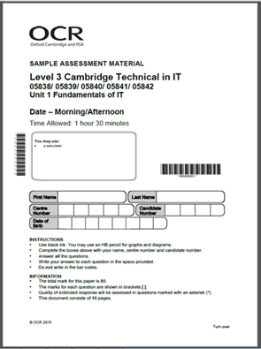
Resources & Support
Hodder Textbook
Model Assignments
Lesson Elements
Sample Assessments
Resource Links
Mapping Guides
Delivery Guides
Command Verb Definitions

Slide 12
Employer Engagement
We’ve worked with a range of employers, including:

Slide 13
Project Delivery Approach
We are working with employers to produce an holistic project delivery approach which will encompass several units

Slide 14
Unit 13: Social media and digital marketing GRADING CRITERIA An example of the learner journey
LO | Pass | Merit | Distinction
 | The assessment criteria are the Pass requirements for this unit. | To achieve a Merit the evidence must show that, in addition to the pass criteria, the candidate is able to: | To achieve a Distinction the evidence must show that, in addition to the pass and merit criteria, the candidate is able to:
1. Understand digital marketing | P1: Outline the tools available for digital marketing
 | P2: Explain the stages of the digital marketing life cycle |  | D1: Assess the impact of digital marketing on an identified product
2. Understand the use of social media in business | P3: Describe how social media may be used to gather data | M1: Explain how data is used as part of social media digital marketing campaigns
 | P4*: Describe the legal and ethical restrictions on the use of social media as part of digital marketing campaigns (*Synoptic assessment from Unit 1 Fundamentals of IT, Unit 2 Global information and Unit 3 Cyber security)
3. Be able to plan content and propose appropriate social media channels for digital marketing campaigns | P5: Outline social media channels to be used in a digital marketing campaign | M2: Plan the social media content of the digital marketing campaign to meet identified business objectives | D2: Justify the use of identified social media channels in the digital marketing campaign
 | P6: Describe the target audience for the identified social media channels
4. Be able to develop social media digital marketing campaigns | P7: Propose a digital marketing campaign across different social media channels to meet identified business objectives | M3: Recommend adaptations to current business processes to support social media activities

Slide 15
Cambridge Technical in IT from Sept 2016
Certificate
Extended Certificate
Introductory Diploma
Foundation Diploma
Diploma
An Applied General qualification that has the following characteristics:
Guided Learning Hours: | 180
Equivalence (time): | 1 x AS Level
Total Number of Units | 2
Mandatory Units: | 2
Optional Units: | 0
External Assessment: | 100%
Pathways: | -
Additional Information: | These mandatory units are common to all qualification sizes. Learner can top up to larger qualification sizes.

Slide 16
Cambridge Technical in IT from Sept 2016
Certificate
Extended Certificate
Introductory Diploma
Foundation
Diploma
Diploma
An Applied General qualification that has the following characteristics:
Guided Learning Hours: | 360
Equivalence (time): | 1 x A Level
Total Number of Units | 5
Mandatory Units: | 3 (2 x 90glh and 1 x 60glh)
Optional Units: | 2 from a total of 4
External Assessment: | 66.66%
Pathways: | -
Additional Information: | N.B. The 360glh Tech level only has 2 mandatory externally assessed units and will carry the same UCAS points

Slide 17
Cambridge Technical in IT from Sept 2016
Certificate
Extended Certificate
Introductory Diploma
Foundation Diploma
Diploma
A Tech Level qualification that has the following characteristics:
Guided Learning Hours: | 360
Equivalence (time): | 1 x A Level
Total Number of Units | 5
Mandatory Units: | 3 (2 x 90glh and 1 x 60glh)
Optional Units: | 2 from a total of 8 or 9 dependent on pathway
External Assessment: | 50%
Pathways: | Select 1 of 4 pathways available
Additional Information: | Learners can top up or drop down to larger or smaller Applied General and Tech level qualifications

Slide 18
Cambridge Technical in IT from Sept 2016
Certificate
Extended Certificate
Introductory Diploma
Diploma
Diploma
Foundation
A Tech Level qualification that has the following characteristics:
Guided Learning Hours: | 540
Equivalence (time): | 3 x AS Level (or 1.5 x A Levels)
Total Number of Units | 8
Mandatory Units: | 3 (2 x 90glh and 1 x 60glh
Optional Units: | 5 from a total of 8 or 9 dependent on pathway
External Assessment: | 33.33%
Pathways: | Select 1 of 4 pathways available
Additional Information: | Learners can top up or drop down to larger or smaller Applied General and Tech level qualifications

Slide 19
Cambridge Technical in IT from Sept 2016
Certificate
Extended Certificate
Introductory Diploma
Foundation Diploma
Diploma
A Tech Level qualification that has the following characteristics:
Guided Learning Hours: | 720
Equivalence (time): | 2 x A Level
Total Number of Units | 11
Mandatory Units: | 4 (2 x 90glh and 2 x 60glh)
Optional Units: | 7 from a total of 8 or 9 dependent on pathway
External Assessment: | 33.33%
Pathways: | Select 1 of 4 pathways available
Additional Information: | Learners can top up or drop down to larger or smaller Applied General and Tech level qualifications

Slide 20
Cambridge Technical in IT from Sept 2016
Extended
Diploma
DRAFT
A Tech level qualification that has the following characteristics:
Guided Learning Hours: | 1080
Equivalence (time): | 3 x A Level
Total Number of Units | 17
Mandatory Units: | 7(including 3 x 90glh and 4 x 60glh)
Optional Units: | 10 from a total of 12
Minimum External Assessment: | 30.55%
Pathways: | Digital Technician and Application Data Practitioner
Additional Information: | There could still be changes to the structure of this qualification

Slide 21
Certificate (180 GLH)
Overview
Mandatory
2 mandatory units
give a broad grounding across the subject
are externally examined
100% external assessment
The mandatory units are common to all qualification sizes. Learner can top up to larger qualification sizes.

Slide 22
Certificate (180 GLH)
Overview
Mandatory
UnitNo. | Title | GLH | Assessment
1 | Fundamentals of IT | 90 | 1 hour 30 minutes written exam consisting of: Section A: MCQ 15 marks Section B: Short-answer questions 65 marks. Maximum 10 marks per question.
2 | Global Information | 90 | 1 hour 30 minutes written exam consisting of: Short-answer questions based on pre-release research brief. Maximum 10 marks per question.

Slide 23
Extended Certificate (360 GLH)
Overview
Mandatory
Optional
3 mandatory units
All externally examined
2 optional units from a choice of four
66.66% external assessment
Learners can top up or drop down to larger or smaller Applied General and Tech level qualifications
The 360glh Tech level only has 2 mandatory externally assessed units and will carry the same UCAS points

Slide 24
Extended Certificate (360 GLH)
Overview
Mandatory
Optional
UnitNo. | Title | GLH | Assessment
1 | Fundamentals of IT | 90 | 1 hour 30 minutes written exam consisting of: Section A: MCQ 15 marks Section B: Short-answer questions 65 marks. Maximum 10 marks per question.
2 | Global Information | 90 | 1 hour 30 minutes written exam consisting of: Short-answer questions based on pre-release research brief. Maximum 10 marks per question. Total 80 marks.
3 | Cyber Security | 60 | 1 hour written exam consisting of: Section A: Short-answer questions based on pre-release research brief. Maximum 10 marks per question. 40 marks Section B: Short answer questions. 20 marks

Slide 25
Extended Certificate (360 GLH)
Overview
Mandatory
Optional
Optional Units – All 60 GLH
Unit No. | Title | Assessment
8 | Project Management | Internal
9 | Product Management | Internal
11 | Systems Analysis and Design | Internal
17 | Internet of Everything | Internal
BACK

Slide 26
Introductory Diploma (360 GLH)
Overview
Mandatory
Pathways
3 mandatory units
2 externally examined
1 internally assessed
2 Optional units from a total of 8 or 9 dependent on pathway
33.33% external assessment
Select 1 of 4 pathways available
Learners can top up or drop down to larger or smaller Applied General and Tech level qualifications

Slide 27
Introductory Diploma (360 GLH)
Overview
Mandatory
Pathways
Unit No. | Title | GLH | Assessment
1 | Fundamentals of IT | 90 | 1 Hour 30 minutes written exam
2 | Global Information | 90 | 1 Hour 30 minutes written exam
Only ONE internally assessed mandatory unit required per pathway
4 | Computer Networks | 60 | Internally assessed - IT Infrastructure Technician Pathway only
5 | Virtual and Augmented Reality | 60 | Internally assessed – Emerging Digital Technician Pathway only
6 | Application Design | 60 | Internally assessed – Application Developer Pathway only
7 | Data Analysis and Design | 60 | Internally assessed – Data Analyst Pathway only

Slide 28
Introductory Diploma (360 GLH)
Overview
Mandatory
Pathways
IT Infrastructure Technician Pathway Optional Units
UnitNo. | Title | GLH | Assessment
8 | Project Management | 60 | Internally assessed
9 | Product Development | 60 | Internally Assessed
11 | Systems Analysis and Design | 60 | Internally Assessed
12 | Mobile Technology | 60 | Internally Assessed
16 | Smarter Planet | 60 | Internally Assessed
17 | Internet of Everything | 60 | Internally Assessed
18 | Computer Systems – Hardware | 60 | Internally Assessed
19 | Computer Systems – Software | 60 | Internally Assessed
20 | IT Technical Support | 60 | Internally Assessed
Emerging Digital Technology Practitioner Pathway Units
UnitNo. | Title | GLH | Assessment
8 | Project Management | 60 | Internally assessed
9 | Product Development | 60 | Internally Assessed
11 | Systems Analysis and Design | 60 | Internally Assessed
12 | Mobile Technology | 60 | Internally Assessed
13 | Social Media and Digital Marketing | 60 | Internally Assessed
16 | Smarter Planet | 60 | Internally Assessed
17 | Internet of Everything | 60 | Internally Assessed
18 or 19 | Computer Systems – Hardware OR Computer Systems – Software | 60 | Internally Assessed
22 | Big Data Analysis | 60 | Internally Assessed

Slide 29
Introductory Diploma (360 GLH)
Overview
Mandatory
Pathways
Application Developer Pathway Optional Units
UnitNo. | Title | GLH | Assessment
8 | Project Management | 60 | Internally assessed
9 | Product Development | 60 | Internally Assessed
12 | Mobile Technology | 60 | Internally Assessed
13 | Social Media and Digital Marketing | 60 | Internally Assessed
14 | Software Engineering for Business | 60 | Internally Assessed
15 | Game Design and Prototyping | 60 | Internally Assessed
17 | Internet of Everything | 60 | Internally Assessed
21 | Web Design and Prototyping | 60 | Internally Assessed
22 | Big Data Analysis | 60 | Internally Assessed
Data Analyst Pathway Optional Units
UnitNo. | Title | GLH | Assessment
8 | Project Management | 60 | Internally assessed
9 | Product Development | 60 | Internally Assessed
10 | Business Computing | 60 | Internally Assessed
11 | Systems Analysis and Design | 60 | Internally Assessed
13 | Social Media and Digital Marketing | 60 | Internally Assessed
14 | Software Engineering for Business | 60 | Internally Assessed
17 | Internet of Everything | 60 | Internally Assessed
22 | Big Data Analysis | 60 | Internally Assessed

Slide 30
Foundation Diploma (540 GLH)
Overview
Mandatory
Pathways
3 mandatory units
2 externally examined
1 internally assessed
5 Optional units from a total of 8 or 9 dependent on pathway
33.33% external assessment
Select 1 of 4 pathways available
Learners can top up or drop down to larger or smaller Applied General and Tech level qualifications

Slide 31
Foundation Diploma (540 GLH)
Overview
Mandatory
Pathways
Unit No. | Title | GLH | Assessment
1 | Fundamentals of IT | 90 | 1 Hour 30 minutes written exam
2 | Global Information | 90 | 1 Hour 30 minutes written exam
Only ONE internally assessed mandatory unit required per pathway
4 | Computer Networks | 60 | Internally assessed - IT Infrastructure Technician Pathway only
5 | Virtual and Augmented Reality | 60 | Internally assessed – Emerging Digital Technician Pathway only
6 | Application Design | 60 | Internally assessed – Application Developer Pathway only
7 | Data Analysis and Design | 60 | Internally assessed – Data Analyst Pathway only

Slide 32
Foundation Diploma (540 GLH)
Overview
Mandatory
Pathways
IT Infrastructure Technician Pathway Optional Units
Unit No. | Title | GLH | Assessment
8 | Project Management | 60 | Internally assessed
9 | Product Development | 60 | Internally Assessed
11 | Systems Analysis and Design | 60 | Internally Assessed
12 | Mobile Technology | 60 | Internally Assessed
16 | Smarter Planet | 60 | Internally Assessed
17 | Internet of Everything | 60 | Internally Assessed
18 | Computer Systems – Hardware | 60 | Internally Assessed
19 | Computer Systems – Software | 60 | Internally Assessed
20 | IT Technical Support | 60 | Internally Assessed
Emerging Digital Technology Practitioner Pathway Units
Unit No. | Title | GLH | Assessment
8 | Project Management | 60 | Internally assessed
9 | Product Development | 60 | Internally Assessed
11 | Systems Analysis and Design | 60 | Internally Assessed
12 | Mobile Technology | 60 | Internally Assessed
13
16 | Smarter Planet | 60 | Internally Assessed
17 | Internet of Everything | 60 | Internally Assessed
18 or 19 | Computer Systems – Hardware OR Computer Systems – Software | 60 | Internally Assessed
22 | Big Data Analysis | 60 | Internally Assessed

Slide 33
Foundation Diploma (540 GLH)
Overview
Mandatory
Pathways
Application Developer Pathway Optional Units
UnitNo. | Title | GLH | Assessment
8 | Project Management | 60 | Internally assessed
9 | Product Development | 60 | Internally Assessed
12 | Mobile Technology | 60 | Internally Assessed
13 | Social Media and Digital Marketing | 60 | Internally Assessed
14 | Software Engineering for Business | 60 | Internally Assessed
15 | Game Design and Prototyping | 60 | Internally Assessed
17 | Internet of Everything | 60 | Internally Assessed
21 | Web Design and Prototyping | 60 | Internally Assessed
22 | Big Data Analysis | 60 | Internally Assessed
Data Analyst Pathway Optional Units
UnitNo. | Title | GLH | Assessment
8 | Project Management | 60 | Internally assessed
9 | Product Development | 60 | Internally Assessed
10 | Business Computing | 60 | Internally Assessed
11 | Systems Analysis and Design | 60 | Internally Assessed
13 | Social Media and Digital Marketing | 60 | Internally Assessed
14 | Software Engineering for Business | 60 | Internally Assessed
17 | Internet of Everything | 60 | Internally Assessed
22 | Big Data Analysis | 60 | Internally Assessed

Slide 34
Diploma (720 GLH)
Overview
Mandatory
Pathways
4 mandatory units
3 externally examined
1 internally assessed
7 Optional units from a total of 8 or 9 dependent on pathway
33.33% external assessment
Select 1 of 4 pathways available
Learners can top up or drop down to larger or smaller Applied General and Tech level qualifications

Slide 35
Diploma (720 GLH)
Overview
Mandatory
Pathways
Unit No. | Title | GLH | Assessment
1 | Fundamentals of IT | 90 | 1 Hour 30 minutes written exam
2 | Global Information | 90 | 1 Hour 30 minutes written exam
3 | Cyber Security | 60 | 1 Hour written exam
Only ONE internally assessed mandatory unit required per pathway
4 | Computer Networks | 60 | Internally assessed - IT Infrastructure Technician Pathway only
5 | Virtual and Augmented Reality | 60 | Internally assessed – Emerging Digital Technician Pathway only
6 | Application Design | 60 | Internally assessed – Application Developer Pathway only
7 | Data Analysis and Design | 60 | Internally assessed – Data Analyst Pathway only

Slide 36
Diploma (720 GLH)
Overview
Mandatory
Pathways
IT Infrastructure Technician Pathway Optional Units
Unit No. | Title | GLH | Assessment
8 | Project Management | 60 | Internally assessed
9 | Product Development | 60 | Internally Assessed
11 | Systems Analysis and Design | 60 | Internally Assessed
12 | Mobile Technology | 60 | Internally Assessed
16 | Smarter Planet | 60 | Internally Assessed
17 | Internet of Everything | 60 | Internally Assessed
18 | Computer Systems – Hardware | 60 | Internally Assessed
19 | Computer Systems – Software | 60 | Internally Assessed
20 | IT Technical Support | 60 | Internally Assessed
Emerging Digital Technology Practitioner Pathway Units
UnitNo. | Title | GLH | Assessment
8 | Project Management | 60 | Internally assessed
9 | Product Development | 60 | Internally Assessed
11 | Systems Analysis and Design | 60 | Internally Assessed
12 | Mobile Technology | 60 | Internally Assessed
13
16 | Smarter Planet | 60 | Internally Assessed
17 | Internet of Everything | 60 | Internally Assessed
18 or 19 | Computer Systems – Hardware OR Computer Systems – Software | 60 | Internally Assessed
22 | Big Data Analysis | 60 | Internally Assessed

Slide 37
Diploma (720 GLH)
Overview
Mandatory
Pathways
Application Developer Pathway Optional Units
UnitNo. | Title | GLH | Assessment
8 | Project Management | 60 | Internally assessed
9 | Product Development | 60 | Internally Assessed
12 | Mobile Technology | 60 | Internally Assessed
13 | Social Media and Digital Marketing | 60 | Internally Assessed
14 | Software Engineering for Business | 60 | Internally Assessed
15 | Game Design and Prototyping | 60 | Internally Assessed
17 | Internet of Everything | 60 | Internally Assessed
21 | Web Design and Prototyping | 60 | Internally Assessed
22 | Big Data Analysis | 60 | Internally Assessed
Data Analyst Pathway Optional Units
UnitNo. | Title | GLH | Assessment
8 | Project Management | 60 | Internally assessed
9 | Product Development | 60 | Internally Assessed
10 | Business Computing | 60 | Internally Assessed
11 | Systems Analysis and Design | 60 | Internally Assessed
13 | Social Media and Digital Marketing | 60 | Internally Assessed
14 | Software Engineering for Business | 60 | Internally Assessed
17 | Internet of Everything | 60 | Internally Assessed
22 | Big Data Analysis | 60 | Internally Assessed

Slide 38
Extended Diploma (1080 GLH)
Overview
Mandatory
Optional
7 mandatory units
4 externally examined
3internally assessed
10 optional units from a choice of 12
Select from one of 2 pathways
30.55% external assessment
Learners can drop down to smaller Applied General and Tech level qualifications

Slide 39
Extended Diploma (1080 GLH)
Overview
Mandatory Digital Technician Pathway
Optional
Unit No. | Title | GLH | Assessment
1 | Fundamentals of IT | 90 | 1 Hour 30 minutes written exam
2 | Global Information | 90 | 1 Hour 30 minutes written exam
3 | Cyber Security | 60 | 1 Hour written exam
25 | Cloud Technology | 90 | 1 Hour written exam TBC
4 | Computer Networks | 60 | Internally assessed
5 | Virtual and Augmented Reality | 60 | Internally assessed
24 | Research project (Title TBC) | 60 | Internally assessed

Slide 40
Extended Diploma (1080 GLH)
Overview
Mandatory
Optional
Digital Technician Pathway
11 Optional Units – All except unit 23 (30GLH) are 60 GLH
Unit No. | Title | Assessment
8 | Project Management | Internal
9 | Product Development | Internal
11 | Systems Analysis and Design | Internal
12 | Mobile Technology | Internal
13 | Social Media and Digital Marketing | Internal
16 | Smarter Planet | Internal
17 | Internet of Everything | Internal
18 | Computer Systems – Hardware | Internal
19 | Computer Systems – Software | Internal
20 | IT Technical Support | Internal
22 | Big Data Analytics | Internal
23 | Cognitive Computing | Internal

Slide 41
Extended Diploma (1080 GLH)
Overview
Mandatory
Application Data Practitioner Pathway
Optional
 | Title | GLH | Assessment
1 | Fundamentals of IT | 90 | 1 Hour 30 minutes written exam
2 | Global Information | 90 | 1 Hour 30 minutes written exam
3 | Cyber Security | 60 | 1 Hour written exam
25 | Cloud Technology | 90 | 1 Hour written exam TBC
6 | Application Design | 60 | Internally assessed
7 | Data Analysis and Design | 60 | Internally assessed
24 | Research Project (Title TBC) | 60 | Internally assessed

Slide 42
Extended Diploma (1080 GLH)
Overview
Mandatory
Optional Application Data Practitioner Pathway
11 Optional Units – All except unit 23 (30GLH) are 60 GLH
Unit No. | Title | Assessment
8 | Project Management | Internal
9 | Product Development | Internal
10 | Business Computing | Internal
11 | Systems Analysis and Design | Internal
12 | Mobile Technology | Internal
13 | Social Media and Digital Marketing | Internal
14 | Software Engineering for Business | Internal
15 | Game Design and Prototyping | Internal
17 | Internet of Everything | Internal
21 | Web Design and Prototyping | Internal
22 | Big Data Analytics | Internal
23 | Cognitive Computing | Internal

Slide 43
First Teaching September 2016

