Slide 1
Business IT Systems

Slide 2
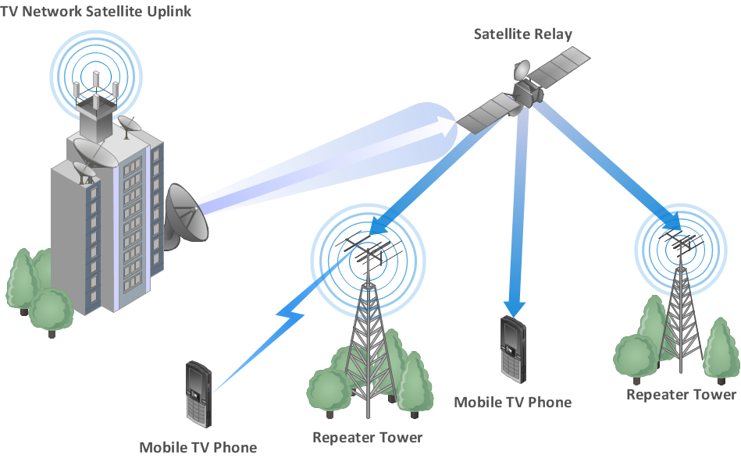

Slide 3
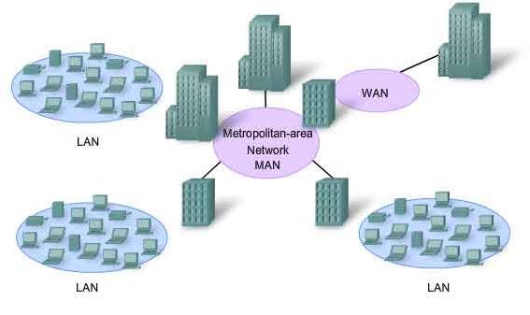

Slide 4
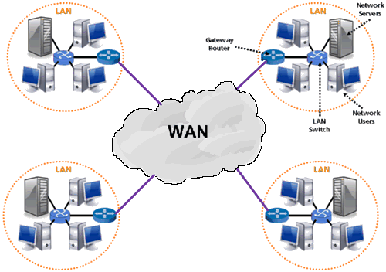

Slide 5
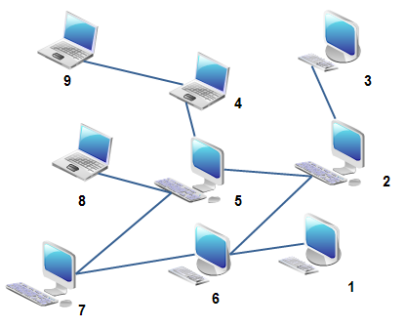
Peer to Peer and Client to Server
What is a peer to peer system?
What is a client to server system?
Which one do you think the school has?

Slide 6
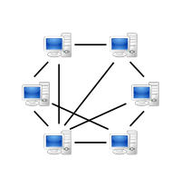
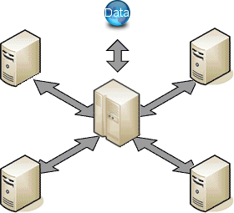
Peer to Peer and Client to Server
Where do you think your user profile is stored? On the server or on your PC’s?

Slide 7
Peer to Peer and Client to Server
Peer to Peer | Client to Server
All computers have equal status | Specialised roles: Computer tend to be a client or a server
Easy to set up and maintain | Needs a network manager to run the network
No centralised management | Centralised security and management
Backup each computer separately | Backup done from central server
No dependency on a server | Dependent on central server

Slide 8
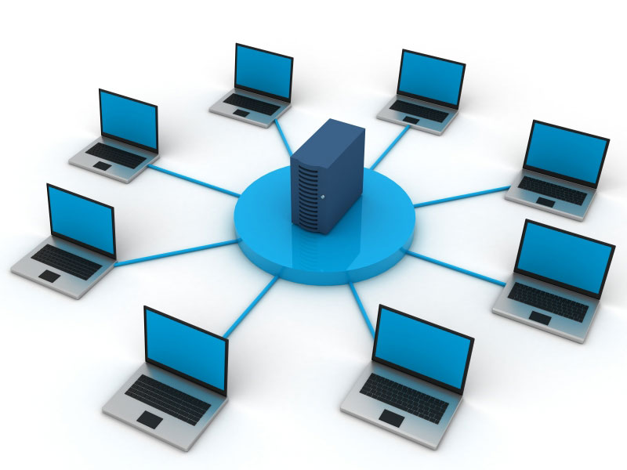
Communication of Devices
For computers to be able to speak to each other, they need to have rules
Hello, Hello, How are you, I’m fine thank you
These rules are called protocols.
How the communication will start, getting the attention of the computer
The significance of the bits being transmitted (like the language)
How the bits will be delivered (one at a time or in a group)
Error checking procedures

Slide 9
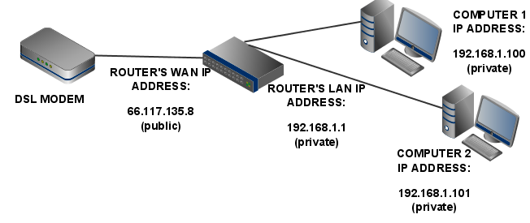
Internet Protocol/MAC Address
Each device on the internet must have a unique IP address so that they can communicate over a large area
This is addition to a MAC address which is only used to address devices in a LAN.
An IP address is made of four numbers separated by three dots i.e. 193.127.30.23

Slide 10
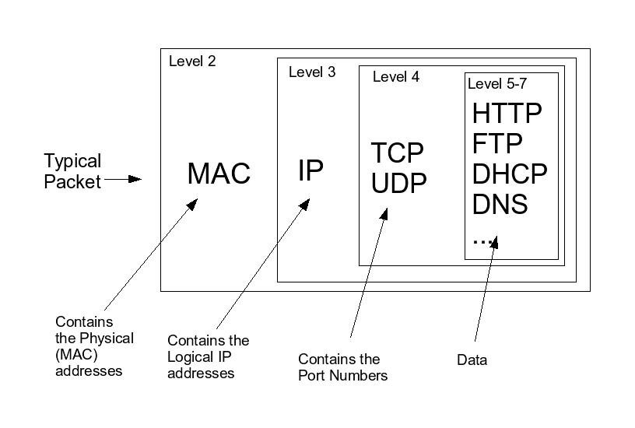
Packets
When two devices want to communicate across a LAN one device will send a message to the other.
This message is broken into smaller chucks called “Packets”
http://computer.howstuffworks.com/question525.htm

Slide 11
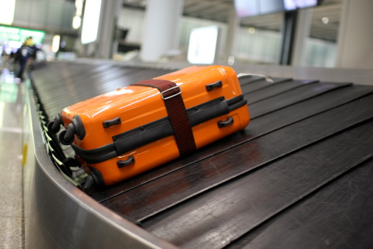
Luggage and Packets
The destination device will see all of the traffic on the LAN but will only pick up the packets with its own MAC address on it
It’s a bit like getting your luggage back after a flight, you watch it going around, but you’re the only one that pick its up

Slide 12
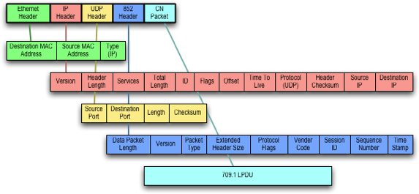
Luggage and Packets
Packet headers contain destination MAC address

Slide 13
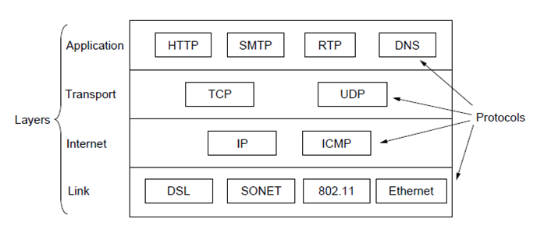
Protocols
IP: Internet Protocol
TCP: Transmission control Protocol
UDP: User Datagram Protocol
SMTP: Simple Mail Transfer Protocol
FTP: File Transfer Protocol
HTTP: Hyper text transmission protocol
SNMP: Simple network management protocol
ICMP: Internet control message protocol
POP: Post office protocol

Slide 14
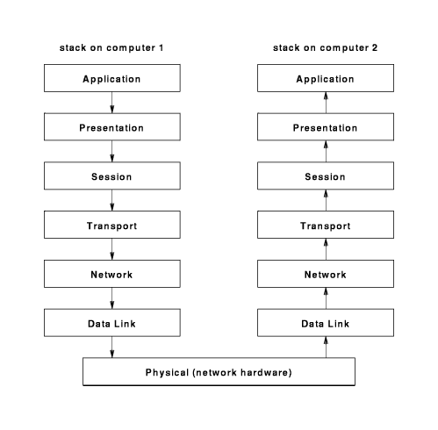
Layers
Link layer
Lowest level & deals with hardware, navigating through the myriad of routers/servers & machinery to get to the destination.
Internet layer
Focuses on targetting the IP address.
Transport layer
Establishes a communication between hosts and moves the package (data) towards its destination.

Slide 15
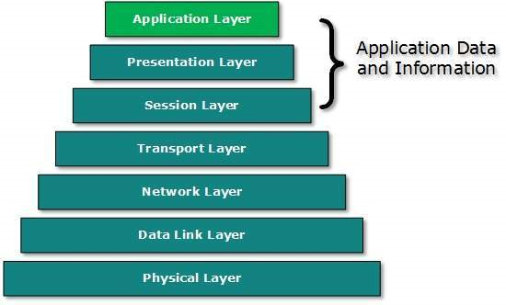
Application layer
The Application Layer:
The highest layer, contains other protocols including HTTP, HTTPS & SMTP.
HTTP (Hyper text transfer protocol) sends out a request to the client to establish permission to transfer data.
HTTPS (Secure) ensures a secure connection. Used in eCommerce/banking/for private data.
Other protocol: POP & IMAP for eMail for client level access.

Slide 16
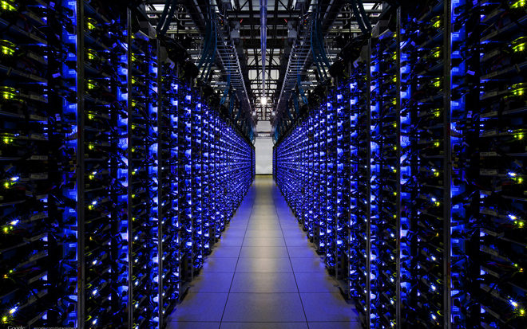
What are servers used for?
https://www.youtube.com/watch?v=ByI1PHMcPJQ
Email
File transfer
Applications
Databases
Webpages
Creating webpages specifically for users (Facebook)

Slide 17
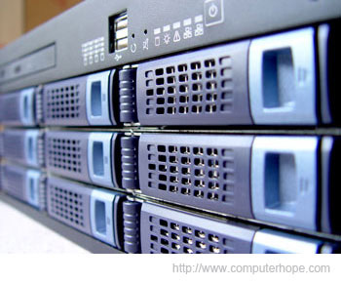
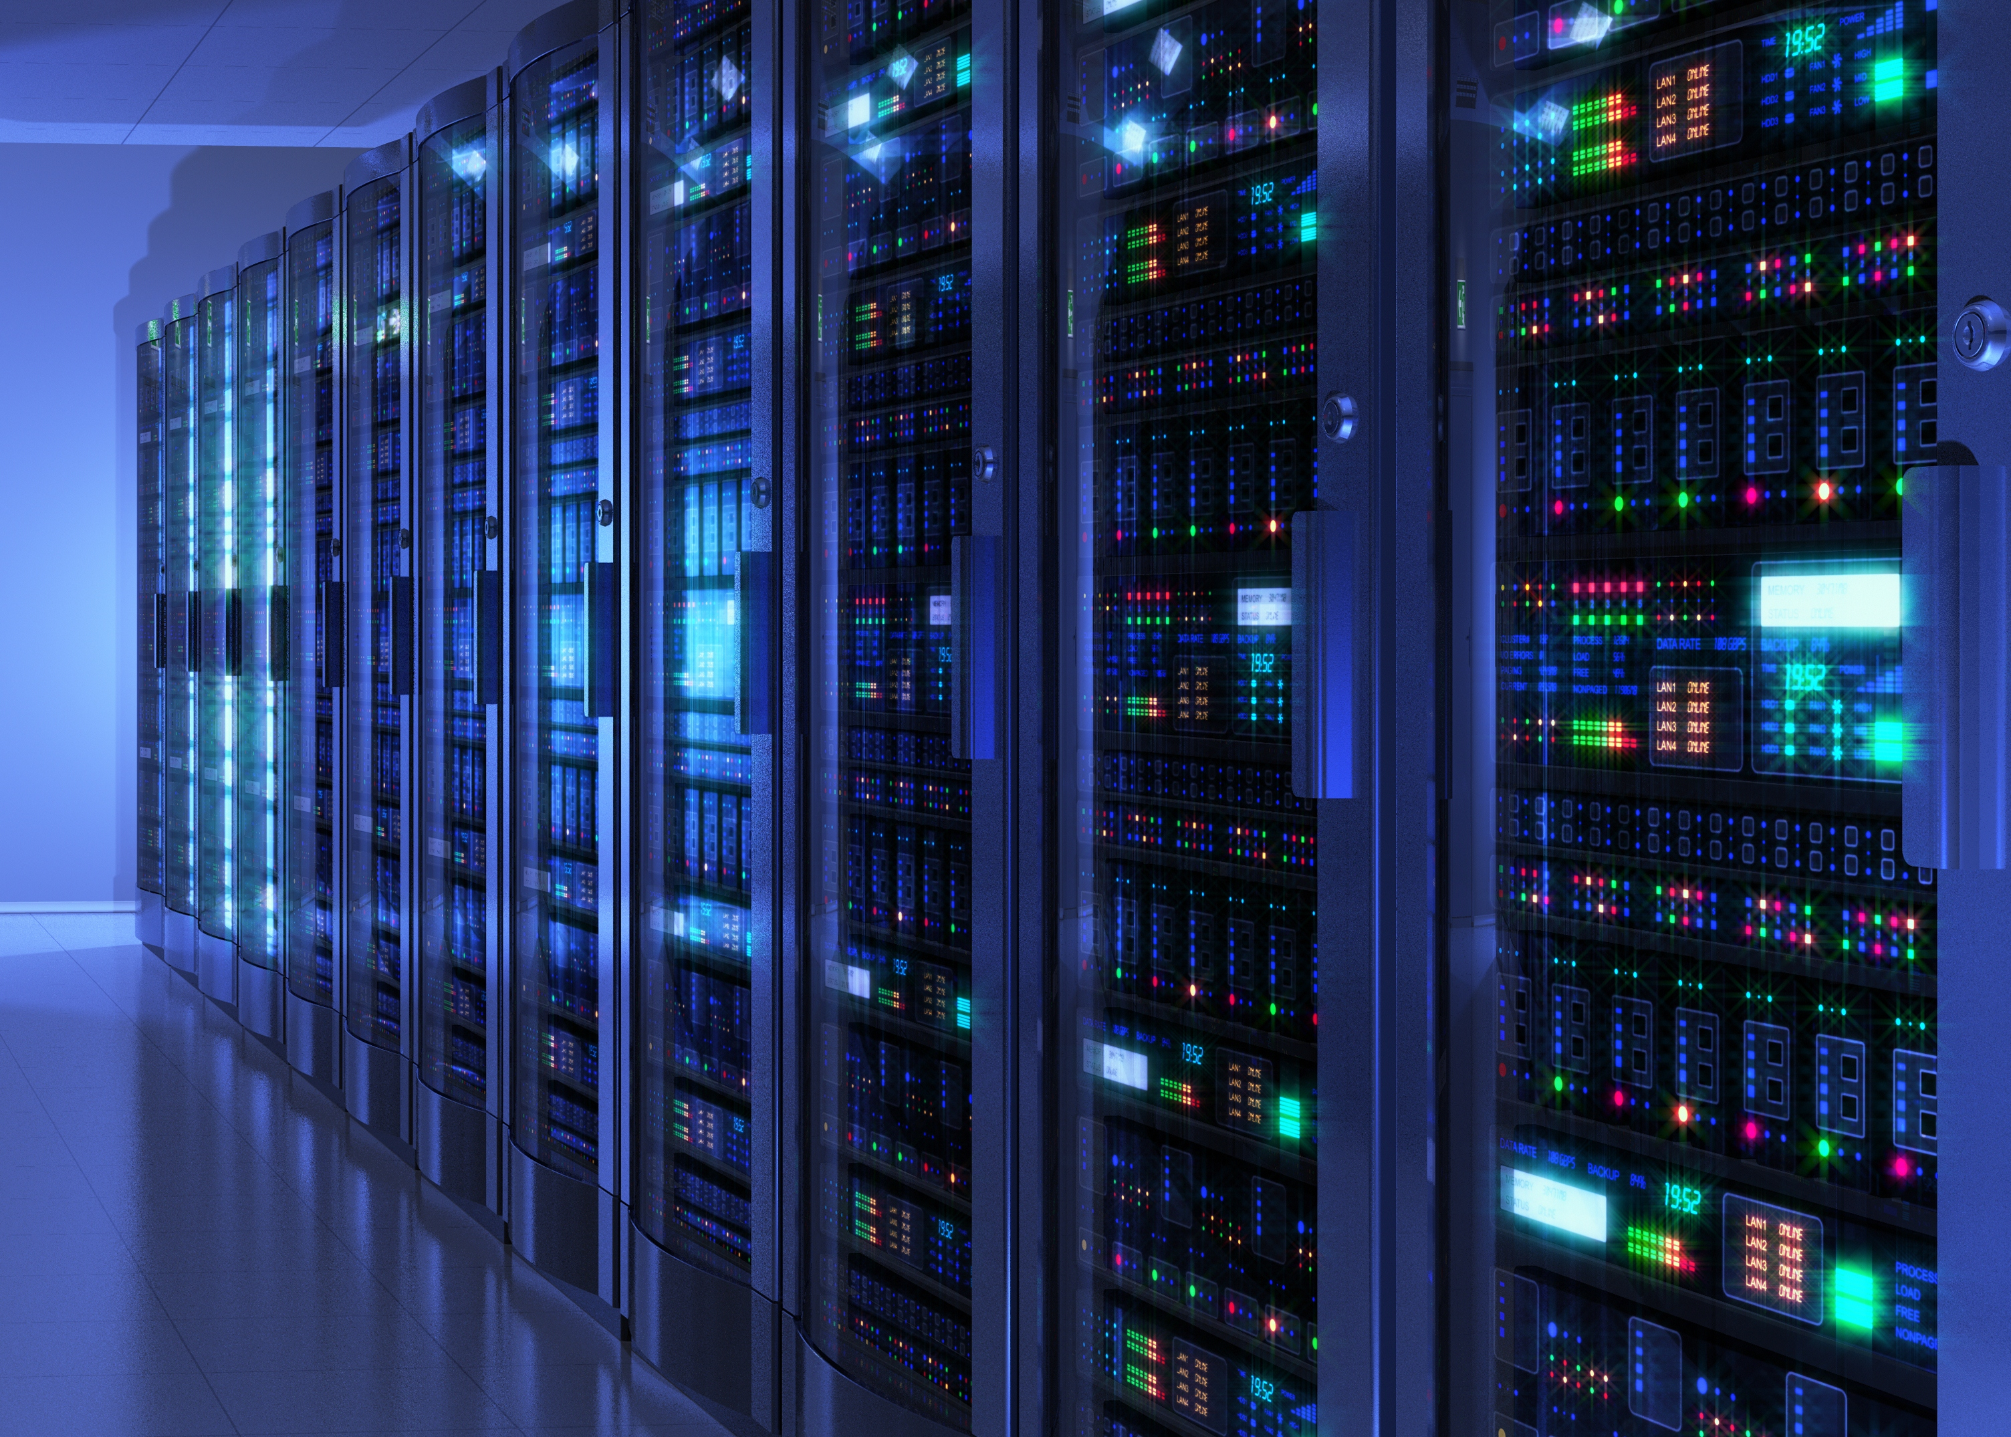
Servers
https://www.youtube.com/watch?v=XZmGGAbHqa0

Slide 18
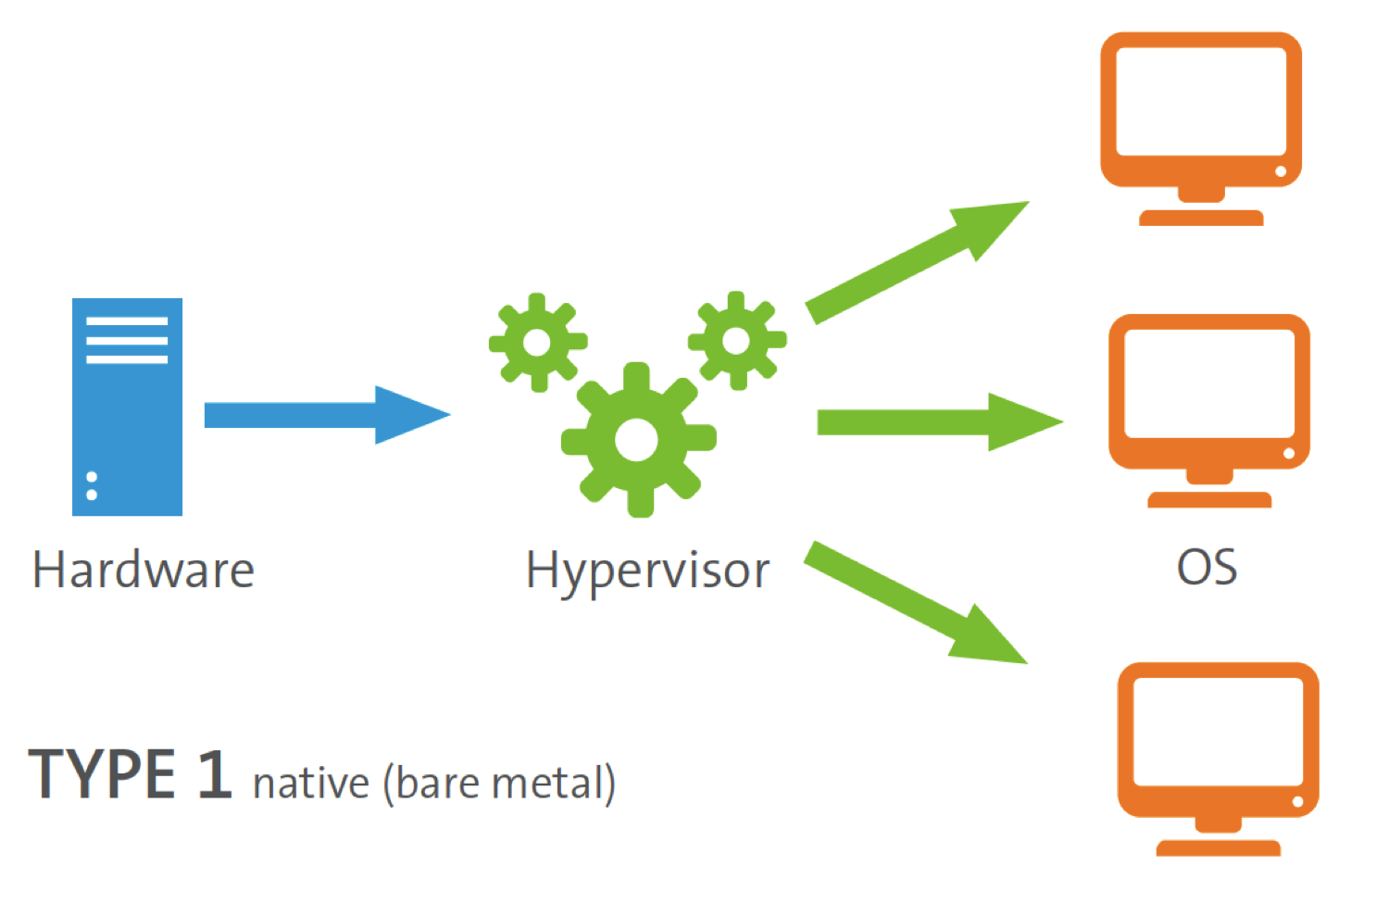
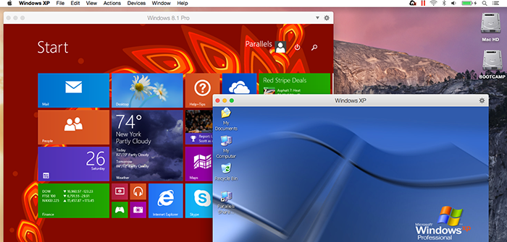
Hypervisior
Software written for a particular processor which manages different Operating systems or copies of the same operating system on a single computer. It manages resources such as the processor, memory and devices so that each OS receives resources it needs and does not clash with other OS’s. (Virtualization)

Slide 19
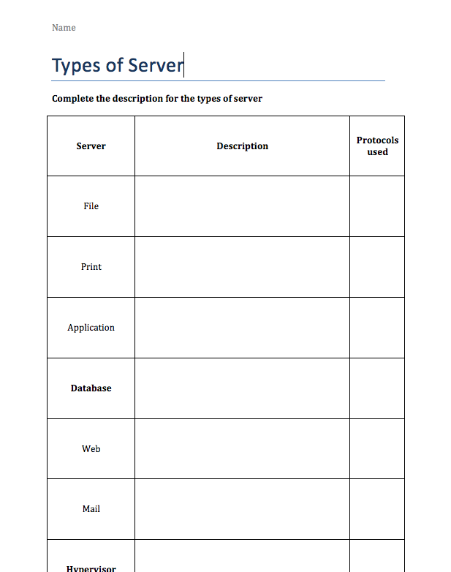

Slide 20
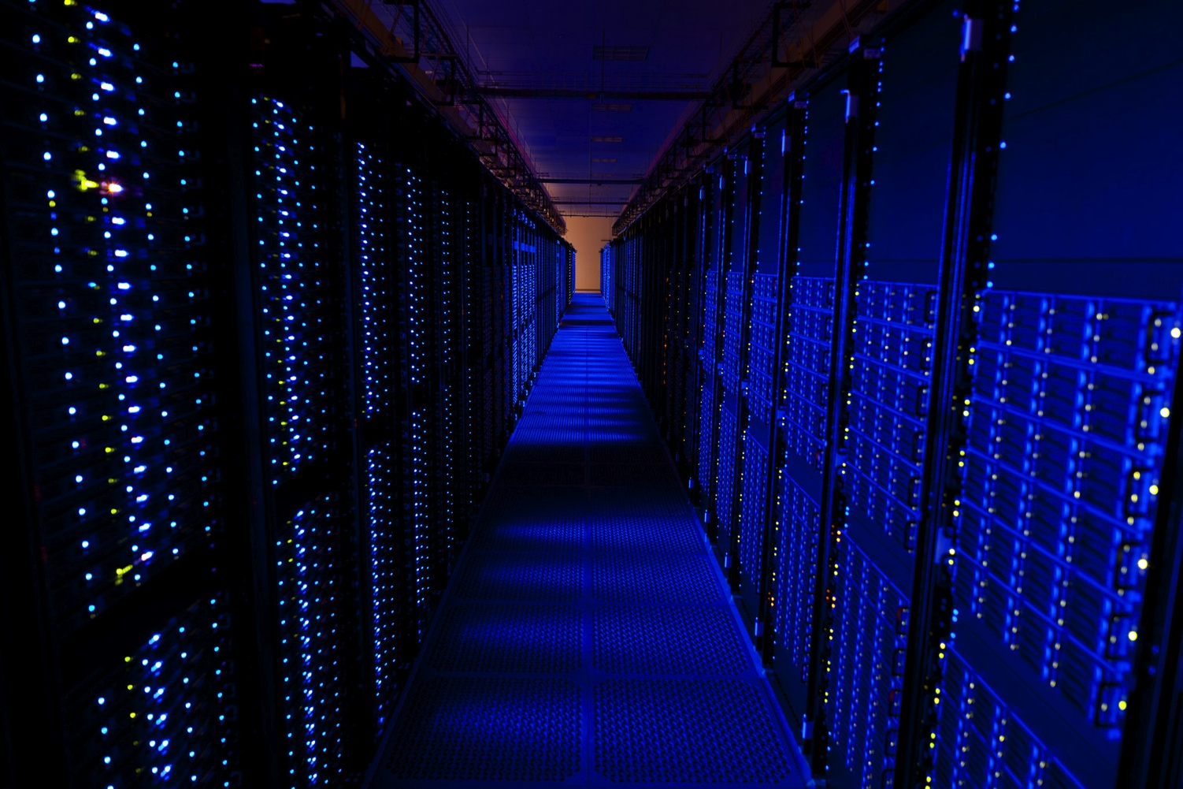
What is virtualisation?
https://www.youtube.com/watch?v=V9AiN7oJaIM

Slide 21
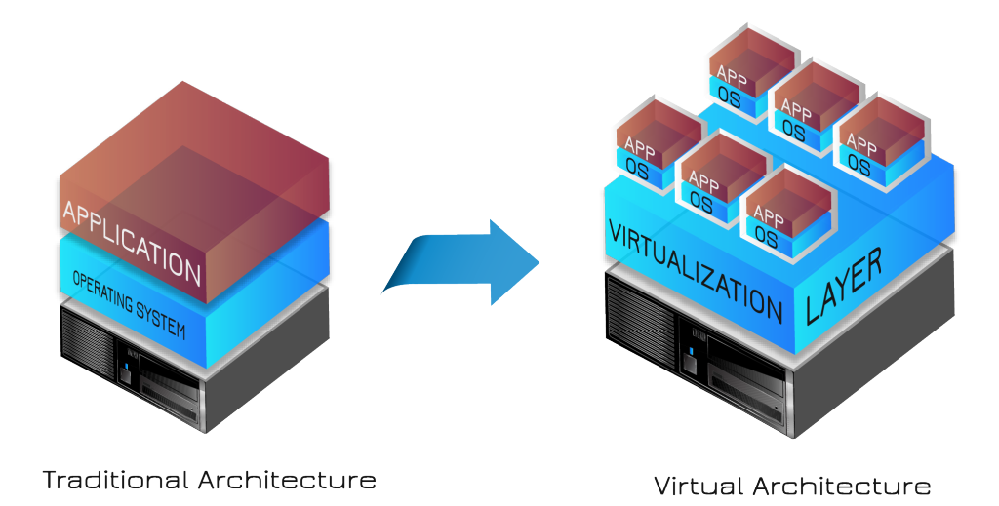

Slide 22
Key points to write down
Virtualization is to create a simulated, or virtual network, computer or server using computer software. For example, VM-Ware.
It allows a single physical server to run several applications, each appearing to have its own server.
Storage virtualization is similar:
Block level allows a storage area network (SAN) to use a range of storages arrays as if they were one.
File-Level, allows network attached storage (NAS) and removes the link between the data items and physical locations. On a particular file server.

Slide 23
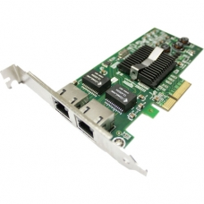
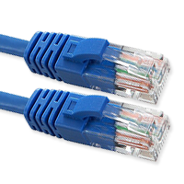
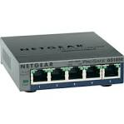
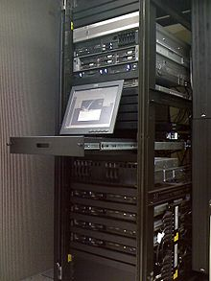
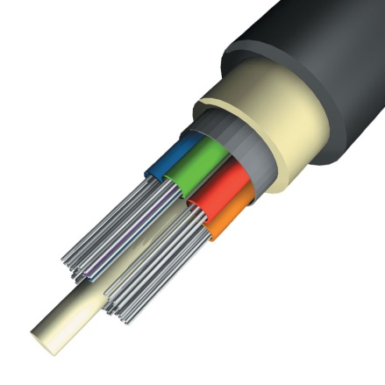
The Hardware behind the network
Ethernet Cable
Network Interface Card
Server
Switch
Backbone Cabling

Slide 24
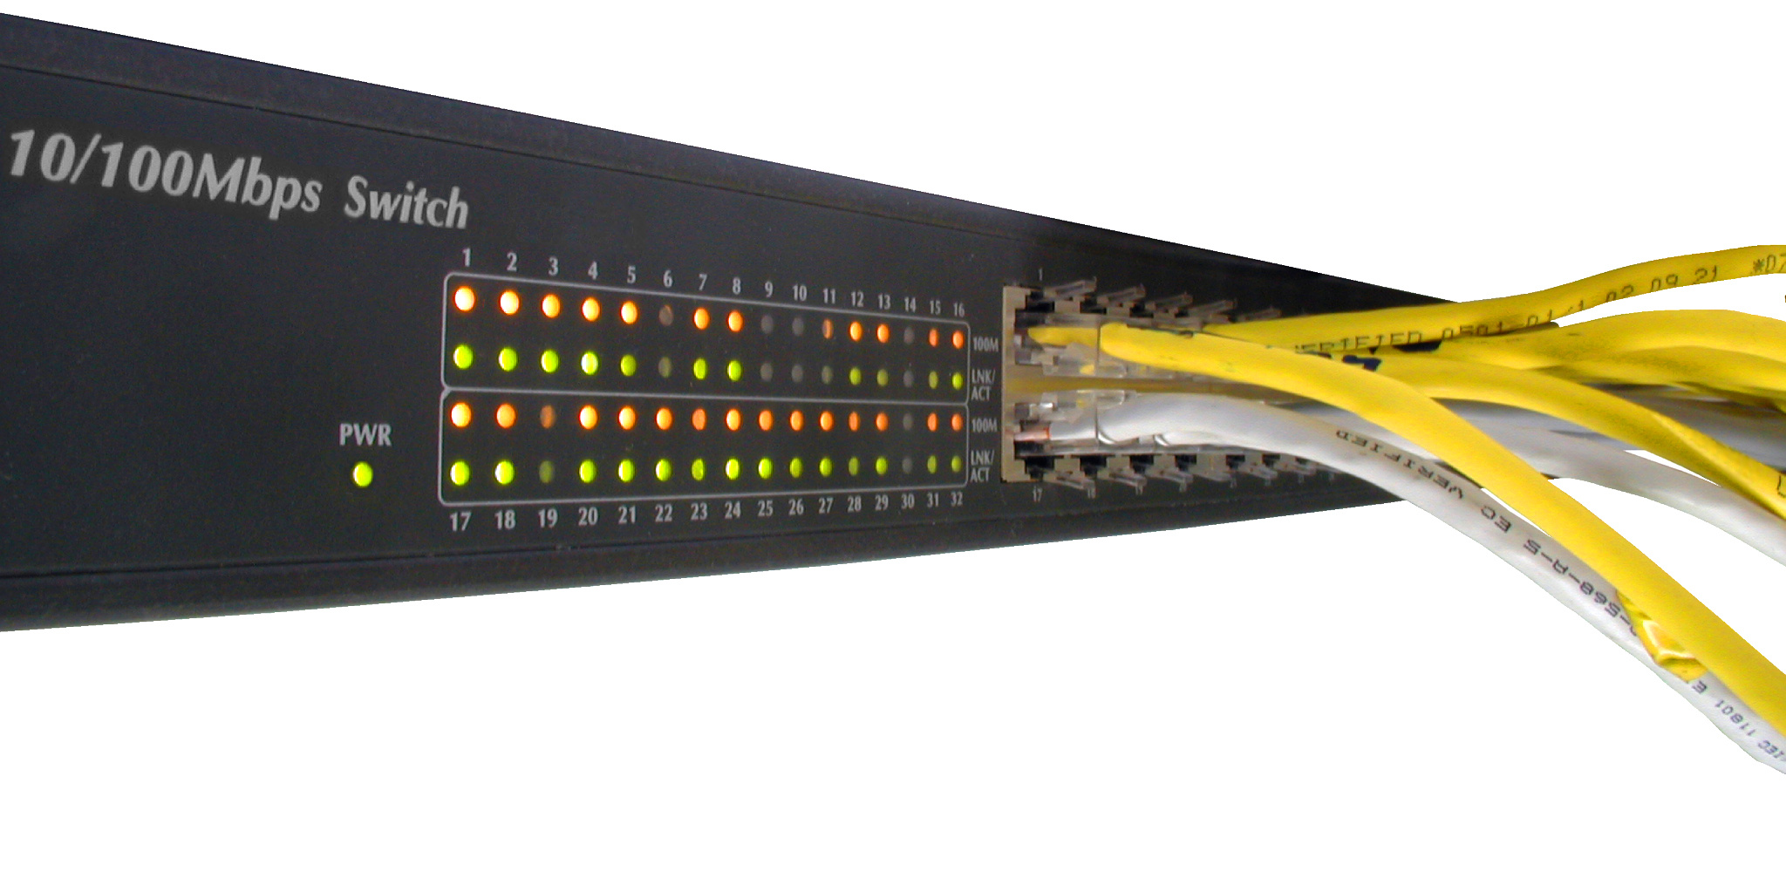
Keywords
Hub: Connects computes with ethernet.
Router: Allows comms between LAN & Internet.
Switch: Similar to hub but more efficient.
WAP: Any device connecting without cables.
NIC: Network card.
CLIENT: User computer
SERVER: File server computer

