Slide 1
What do each of these mean?
Open books, title ‘Business Connectivity methods’
What do these stand for? (Write down in book…)
LAN (e.g. Ethernet, Token Ring)
WAN (e.g. ADSL, leased line, ISDN)
MAN
Voice (e.g. PSTN, cellular)
Satellite (e.g. Voice,data)
Notes:
10min copy files and answer

Slide 2
Answers
What do these stand for?
LAN (e.g. Ethernet, Token Ring) – LOCAL AREA NETWORK
WAN (e.g. ADSL, leased line, ISDN) – WIDE AREA NETWORK
MAN – METROPOLITAN AREA NETWORK
Voice (e.g. PSTN, cellular) – Telephone or mobile network
Satellite (e.g. Voice, data)- Satellite network
Notes:
10min copy files and answer

Slide 3
Objectives
know a range a connectivity methods
Understand their characteristics
Know when each would be used
Complete a descriptive table of the key connectivity methods
Explain their characteristics and purpose
Complete an example exam question on the topic
Notes:
1min

Slide 4
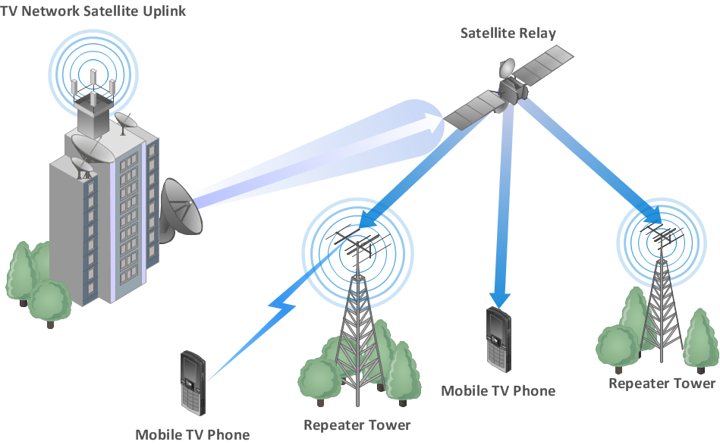

Slide 5
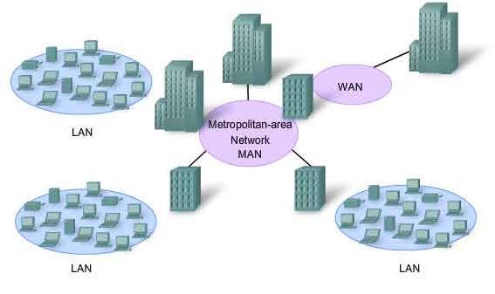

Slide 6
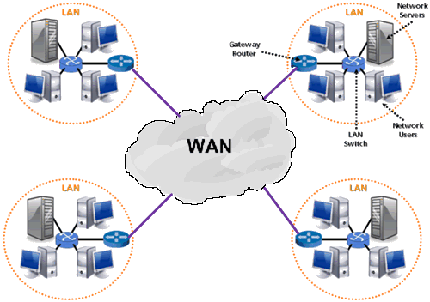

Slide 7
Main Task
Using the fact sheets, discuss on your tables the methods and complete the Characteristics and Examples of use section
Characteristics: Speed/Cost/clarity/delay
Examples of use eg: offices/across cities/across countries/for remote locations such as boats/in rural areas/in buildings for video calls etc.
Complete? Stick both sheets in book and annotate the chart. Be prepared for an exam style question….

Slide 8
Exam question
Draw a diagram to show how a new branch for a bank would be connected to a data center, you should clearly identify any hardware, communications and security included [7 marks]
Clues:
1. mark for a suitable diagram
2. mark for routers at either end
3. mark for correctly identifying type of network [LAN’s/WAN’s]
4. Modem at either end
5. labels of devices
6. labels of type of line [ADSL/Wireless]
7. label of type of security [e.g. Firewall and VPN router]

Slide 9
Exam Style answer
Mark your partners ?/7
1. mark for a suitable diagram
2. mark for routers at either end
3. mark for correctly identifying type of network [LAN’s/WAN’s]
4. Modem at either end
5. labels of devices
6. labels of type of line [ADSL/Wireless]
7. label of type of security [e.g. Firewall and VPN router]

