Slide 1
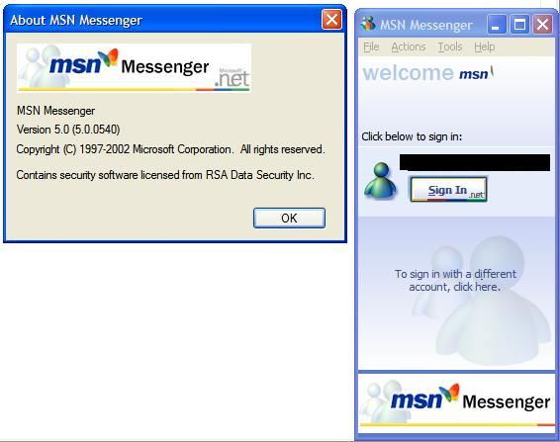
Title 4.2 Communication technology
Open Books. Title & date (7th feb) & Open the VLE
Think: How has communication technology changed in the last 20 years…
Notes:
10mins

Slide 2
New learning goals
All will: Understand a range of Communication technology
Most will: Explain suitable uses in a given scenario
Notes:
1mins

Slide 3
Communication technology
Technology has got smaller over the years.
The physicality is now minuscule.
The storage capacities are ever increasing Mr G’s Computers Ram: 512mb RAM (2004) 1GB ram (2006) 7 gb RAM (2012) 8gb RAM (2016)
More so across the internet….
https://www.youtube.com/watch?v=WaUzu-iksi8

Slide 4
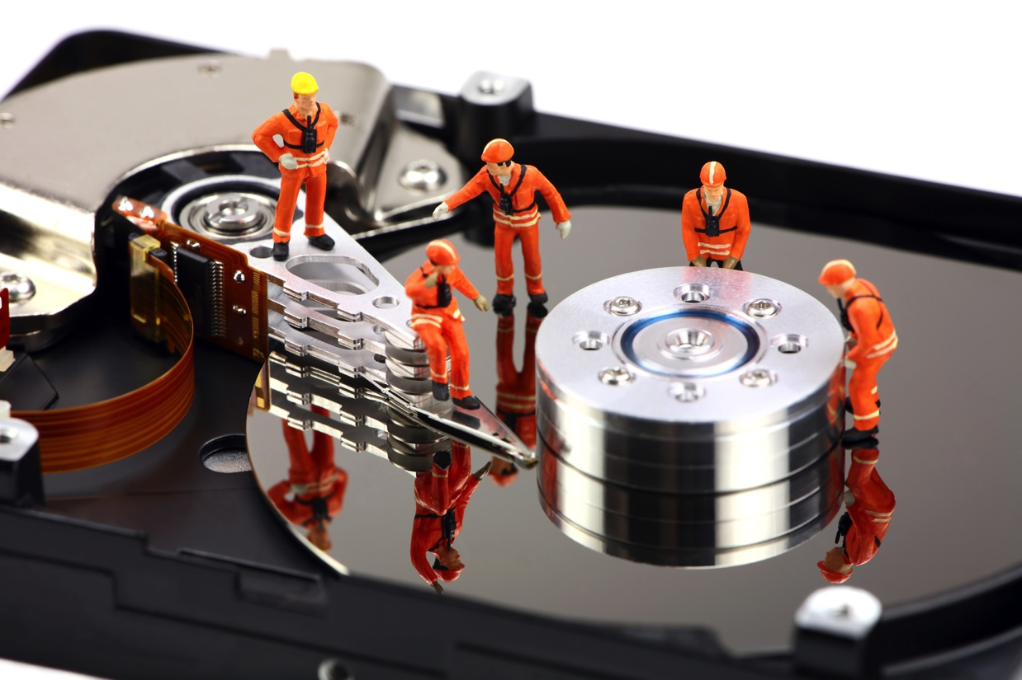
Task: Match the terms
Using the VLE, match the terms to communication technology we use
When do, answer in your books which you would recommend for a small IT Repaircompany.
Remember to justify your answers. Why, what is the benefit of each.
Notes:
4mins demo, 20mins – create logo, then export together. 15mins – Add to PPT and Callout, show each others logos.

Slide 5
Answers…
Presentation software can include text, graphics, video and audio images and is used to tell a story or used to support someone presenting information.
Word Processing – used for the production, editing, printing and storing or text on a computer. E.g.: written letters, reports, books, leaflets or posters.
E-mail – the distribution of electronic messages from one computer to another via a network.
Web- a system of internet servers that support specially formatted documents often connected via hyperlinks.
Blog – a regularly updated web page run by an individual or small group taking the form of a personal journal which is accessible to the public.
Vlog or video log – a form of blog which includes video clips
Instant messaging – a communication service which enables a person to communicate privately with another individual in real time over the internet.

Slide 6
Your recommendations
No Right/Wrong, as long as clearly justified.
Presentation
Word
E-mail
Web
Blow
Vlog
IM

