Slide 1
starter
Open Skills sheet in book & Publisher 4.1 Leaflet from Communication skills lesson.
Add a new page called ‘ Personal Attributes’
Think: What attributes would a model employee have?
Notes:
10mins

Slide 2
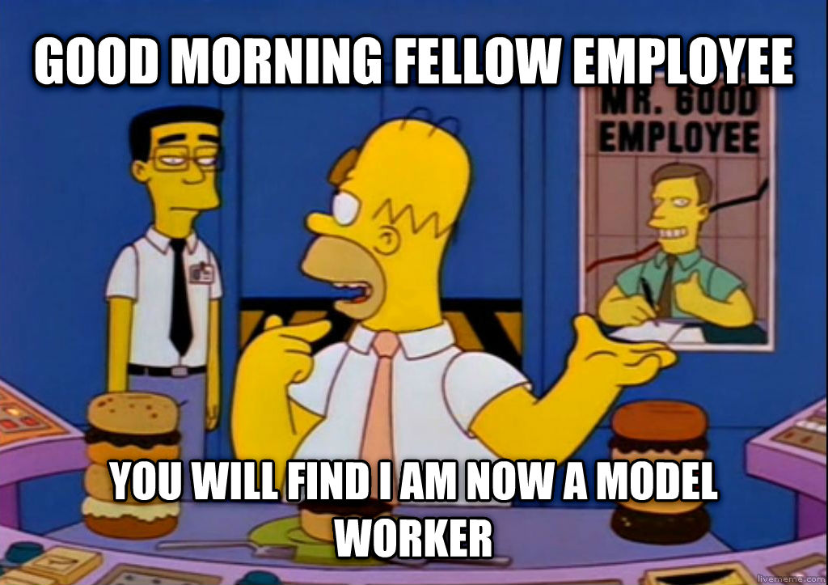
Did you get them all?
Self Motivation
Leadership
Respect
Dependability
Punctuality
Problem solving
Determination
Independence
Time management
Team working
Written & verbal skills
Planning skills

Slide 3
New learning goals
All will: Understand a range of Personal Attributes
Most will: Explain suitable examples in scenarios
Notes:
1mins

Slide 4
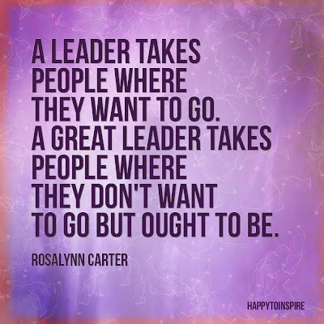
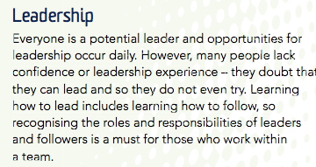
Where have you seen examples of…?

Slide 5
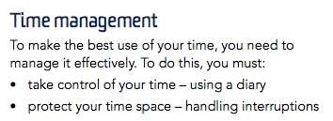
Where have you seen examples of…?

Slide 6
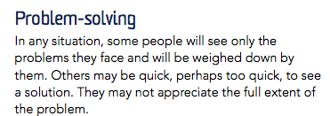
Where have you seen examples of…?

Slide 7
Where have you seen examples of…?
https://www.youtube.com/watch?v=78b67l_yxUc

Slide 8
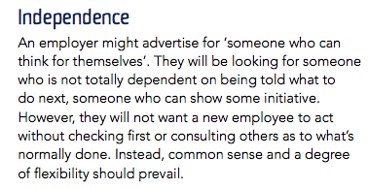
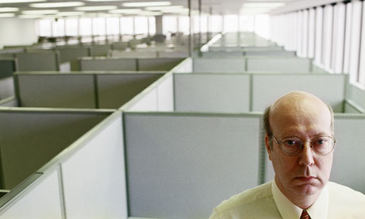
Where have you seen examples of…?

Slide 9
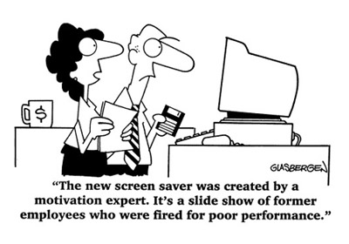
Where have you seen examples of…?

Slide 10
Task: add to leaflet
Add another page
To your leaflet titled ‘Attributes’
Discuss 3 Attributes Desired:
For each explain the expectation at the company. & include an image of each
Self Motivation
Leadership
Respect
Dependability
Punctuality
Problem solving
Determination
Independence
Time management
Team working
Written & verbal skills
Planning skills
Notes:
4mins demo, 20mins – create logo, then export together. 15mins – Add to PPT and Callout, show each others logos.

Slide 11
YOUR DESCRIPTIONS…
Self Motivation
Leadership
Respect
Dependability
Punctuality
Problem solving
Determination
Independence
Time management
Team working
Written & verbal skills
Planning skills
Read out your description, Can others guess the attribute?

