Slide 1
Theory 3 software
Monday, 29 October 2012

Slide 2
Write title & revise protocols
Open your : Books
Title: Types of Server (Date: 9/12/2016)
THINK: Revise the Types of Protocol ready to be questioned/question the other half of the class.
Notes:
10min copy files and answer

Slide 3
Answers
IP: Internet Protocol
TCP: Transmission control Protocol
UDP: User Datagram Protocol
SMTP: Simple Mail Transfer Protocol
FTP: File Transfer Protocol
HTTP: Hyper text transmission protocol
SNMP: Simple network management protocol
ICMP: Internet control message protocol
POP: Post office protocol

Slide 4
The four layers of tcp/ip: Answers
Link layer
Lowest level & deals with hardware, navigating through the myriad of routers/servers & machinery to get to the destination.
Internet layer
Focuses on targetting the IP address.
Transport layer
Establishes a communication between hosts and moves the package (data) towards its destination.

Slide 5
The four layers of tcp/ip: Answers
The Application Layer:
The highest layer, contains other protocols including HTTP, HTTPS & SMTP.
HTTP (Hyper text transfer protocol) sends out a request to the client to establish permission to transfer data.
HTTPS (Secure) ensures a secure connection. Used in eCommerce/banking/for private data.
Other protocol: POP & IMAP for eMail for client level access.
Complete your description of the Protocols.

Slide 6
New learning goals
All will: Understand a range of Servers
Most will: Analyse and research the IP’s the servers use
Few will: Evaluate which servers to use for a business
AIMS:
Describe each type of server
Research which Protocols they each use
Give a recommendation to a range of users based on the types of server
Notes:
1min

Slide 7
What are servers used for?
https://www.youtube.com/watch?v=7d2JyaW9X34
Email
File transfer
Applications
Databases
Hypervision
Webpages
Creating webpages specifically for users (Facebook)

Slide 8
Types of Server
One example a Database Server:
A Database server could use the programming languages SQL. This could manage databases with multiple users, for example user accounts at amazon, their orders and deliveries.
Amazon server room

Slide 9
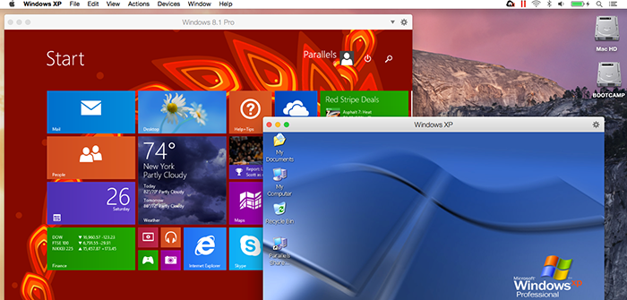
Types of Server
Another example :Hypervisor server:
Software written for a particular processor which manages different Operating systems or copies of the same operating system on a single computer. It manages resources such as the processor, memory and devices so that each OS receives resources it needs and does not clash with other OS’s. (Virtualization)

Slide 10
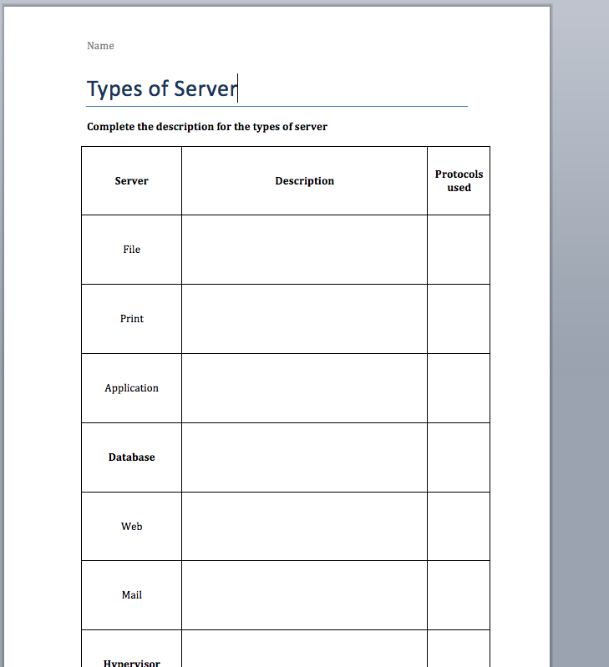
Task 1: Describe the servers
Read & use the ‘Kingdown Servers’ Sheet to help complete a description of each of the servers
Some you will need to research online. (In Bold)
Search with Keywords: Eg ‘Database Server Description’
Done all? Research protocols used for each.

Slide 11
Task 2: Recommendations
For each of the below recommend at least two types of server and describe which you would spend the most money on and why.
A new E-Commerce company ‘Astro Games’ who sell games through posted disc’s or downloadable content.
A New Blogging site ‘gig chat’ based on photo’s & reviews of live music gigs.

Slide 12
Your recommendations
Share recommendations.
Do you agree?
What would you add?
A new E-Commerce company ‘Astro Games’ who sell games through posted disc’s or downloadable content.
A New Blogging site ‘gig chat’ based on photo’s & reviews of live music gigs.

Slide 13
Journey of a packet of data
https://www.youtube.com/watch?v=hymzoUpM0K0

