Slide 1
Lesson 1 - Input/output Devices
Notes:
2mins

Slide 2
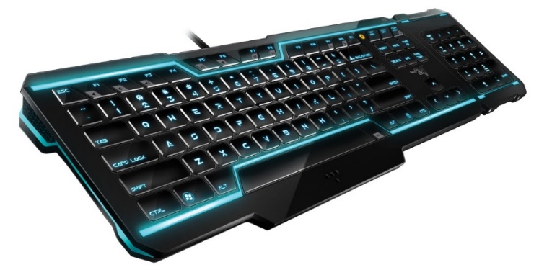
Input/output Devices
Input devices take analogue data and convert it into digital
This data is then sent into the computer
The computer processes the data and then produces digital outputs that we can understand using an output device.
Notes:
2mins

Slide 3
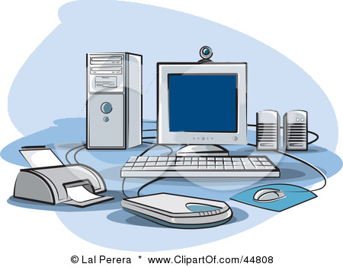
Input Devices
Keyboard
Known as the “Qwerty” keyboard because of the layout of the letters on the first row.
Camera
Web cams are now on most PCs and Laptops. Used for social networking or Skype but also may be used for iris or facial recognition
Scanner
Used to digitise images. They make a digital copy of data.
Mouse
Invented in 1963, and is now the most common form on input. Used to highlight, select and edit using sensors on the bottom
Microphone
Used to input sound and control the computer using voice recognition software.
Notes:
3mins Mini plenary, students say the parts as revealed.

Slide 4
OUTput Devices
Speakers
Sound is output through use of speakers or headphones. In industry speakers are used as a warning, for example in hospitals
Monitor
Most systems will have some kind of visual output that requires a monitor. LCD and LED are the most common flat screen monitors
Printer
These are used to produce a hard copy of information. There are different types including fast laser printers and cheaper ink-jet printers which are more common in the home.
Notes:
3mins

Slide 5
Communication devices
A piece of equipment or hardware designed to move information from one place to another, in other words, allowing one computer device to communicate with another.
Network interface card (NIC) or Network connector
Wi-fi cards
Router
Modem

Slide 6
Task 1
Label each of the inputs and outputs in the U1T1 Hardware booklet: Inputs: Scanner, Webcam, Microphone, Mouse, Keyboard, touch-screen, Stylus Outputs: Printer, Monitor, Speakers, LED Lights, Plotter. Communication Devices: VoIP Phone, Tablet, Mobile Phone, Braille Keyboard
For each consider the purpose and add a benefit/limitation.

Slide 7
Task 2
Have a go at answering these exam style questions
Notes:
10mins

Slide 8
Answers
A supermarket self-checkout has a range of input and output devices. Identify any input and output devices that the checkout might use, clearly stating which is an input, output or both. Describe the purpose of each device.
INPUT: keypad, barcode scanner, electronic scales, epos keypad, magnetic strip reader, coin weight checker, bank note scanner
OUTPUT: bleeper, epos display, printer, flashing light to call attendant
BOTH touchscreen

Slide 9
Answers
A patient in intensive care in a hospital will be connected to various sensors. Identify some of the sensors that may be used and what they are used for. There will also be various output devices. Identify some that may be used and explain their purpose
SENSORS: Used to monitor heart rate, blood pressure, brain activity, weight, temperature, oxygen, levels in the blood …
OUTPUTS: To alert carers buzzers, lights. To provide data screens, printouts of charts and graphs

Slide 10
Answers
Hannah is an artist who is beginning to use computers for her drawings, what input device would you recommend and why?
Graphic tablet to allow her to create accurate and detailed drawings straight onto the computers
Steve loves loud music but still lives at home with his mum and dad what output device would you recommend and why?
Headphones so that he can listen to his headphones without disturbing his mum and dad.
Explain how the “touchscreen” of a tablet pc can be both an input and an output device.
The screen outputs the display and is therefore an output device, whereas the screen is also a touch pad with allows users to input information.
Notes:
3mins

Slide 11
Lesson 2 - Components
Notes:
2mins

Slide 12
Components
There are many different components that go into making a computer​
How many can you name?​
Notes:
2mins

Slide 13
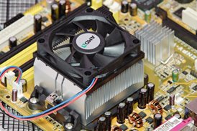
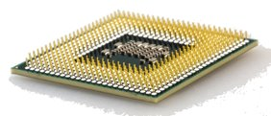
CENTRAL PROCESSING UNIT​
The brain of the computer​
The purpose of a CPU is to process data​
Sorting, Searching, Calculating and Decision making​
Fetches instructions from memory​
Decodes the instructions​
Executes the instructions​

Slide 14
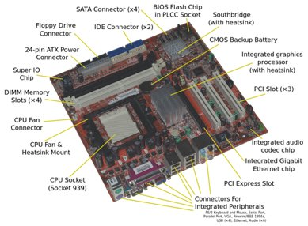
MOTHERBOARD​
The motherboard is a printed circuit board that allocates power and allows communication between hardware components.​
The purpose of a motherboard is to connect everything together​

Slide 15
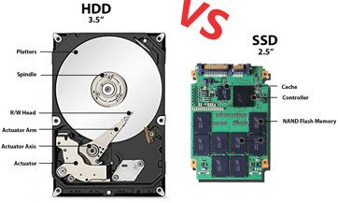
STORAGE​
A hard disk drive (HDD) is a storage device that uses mechanical platters and a moving head to access data. ​
A solid-state drive (SSD) is a newer, faster type of device that stores data on instantly-accessible memory chips.​

Slide 16
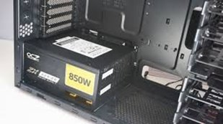
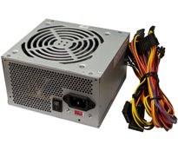
POWER SUPPLY​
The power supply provides all other components with power.​
It converts AC (alternating current) into a steady low-voltage DC (direct current) usable by the computer.​

Slide 17
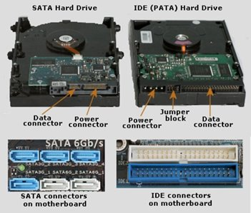
PORTS​
Their purpose is to connect hardware to the motherboard​
​
IDE lead​
SATA lead​
SATA leads are newer, faster and smaller than IDE leads

Slide 18
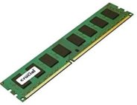
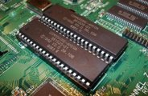
MEMORY​
RAM – Random Access Memory​
Stores the programs and data that the CPU requires when running a program​
Volatile - Data is lost if the power is turned off​
ROM – Read Only Memory​
Stores information essential to operate the system (Boot up)​
Non-volatile - Always retains its data​
Can’t be written to so is used for programs/devices that don’t need to be changed (Calculators)​

Slide 19
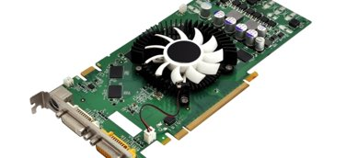
EXPANSION CARDS​
An expansion card is a printed circuit board that fits into an expansion slot on a desktop computer. ​
They are used to give a computer additional capabilities, such as enhanced video performance via a graphics card.​

Slide 20
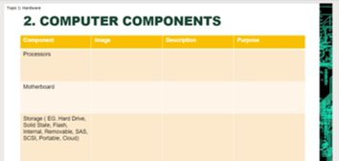
TASK 1​
Open your U1T1 Student Booklet (Slide 6)​
Label each of the computer components​
Processor, motherboard, storage, power supply, ports, memory, expansion cards​
Find an image for each and add a description and purpose ​

Slide 21
Lesson 3 - System types

Slide 22
System types
Desktop/server ​
Tablet/hybrid ​
Smartphone ​
Embedded system (e.g. cars, home appliances, etc.) ​
Mainframe ​
Quantum​

Slide 23
Individual components (Monitor, keyboard, mouse, Case containing motherboard, CPU, etc)​
All in one​
Harder to upgrade/repair​
More expensive​
More easily moved​
Reduce space​

Slide 24
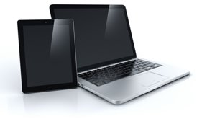
TABLET/HYBRID​
Laptops and tablets can be used in a variety of locations​
Very similar to all in one computers​
Smaller screen size than a desktop​

Slide 25
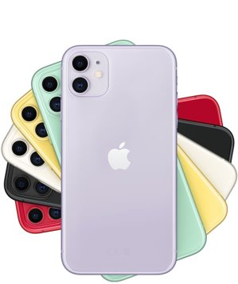
Can run applications, send and receive emails, take photos, etc​
Less human interaction​
Reduce spacial awareness when being used​
Lowered security

Slide 26
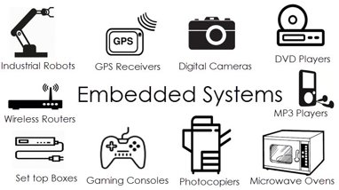
EMBEDDED SYSTEM/INTERNET OF THINGS​
These are everywhere ​
Cars have computers that can monitor emissions from the engine and adjust settings if needed​
Microchips in animals that can identify their owners if lost​

Slide 27
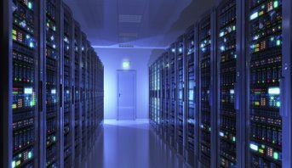
MAINFRAME​
Huge machines designed to solve complex scientific and engineering proplems and calculations​
Manipulate, collect and store large amounts of data​
Used by organisations that need to process large amounts of data quickly (Banks, airlines)​
Reliable and secure ​
Expensive

Slide 28
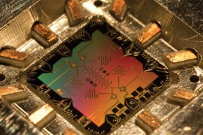
QUANTUM COMPUTER​
Experimental​
Work with quantum bits (Qubits) which represent atomic particles such as electrons and protons​
A fully working quantum computer will be able to carry out data manipulations millions times quicker than current computers​

Slide 29
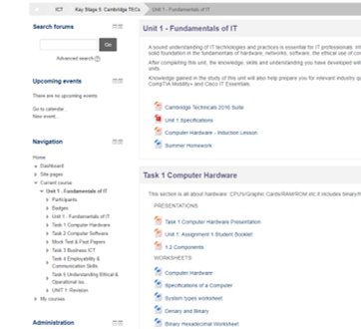
TASK 1​
Open the system types worksheet on the VLE​
ICT > Key stage 5: Cambridge TECs > Unit 1: Fundamentals of IT > Task 1 computer hardware​
Make sure to save into your unit 1 task 1 hardware folder

Slide 30
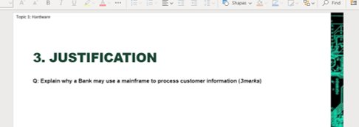
Task 2
When completed, try answering the exam style question on the next slide in the PowerPoint​
​
(Try and answer it first before you move the box covering the answer... See how many marks you would have got)​

Slide 31
Lesson 4 - Connectivity methods

Slide 32
Connectivity methods
Copper​
Fibre​
Wireless

Slide 33
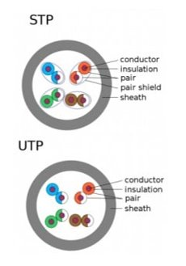
Copper wire connections
Copper cables use electrical signals to pass data between networks​
Twisted pair cables are often used in telephone systems​
Several can be brought together to form a twisted cable​
Unshielded Twisted Pair (UTP)​
Shielded Twisted Pair (STP)

Slide 34
Advantages​​
A cabled telephone can be powered directly from the copper cable, so the phone will still work if there is a loss of power ​​
Copper can be cheaper to set up​
Disadvantages​​
Degenerates over long distances

Slide 35
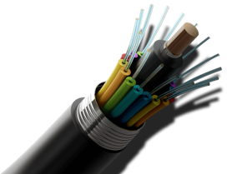
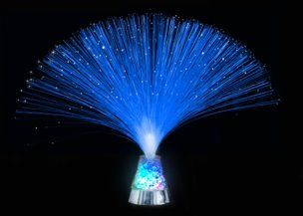
FIBRE-OPTIC CONNECTIONS​
Fibre-optic cable is widely used for larger LAN installations where cable runs over longer distances​
It is also widely used where extreme bandwidth is required for example cable television and high-speed internet access.​​

Slide 36
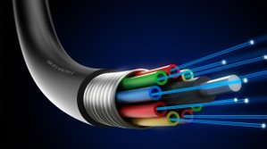
FIBRE-OPTIC CONNECTIONS​
Advantages​
Can carry signals over much larger distances​
Can carry different services over the same line​
Disadvantages​
More expensive to set up​
Splicing cables is more difficult​

Slide 37
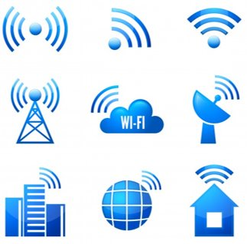
WIRELESS​
Wi-Fi​
Bluetooth​
Microwave​
Laser​
Satellite​
Infrared​
4G/5G GSM

Slide 38
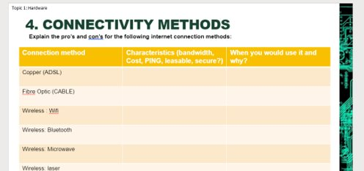
TASK 1​
Slide 11 on the U1T1 Hardware Student Booklet​
Fill in the table with the Characteristics and when you would use it.

Slide 39
Task 2
When completed, try answering the exam style question on connectivity methods

Slide 40
Lesson 5 - Communication hardware

Slide 41
Slide 13 in the U1T1 booklet - Match the description to either a router or a modem​
Forwards data packets to the appropriate parts of the network. ​
converts between digital and analogue signals. Must be used so that computers (digital) ​
Allows the Internet connection to be shared by multiple devices ​
can connect to the Internet through telephone lines (analogue).​

Slide 42
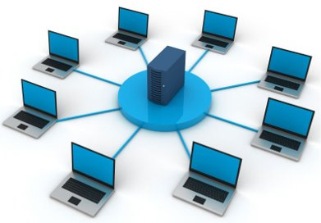
Communication hardware
Transmit analogue or digital signals over wired or wireless channels​
Modem​
Network Hub​
Switch​
Router​
Hybrid network​

Slide 43
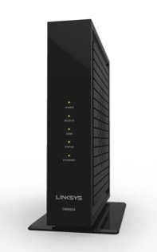
MODEM​
Connects your home to your Internet service provider (ISP) ​
Takes analog signals from your ISP and translates them into digital signals your local devices can use, and vice versa​
The connection between your house and the Internet is a wide area network (WAN)

Slide 44
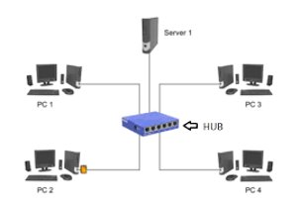
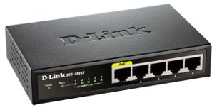
NETWORK HUB​
Cheap and easy way to set up a small Local Area Network​
The central connection point for all devices in the network​
If one device (node) sends data, all devices (nodes) will receive the same data​
Can’t send to a specific node

Slide 45
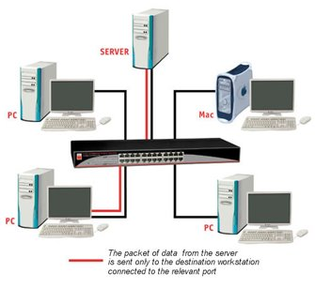
SWITCH​
Similar to network hubs but data can be sent to a specific node​
The switch receives data, processes it and forwards it onto the specific device​
Faster than a hub as data is sent through multiple channels, to and from specific destinations

Slide 46
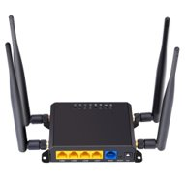
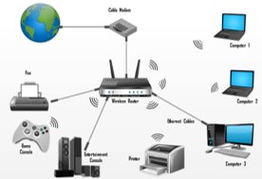
ROUTER/HYBRID NETWORK HUB​
Can send data between networks via wired or wireless connections​
They have a fixed number of ethernet ports for wired devices and Hybrid network hubs also broadcast a wi-fi signal for wireless connections​

Slide 47
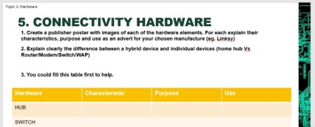
Task 1
Slide 14 in the U1T1 Hardware Student Booklet​
Fill in the table with the characteristics, purpose and use of each hardware type​
Using this information, create a revision poster about communication hardware​

Slide 48
Lesson 6 - Troubleshooting

Slide 49
FILL IN THE BLANKS​
Fill in the blanks (Slide 15 on the ppt)​

Slide 50
HARDWARE FAULTS​
Faults can occur for several reasons:​
Power surges​
Poor maintenance​
Accidental damage​
Malware ​
Intentional damage

Slide 51
HARDWARE FAULTS​
IT technicians and help desk staff must log the issue (i.e. battery will not charge, hard drive failure) on a fault log sheet identifying the:​
Machine​
Owners or users​
Fault​
Date​
Symptoms​
Problem history​
Back up documentation

Slide 52
WHAT TO DO?​
Always look for the simplest explanation first​
i.e. Computer is not turning on? Check it is plugged into the mains​
Record the steps you take to identify the fault​
State the tools you have used​
Record the actions you have taken to resolve the issue​
i.e. Replaced hard disc, updated drivers, reinstalled software etc.​
Note the product specification of any new software or hardware​
So if it is faulty you can let the supplier know​
Record the time taken and costs

Slide 53
TROUBLESHOOTING TOOL - EVENT VIEWER​
When errors occur, the event viewer is updated with information about it:​
What the problem is​
Date and time​
The seriousness of the problem​
What caused it​
An event ID number​
Who was logged on at the time

Slide 54
SELF TEST PROGRAMS​
May be provided by the hardware manufacturers​
Power on Supply Test (POST)​
Ping tests​
Ipconfig/Ifconfig​
Nslookup

Slide 55
POWER ON SUPPLY TEST (POST)​
A function of the BIOS for a particular computer​
It checks memory, power supply, hardware, CPU, BIOS and heat/cooling​
Two types of BIOS-related diagnostic information are provided:​
Beep codes​
One beep means that all is well from the motherboard as the CPU is functioning​
More than one beep means there is an error​
Each BIOS has its own set of beep codes which can be downloaded from the manufacturers website to identify a particular error​
POST codes​
A visual, two-characters read out of the stage that the POST is at​

Slide 56
PING​
Ping tests the connectivity between the requesting host and the destination host​
It uses the Internet Control Message Protocol (ICMP) to send an echo request message to the destination host and listens for a response called the echo reply message​
A response shows that the host can be reached​
Troubleshooting - This procedure can be repeated with different hosts until the source of the problem is identified​

Slide 57
IPCONFIG/IFCONFIG​
Identifies the specific IP configuration of the hosts affected by the problem​
Especially useful where dynamic addressing is used and the IP address of each host can change

Slide 58
NSLOOKUP​
Aids the diagnosis of issues with dynamic name systems (DNS) addresses​
Looks up the IP addresses associated with a particular domain name such as bbc.co.uk​
If the utility can’t determine this information then there is a DNS issue​
Can also query DNS servers to find out if there is an issue with the default DNS server

Slide 59
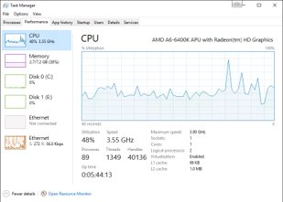
DIAGNOSTIC SOFTWARE​
Available from third parties​
Some are free and others require payment​
They include memory testers

Slide 60
TASK 1​
Slide 16 in the U1T1 Hardware Student Booklet​
May need to copy/paste each one onto a different slide​
Research and answer each of these questions​

Slide 61
Lesson 7 - Units of measurement

Slide 62
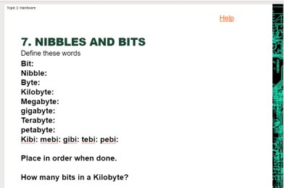
Research and define the key terms and place in size order (Slide 18)

Slide 63
What is binary?
1 or 0 = bit (short for binary digit)​
1010 = nibble​
10101010 = byte​
You don’t need to know these numbers, but you do need to recognise the names and the number of bytes in powers of 10 and powers of 2​
Decimal values​ |  | Binary values​
SI (Système Internationald'Unités)​ | Bytes​ | IEC (InternationalElectrotechnical Commission)​ | Bytes​
kB (Kilobyte)​ | 10³ = 1,000​ | KiB (Kibibyte)​ | 2¹⁰ = 1,024​
MB (Megabyte)​ | 10⁶ = 1,000,000​ | MiB (Mebibyte)​ | 2²⁰ = 1,048,576​
GB (Gigabyte)​ | 10⁹ = 1,000,000,000​ | GiB (Gibibyte)​ | 2³⁰ = 1,073,741,824​
TB (Terabyte)​ | 10¹² = 1,000,000,000,000​ | TiB (Tibibyte)​ | 2⁴⁰ = 1,099,511,627,776​
PB (Petabyte)​ | 10¹⁵ = 1,000,000,000,000,000​ | PiB (Pibibyte)​ | 2⁵⁰ = 1,025,899,906,842,624​

Slide 64
TASK 1 EXAMPLE​
Kilobyte KB - about 1 thousand bytes​
1 byte is one typed character​
A small file like a Word document

Slide 65
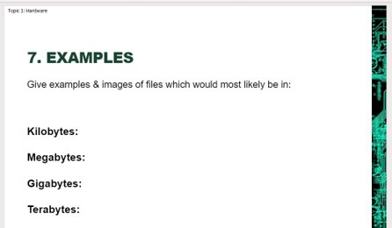
Task 1
Slide 19 in the U1T1 Hardware Student Booklet​
Find examples and images of files

Slide 66
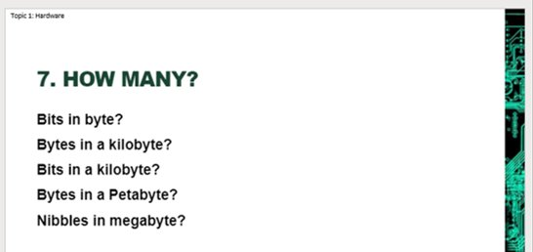
Task 2
Slide 20 in the U1T1 Hardware Student Booklet​
Work out the answers to these questions

