Slide 1
New learning goals
All will: Understand a range of networks and characteristics
Most will: Analyse each giving a pro/con
Few will: Consider exam technique and marks to gain fill marks in an example question
AIMS:
Draw each of the types of network clearly in books
Detail Pro’s and Con’s of each network below them (Page Per Topology)
Answer a 6 mark exam style question
Notes:
1min

Slide 2
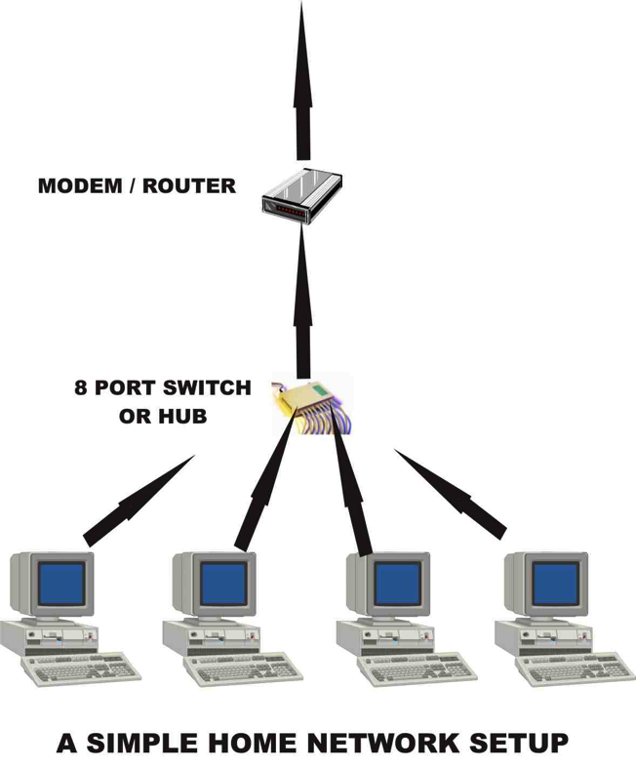
How to network computers together…..
An Ethernet lead can then be connected into the back of the computers and then configured as such.
Note, you need a machine called a hub so the workstation can talk to each other.
The router allows the machines to connect to the internet.
This is a typical LAN.
A WAN (Wide area network) could cover a whole continent, though the same principals apply…

Slide 3
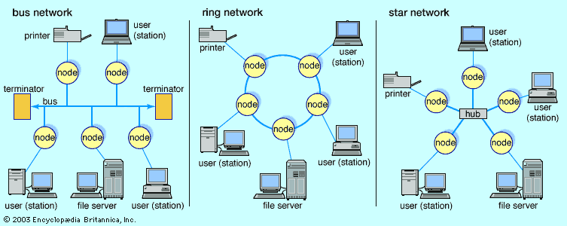
Network Topologies
Draw an image of each in your book, as well as MESH
Below each give 2 pro’s and 2 con’s

Slide 4
Bus Network Topologies
Pros:
Attaching new devices is easy, if one node fails, the rest don’t.
Cheaper to cable than a star network
Transmissions are in both directions
Cons:
Difficult to identify a faulty peripheral.
If the cable is broke, may loose half the network (or split in two)
Adding additional devices slows the network considerably.
Transmissions could crash into each other.

Slide 5
Ring Network Topologies
Pros:
Message is boasted along each node, so give a strong signal strength.
Uses ‘Token Ring’ technology. Whichever computer has the ‘token’ passes on information, others without it wait to stop confusion. This gives safe delivery.
Cheaper as uses less cable than star.
Cons:
If one or 2 nodes down, network fails.
More complex to add in a new device than bus/star.
If main cable fails, so does whole network.

Slide 6
Star Network Topologies
Pros:
Very reliable, if on device fails, rest still work (unless the hub/switch)
High performing as no data collisions can occur.
Cons:
Expensive to install, it uses a lot of cable.
Extra hardware required (hubs/switches)
If a hub/switch fails, whole network fails.

Slide 7
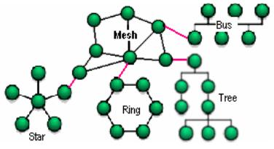
Mesh Network Topologies
There are two types: Total mesh where every node (connection) In the network is connected to all other nodes. If a connection stops, then traffic can be routed around the problem.
Partial Mesh: where some nodes connected to only a smaller number of nodes. This reduces the rerouting options if there is a failure, but is cheaper in cables. Cabled meshs are expensive, wireless mesh’s less so.

Slide 8
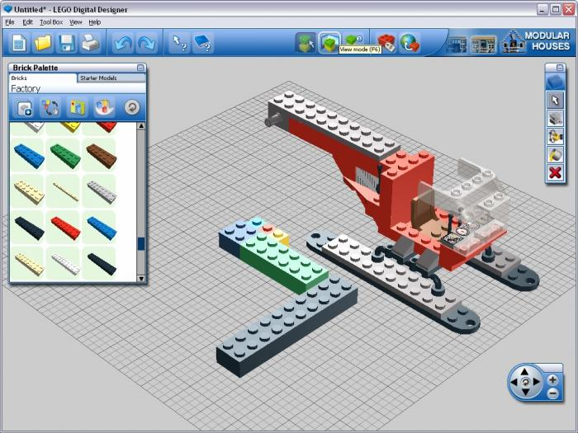
Final: Exam style question
Digital designs want to share their designs between Holland and the UK. Designs are on 30 separate desktop machines in Holland and 14 separate laptop machines in the UK. Which type of network would you recommend for either, give your reasons [6marks]
Clue: 2 marks for 2 correct network guesses, 2 marks for 2 reasons for each network topology.

Slide 9
Model answer
Answer: The [most likely] LEGO designers should use a BUS network in holland [1] and a Token Star Network [1] in the UK. The bus should be used because it is cheaper[1] than a cabled star network. Also because attaching new devices is easy for the designers because if one computer node crashes, it will not affect the others [1]. In the UK they should use a Star network because All 14 devices could connect through one hum, again if one goes down all can still communicate[1] The wireless option would also be cheaper than a cabled solution [1].
Only reveal when you have answered it.

Slide 10
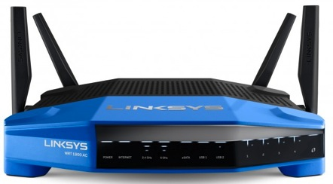
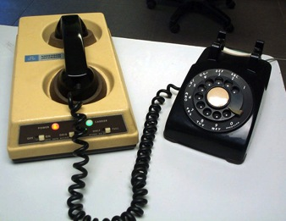
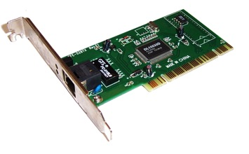
Basics: Hardware & the internet:
Router –
Forwards data packets to the appropriate parts of the network.
Allows the Internet connection to be shared by multiple devices
Modem –
converts between digital and analogue signals. Must be used so that computers (digital) can connect to the Internet through telephone lines (analogue).
Network adapter –
Used to connect a computer to the network (wifi/Ethernet card)

Slide 11
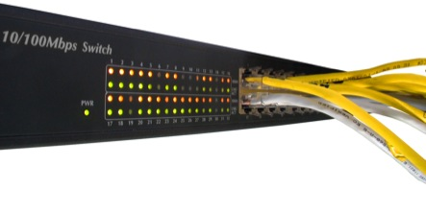
Keywords
Write the definition for each
Hub: Connects computes with ethernet.
Router: Allows comms between LAN & Internet.
Switch: Similar to hub but more efficient.
WAP: Any device connecting without cables.
NIC: Network card.
CLIENT: User computer
SERVER: File server computer

Slide 12
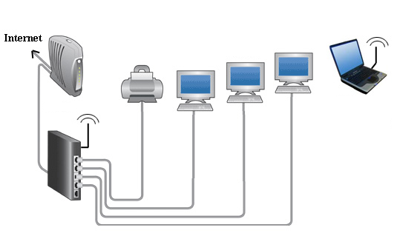
EXT:Create a school network diagram
Open Microsoft Publisher & A3 document
Drag and drop images to it from google of:
Router
Modem
Printer
Tablet
Computer (x10)
Server (x1)
INSERT>SHAPES>Lines to show connections (Merit: For including SERVERS & Describing type of topology)
Answer:

