Slide 1
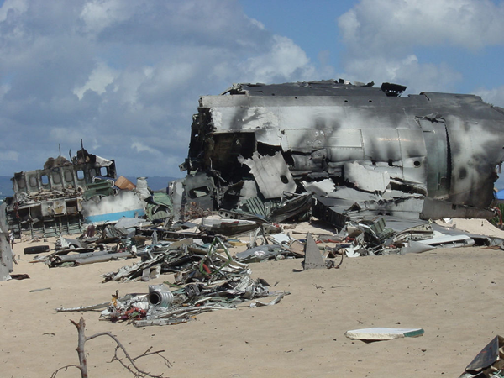
Day 1 – Lost…

Slide 2
You have crash landed on an unknown island, only your class has survived.
In order to survive each day you will be required to learn a new geographical skill, at the end of the day you will be tested on these skills to earn equipment to aid with rescue.

Slide 3
The 5Ws
Who?
What?
When?
Where?
Why?

Slide 4
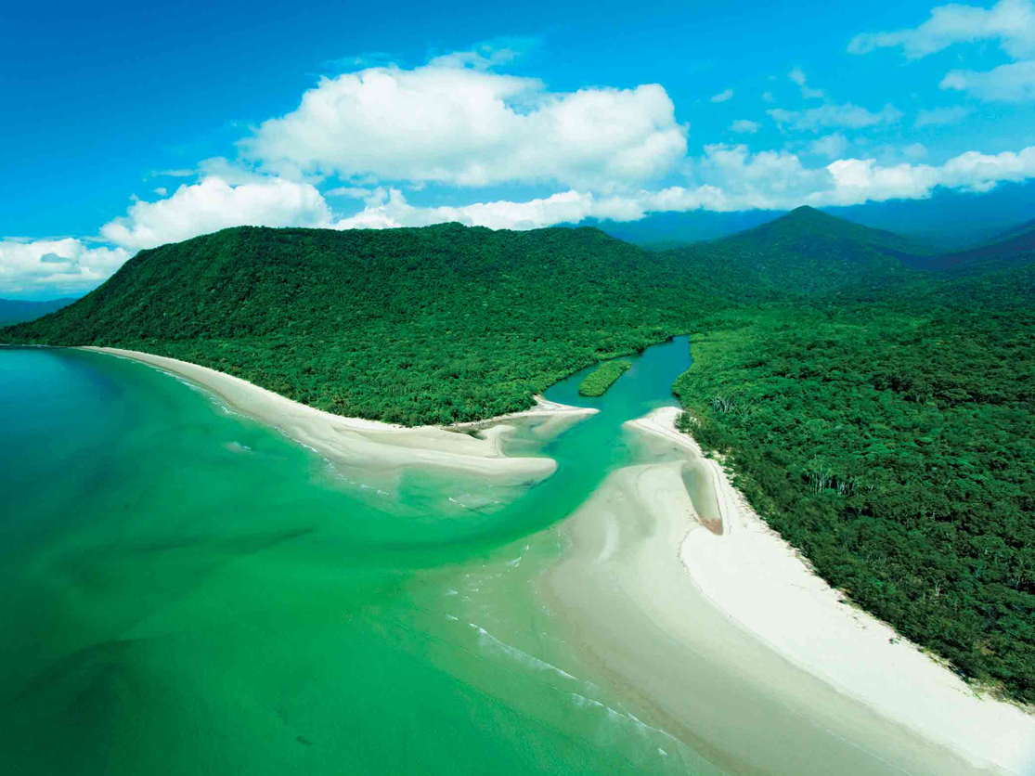
View 1

Slide 5
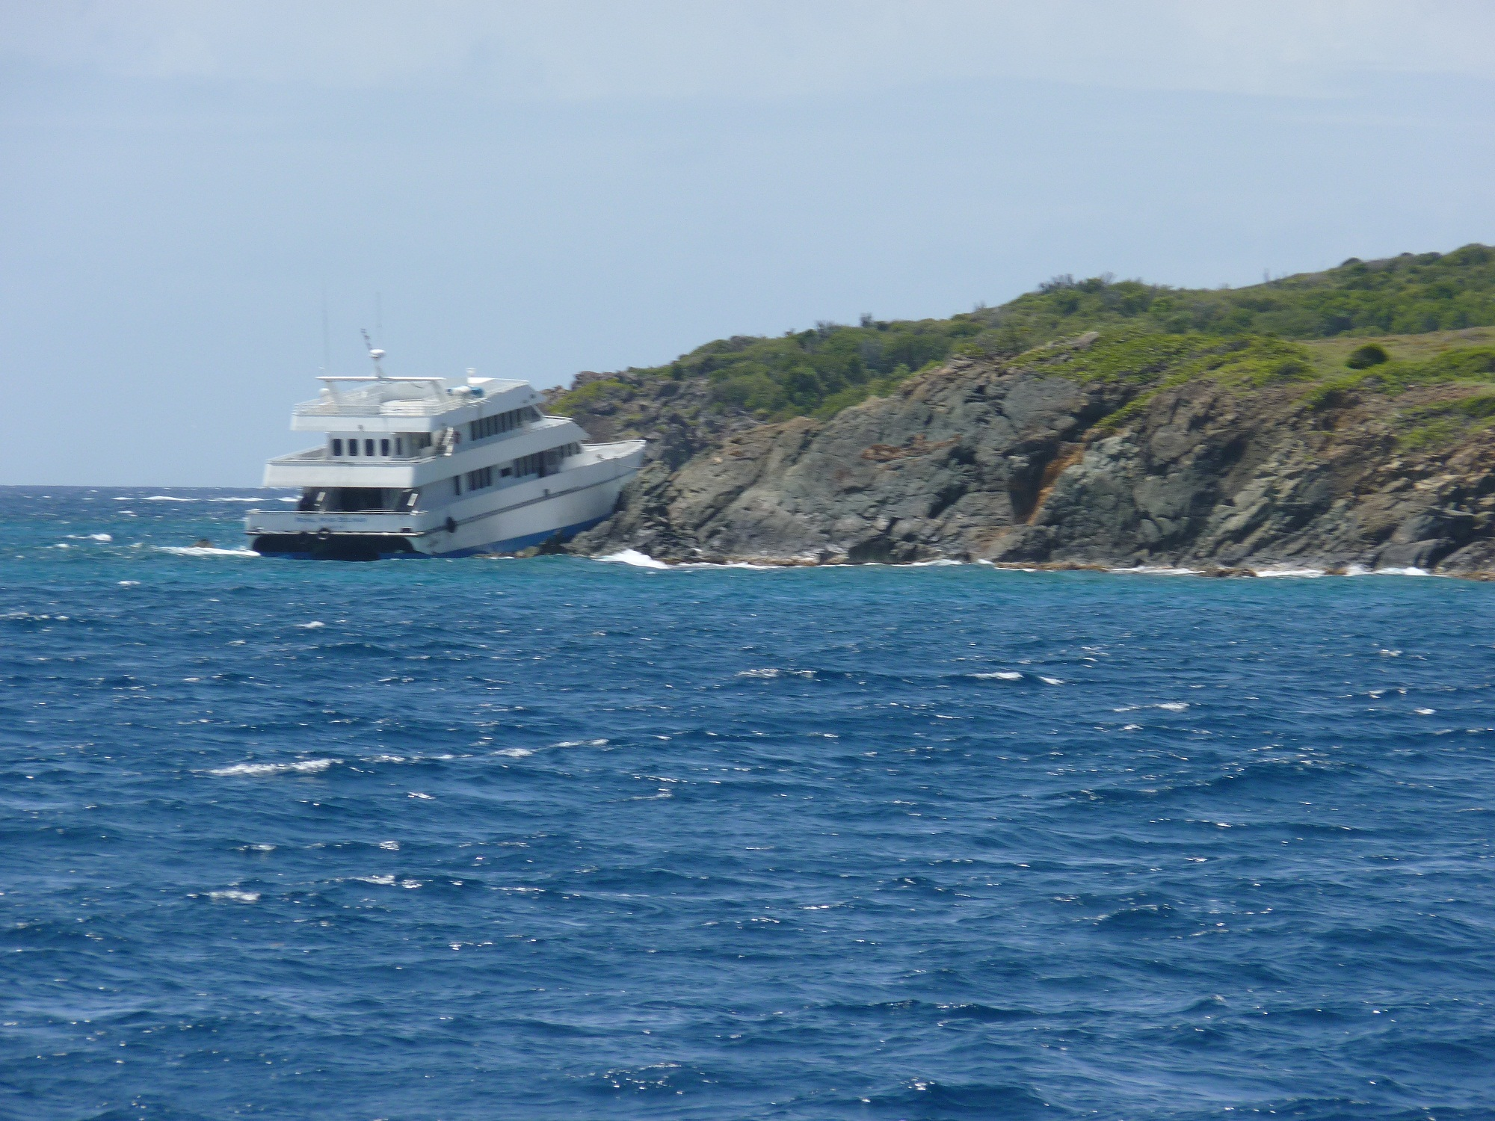
View 2

Slide 6
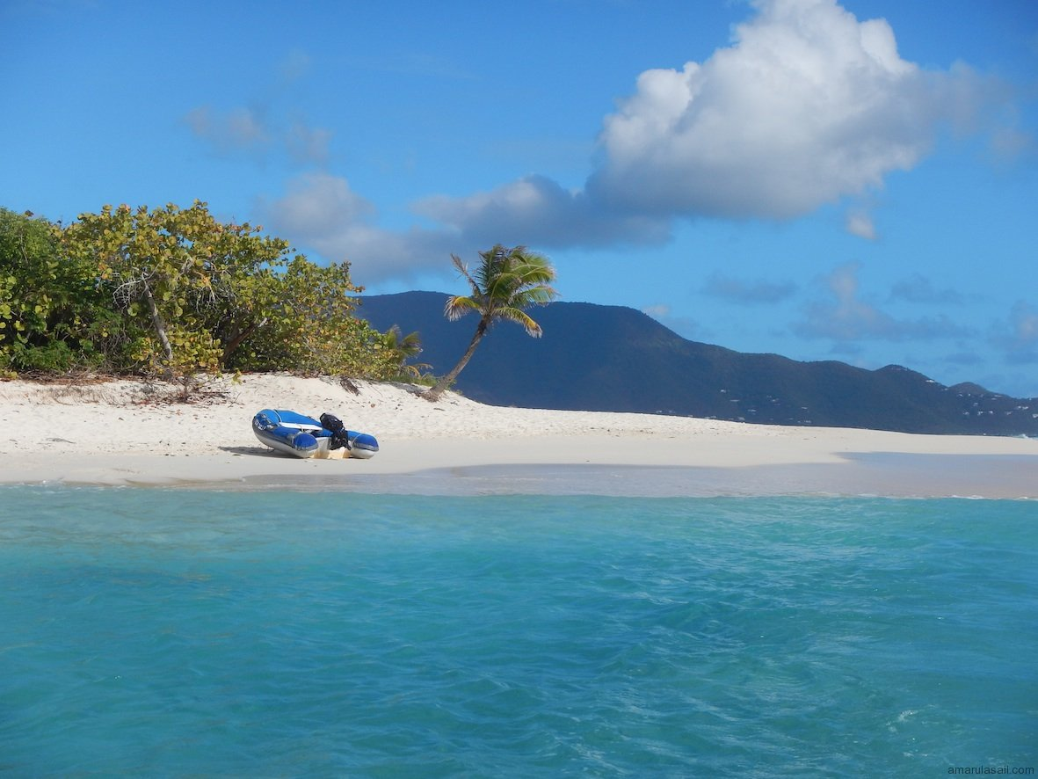
View 3

Slide 7
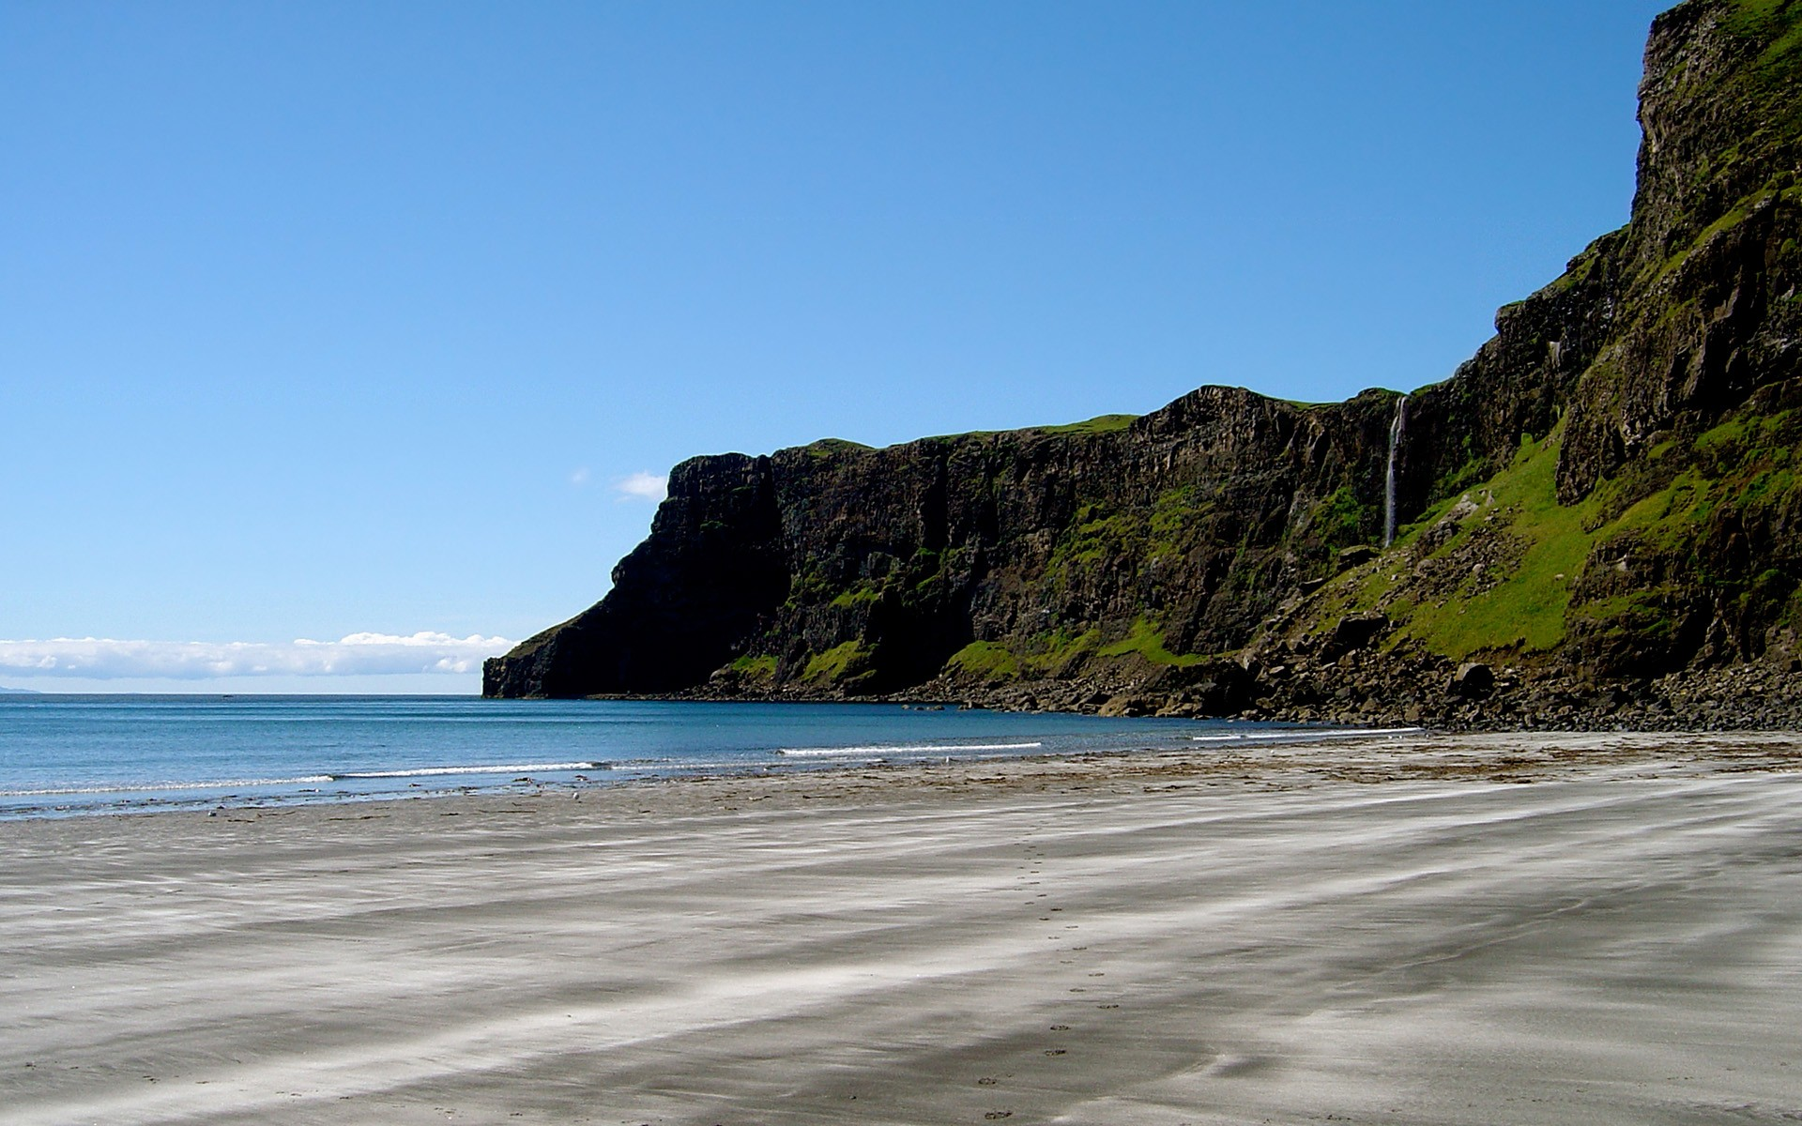
View 4

Slide 8
View 5

Slide 9
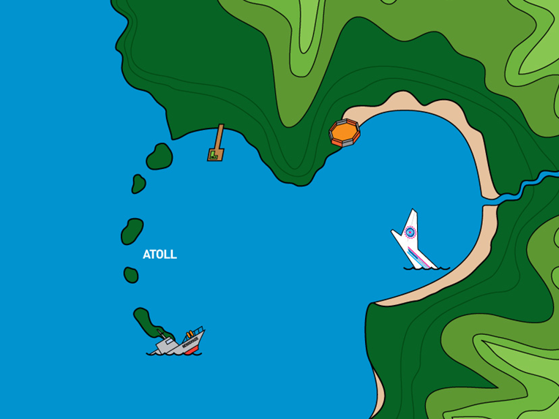
1
3
5
2
4
Check your answers – 1 survival point per correct answer.

