Slide 1
Internet Protocols
IP: Internet Protocol
TCP: Transmission control Protocol
UDP: User Datagram Protocol
SMTP: Simple Mail Transfer Protocol
FTP: File Transfer Protocol
HTTP: Hyper text transmission protocol
SNMP: Simple network management protocol
ICMP: Internet control message protocol
POP: Post office protocol

Slide 2
New learning goals
All will: Understand a range of Servers
Most will: Analyse and research the IP’s the servers use
Few will: Evaluate which servers to use for a business
AIMS:
Describe each type of server
Research which Protocols they each use
Give a recommendation to a range of users based on the types of server
Notes:
1min

Slide 3
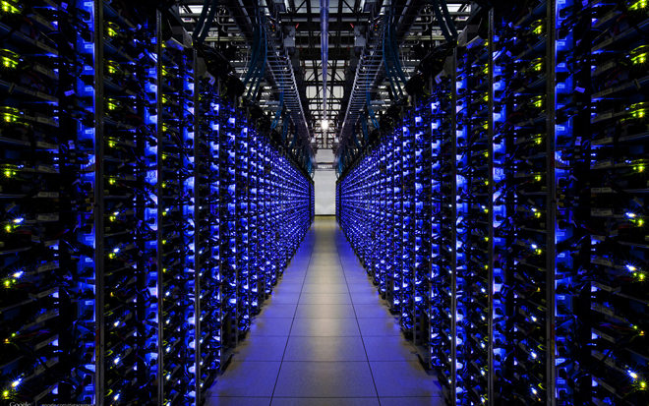
What are servers used for?
https://www.youtube.com/watch?v=7d2JyaW9X34
Email
File transfer
Applications
Databases
Hypervision
Webpages
Creating webpages specifically for users (Facebook)

Slide 4
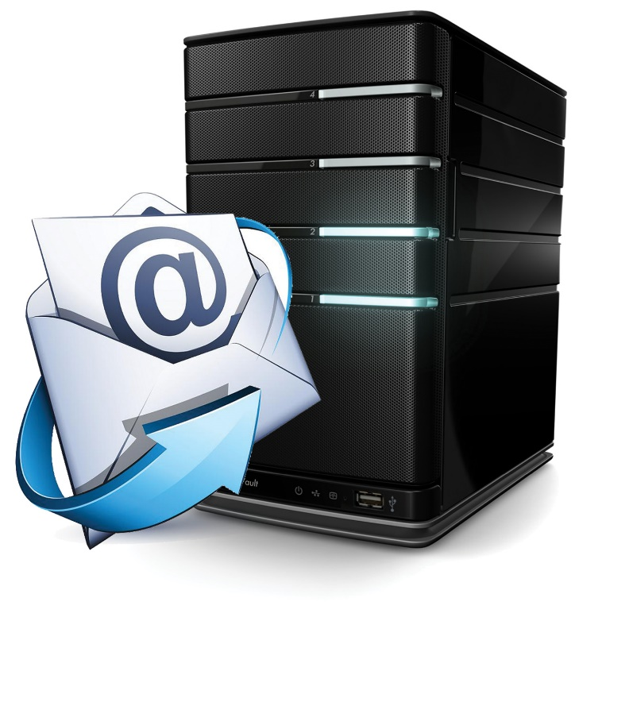
Email Server
Another example : Email server:
The server stores incoming mail for distribution to local users and sends out outgoing messages. This uses a client-server application model to send and receive messages using Simple Mail Transfer Protocol (SMTP). An email server may also be known as a mail or message transer agent.

Slide 5
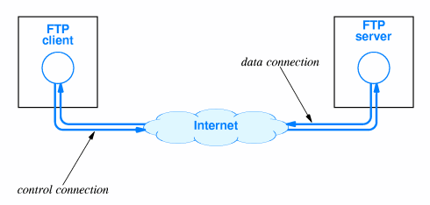
File Transfer Server
Another example : File Transfer Server
The File Transfer Protocol (FTP) is a standard network protocol used for the transfer of computer files between a client and server on a computer network. FTP is built on a client-server model architecture using separate control and data connections between the client and the server.

Slide 6
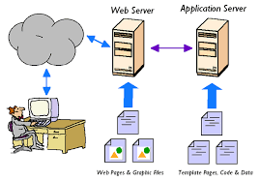
Application Server
An application server is a software framework that provides both facilities to create web applications and a server environment to run them.
Application Server Frameworks contain a comprehensive service layer model. An application server acts as a set of components accessible to the software developer through a standard API defined for the platform itself.
For Web applications, these components are usually performed in the same running environment as their web server(s), and their main job is to support the construction of dynamic pages. However, many application servers target much more than just Web page generation: they implement services like clustering, fail-over, and load-balancing, so developers can focus on implementing the business logic

Slide 7
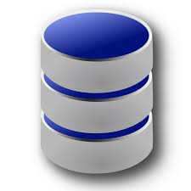
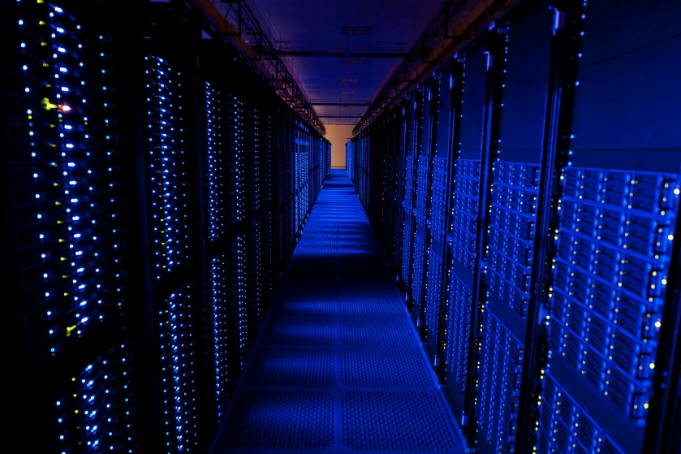
Database Server
One example a Database Server:
A Database server could use the programming languages SQL. This could manage databases with multiple users, for example user accounts at amazon, their orders and deliveries.
Database server is the term used to refer to the back-end system of a database application using client/server architecture. The back-end, sometimes called a database server, performs tasks such as data analysis, storage, data manipulation, archiving, and other non-user specific tasks

Slide 8
Hypervisor Server
Another example : Hypervisor server:
Software written for a particular processor which manages different Operating systems or copies of the same operating system on a single computer. It manages resources such as the processor, memory and devices so that each OS receives resources it needs and does not clash with other OS’s. (Virtualization)

Slide 9
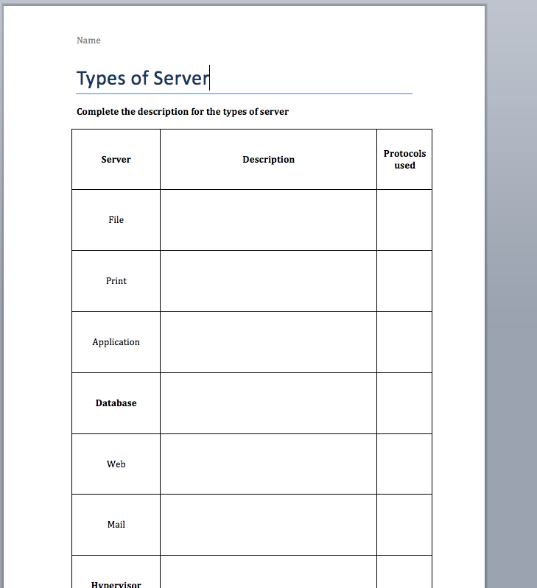
Task 1: Describe the servers
Read & use the ‘Kingdown Servers’ Sheet to help complete a description of each of the servers
Some you will need to research online. (In Bold)
Search with Keywords: Eg ‘Database Server Description’
Done all? Research protocols used for each.

Slide 10
Journey of a packet of data
https://www.youtube.com/watch?v=hymzoUpM0K0

