Slide 1
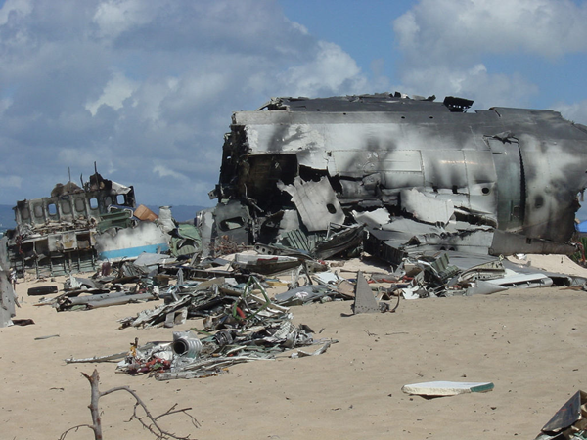
Day 7 - Identifying key features

Slide 2
Physical features show natural objects such as mountains and rivers. Human features are things that are built by humans such as bridges and roads.)

Slide 3
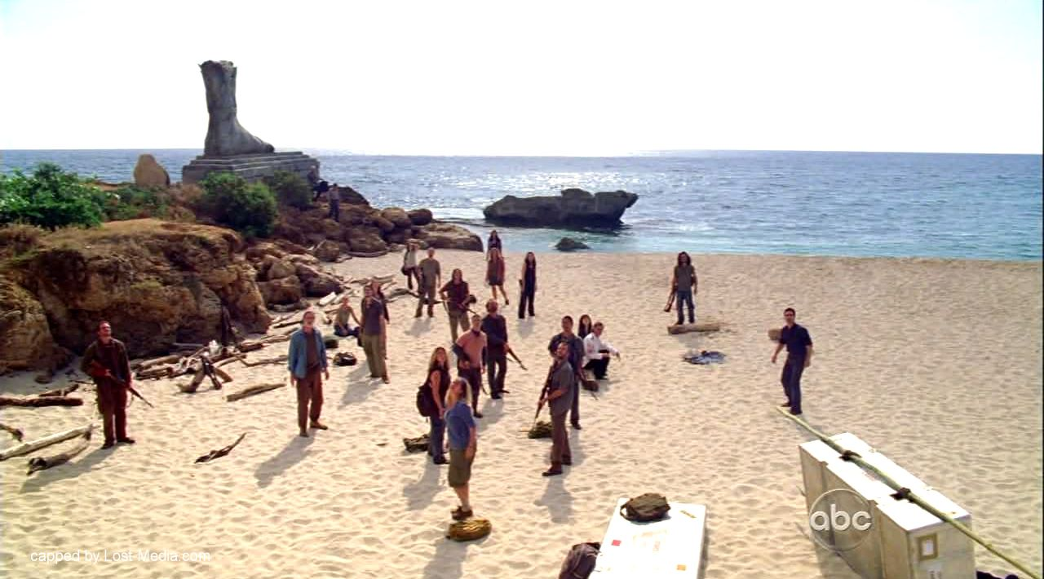
Statue of Tawaret

Slide 4
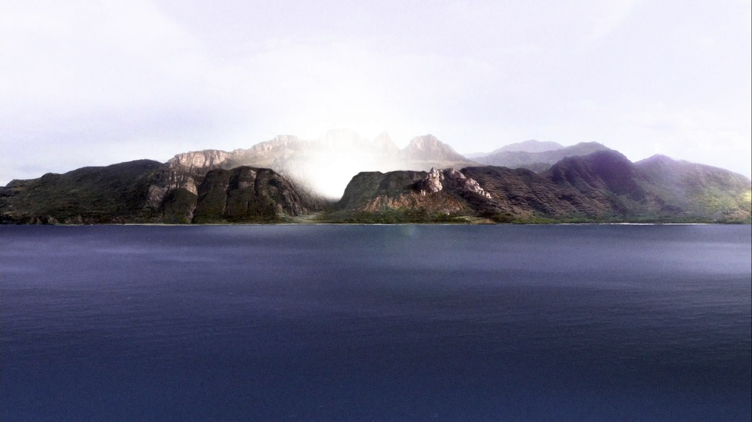
Crater

Slide 5
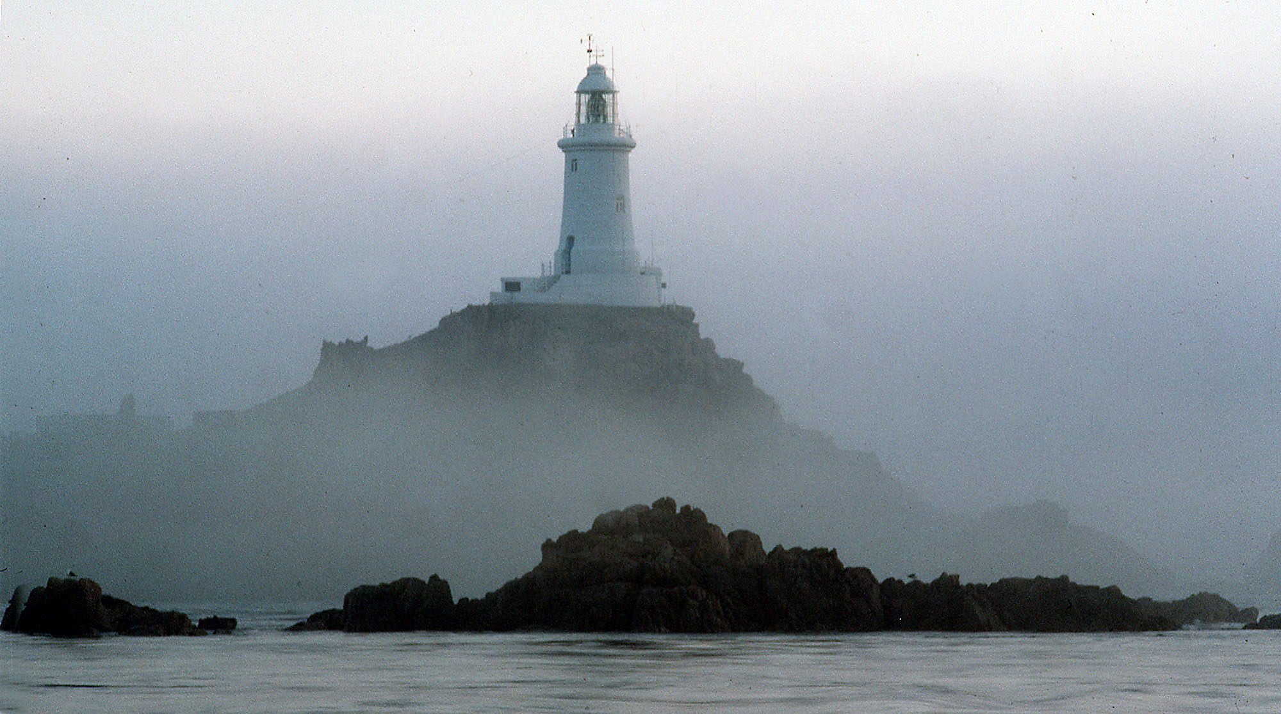
The Lighthouse

Slide 6
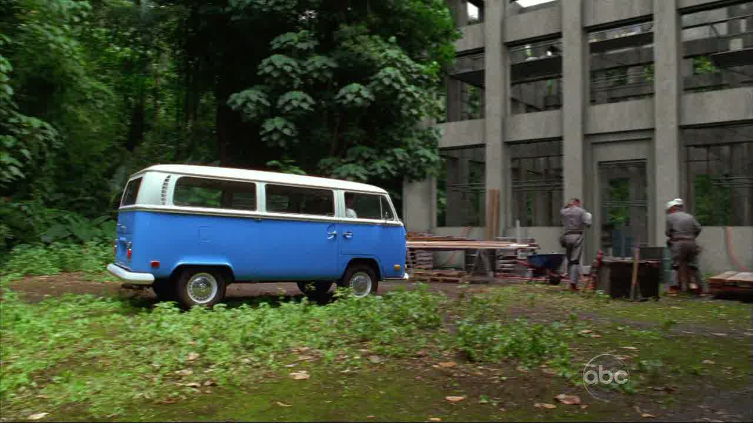
The Orchid

Slide 7
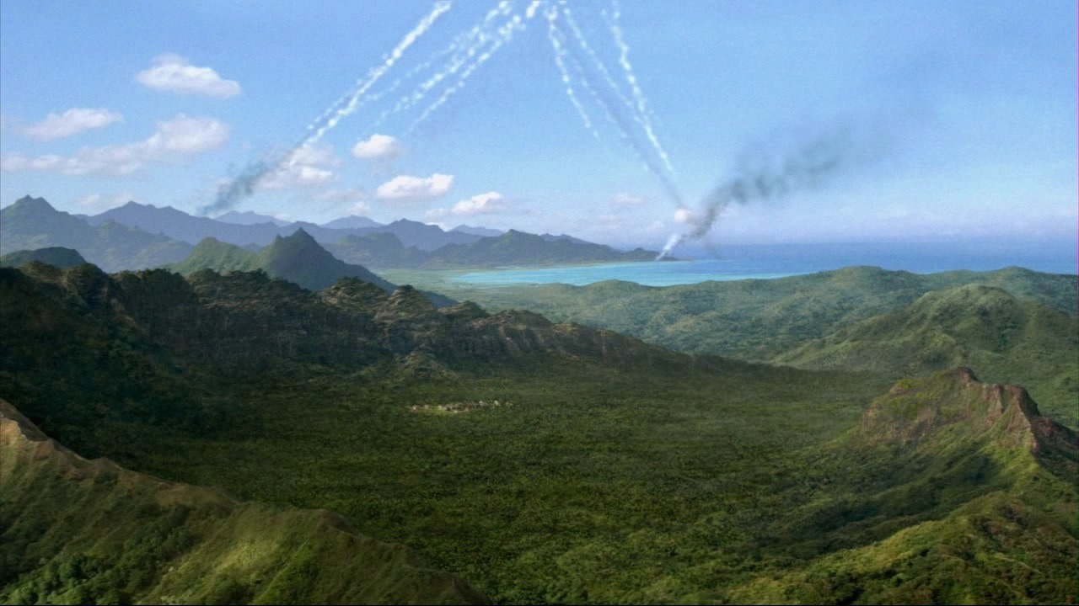
The Barracks

Slide 8
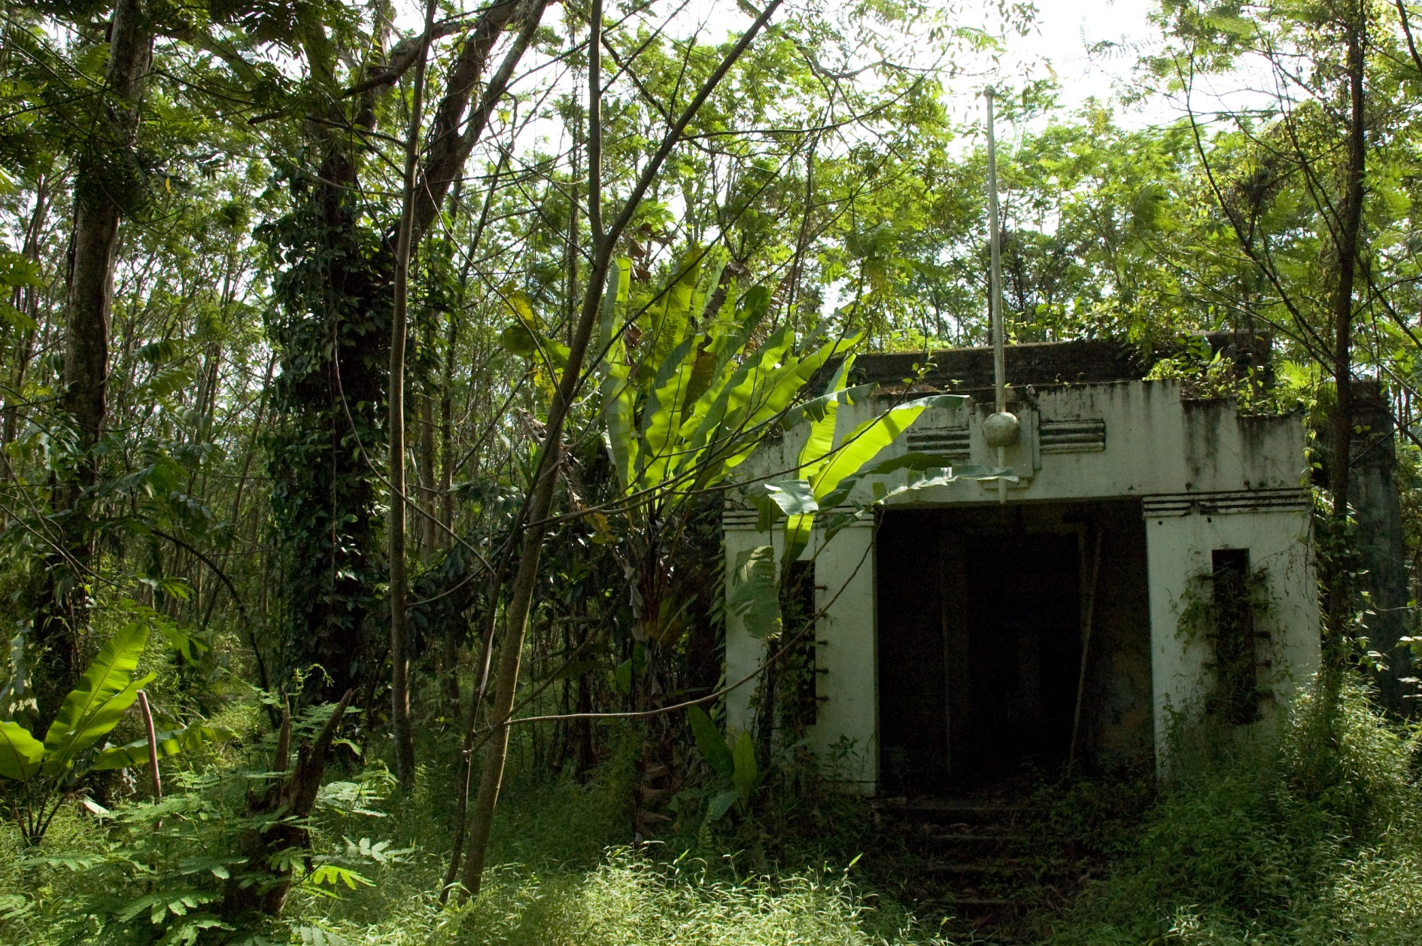
The Door

Slide 9
Locations
Statue of Tawaret – 468139
Crater – 505112
The Lighthouse - 539114
The Orchid - 473140
The Barracks - 488173
The Door – 116168
½ survival point for each 4 figure grid reference correct.
1 survival point for each 6 figure grid reference correct.

