Slide 1
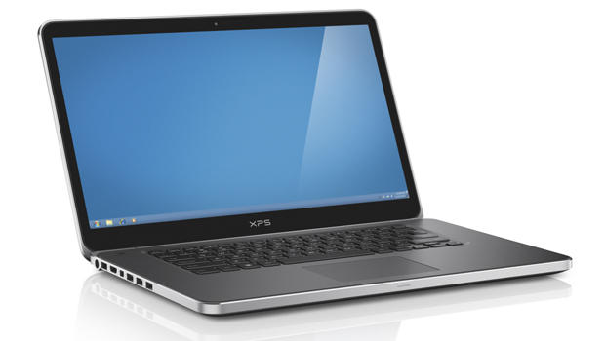
Task 1 - Hardware
OCR Cambridge Technicals Level 3

Slide 2
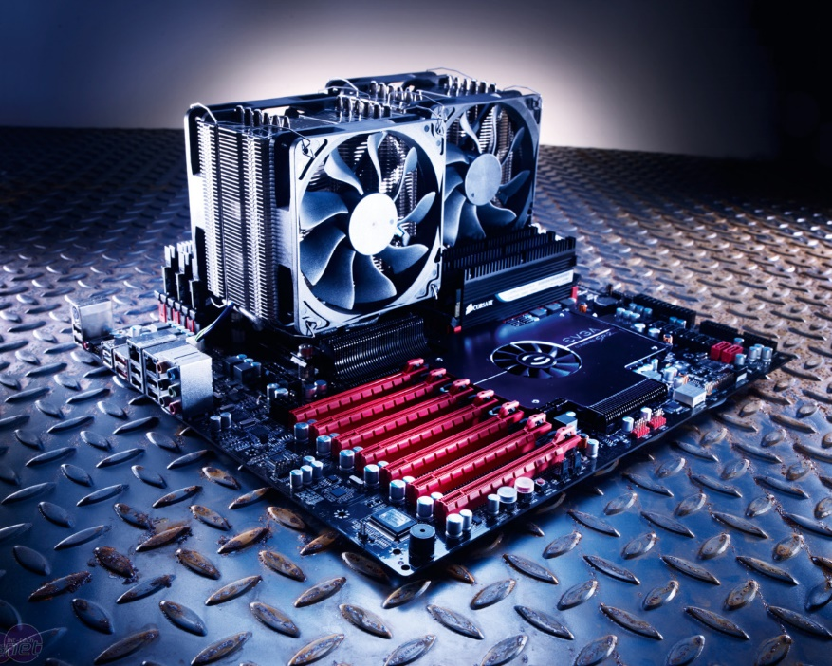
Computer Hardware Overview
Input devices
Output devices
Communications devices
Benefits (e.g. integrated devices make portable devices simpler to use)
Limitations (e.g. voice recognition performs poorly in noisy environments)
Uses (e.g. membrane keyboard)

Slide 3
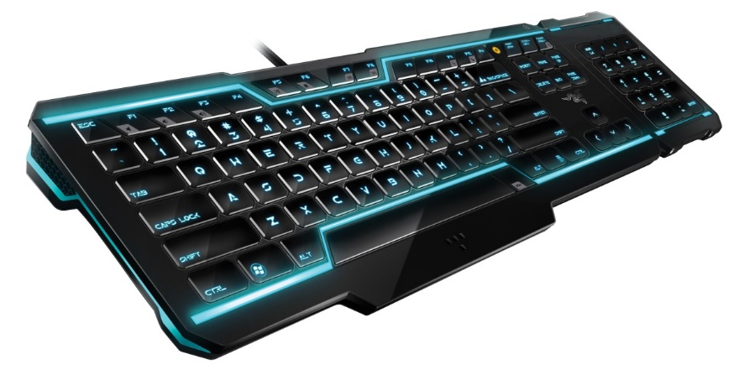
Input/Output
What is an input devices?
Input devices allow us to enter raw data into a computer. The computer processes the data and then produces outputs that we can understand using an output device. Input devices can be manual or automatic.
The processing is mainly handled by the Central Processing Unit (CPU).
Manual input devices
Automatic input devices
Central Processing Unit
Output devices

Slide 4
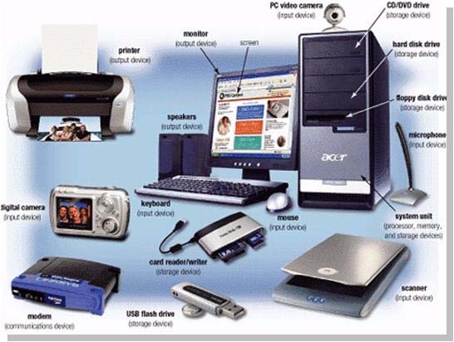
Input Devices
We live in an analogue world, so we need to convert this into a digital format. So we need devices to input into a digital way.
Write into your books about the following input devices and their conversations (How do they work):
Keyboard, Mouse, Touch Screen, Barcode Scanner, OMR, OCR and Joystick
Microphone, Sensors, Cameras and Sip Puff switches
Website you can use is www.howstuffworks.com
Ask your teacher for headphones if you wish to watch the videos.

Slide 5
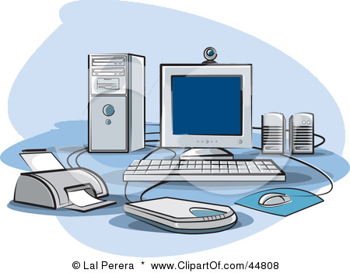
Input Devices
Camera
Web cams are now on most PCs and Laptops. Used for social networking or Skype but also may be used for iris or facial recognition
Key board
Known as the “Qwerty” keyboard because of the layout of the letters on the first row.
Scanner
Used to digitise images. They make a digital copy of data.
Mouse
Invented in 1963, and is now the most common form on input. Used to highlight, select and edit using sensors on the bottom
Microphone
Used to input sound and control the computer using voice recognition software.
Notes:
3mins Mini plenary, students say the parts as revealed.

Slide 6
Output Devices
We live in an analogue world, so we need to convert this into a back to a human format. So we need devices to output from a digital signal. Write into your books about the following output devices and their conversations (How do they work):
Monitor, Speakers, Printer, Actuator and LED’s
Website you can use is www.howstuffworks.com
Ask your teacher for headphones if you wish to watch the videos.

Slide 7
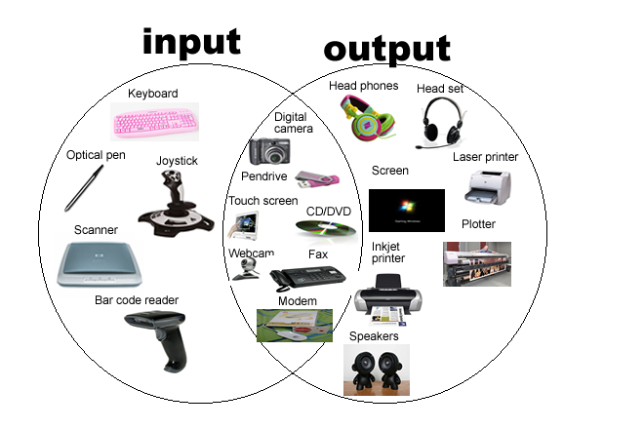

Slide 8
Other Devices
Graphics Tablet
A graphics tablet consists of a flat pad (the tablet) on which the user draws with a special pen. As the user draws on the pad the image is created on the screen. Using a graphics tablet a designer can produce very accurate on-screen drawings as if they were drawing on paper.
INPUT
Plotters
A plotter is a special kind of printer often used for producing complex technical line drawings which need to be really accurate. The plotter is like a robotic arm and a series of pens which draws the image on a large piece of apper
OUTPUT
RFID (Radio-Frequency Identification)
These are often used in shops to track items past sensors, e.g. baggage handling in airports, toll booths, car park access or in pet identification chips
INPUT
Notes:
2min

Slide 9
Other Devices
Sensors
Sensors are used on a wide range of applications including temperature, water level, light, pressure and motion sensors. Sensors are often found in computer control and more modern aeroplanes use sensors to provide automatic feedback.
INPUT
Barcode Reader
Bar code readers are used to scan barcodes from labels to identify an item and retrieve the data from a database
INPUT
Microphone
Microphone are used to input sound and can be used to control the computer using voice recognition software
INPUT
Notes:
1min

Slide 10
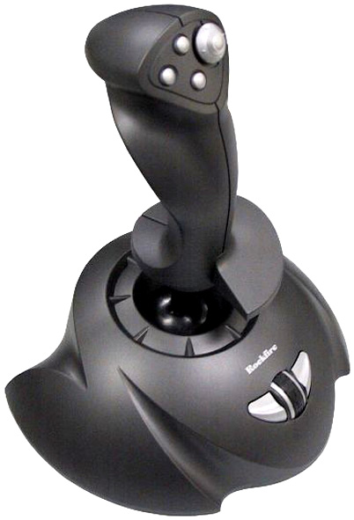
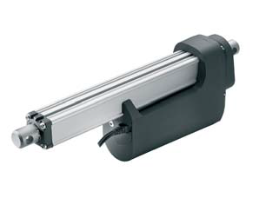
Other Devices
Joystick
Joysticks used to be popular with gamers but have slowly been replaced by other types of game controller. In construction, joysticks are used to control machinery such as cranes.
INPUT
Touch Screen
Alternative to a mouse or keyboard. Senses the users touch. Often used in phones, tablets, kiosks etc.
INPUT
Actuators
A computer system being used to monitor and control a mechanical system will need some way of outputting a physical change. In aeroplanes, actuators are mechanical devices which adjust various parts of the system such as flaps or engines based on the data input.
OUTPUT
Notes:
1min

Slide 11
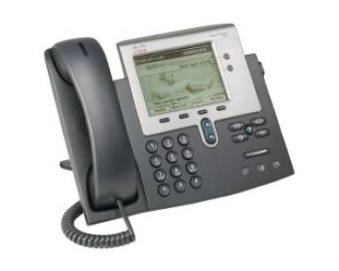
Communication Devices
A communication device is piece of equipment or hardware designed to move information or data from one place to another, in other words, allowing one computer device to communicate with another. There are many examples of communication devices and we will look at a few below.
Network interface card (NIC) or Network connector
Wi-fi cards
Router
Modem
What is the difference between a router and a modem?

Slide 12
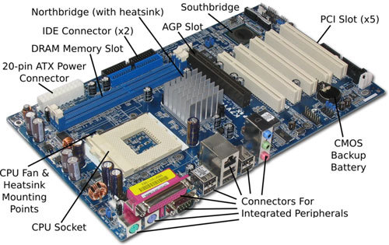
Today we’ll look inside the machine
Notes:
1min

Slide 13
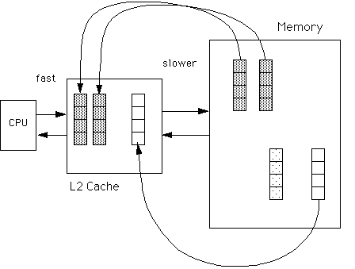
Central Processing Unit
The CPU is the brain of the computer
It is made up of the main memory, the processor and the cache.
The program instructions move between the main memory and the processor using internal connections called system buses
Cache is a small amount of rapid memory and can be small as 2mb
Draw the fetch-Execute diagram into your books. What is this?

Slide 14
Fetch and Execute Cycle
Fetch an instruction from the main memory
Decode the instruction
Execute the instruction
A program initially runs from the main memory, the processor then accesses it, the processor is given the location
One instruction is done each time on the fetch-execute cycle. The cache stores some of the instruction, so the processor does not have to wait

Slide 15
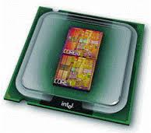
Dual Core Processor
Interface to bus and L2 Cache
CPU and L1 Cache
CPU and L1 Cache
Back Side Bus
Each CPU can do its own decode, execute and fetch code where some of each process is saved into the different cache
Goes to the Front Side Bus

Slide 16
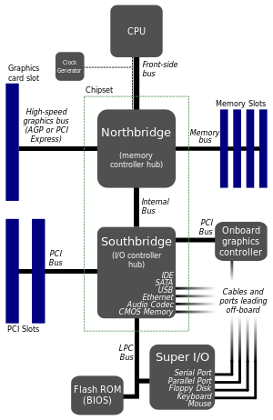
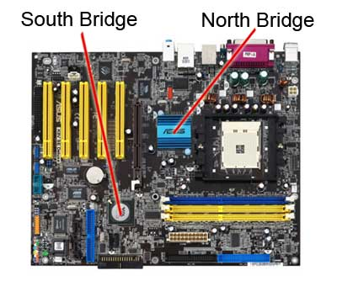
Northbridge and Southbridge

Slide 17
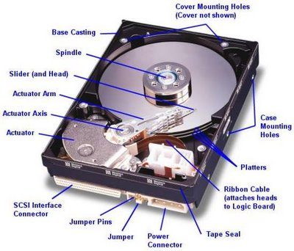
Memory
In computing, memory refers to the physical devices used to store programs (sequences of instructions) or data (e.g. program state information) on a temporary or permanent basis for use in a computer or other digital electronic device.
Look to the following website, it goes over the different types of memory, disk partioning, virtual memory, etc. Make some notes from the website.
http://bit.ly/memoryking

Slide 18
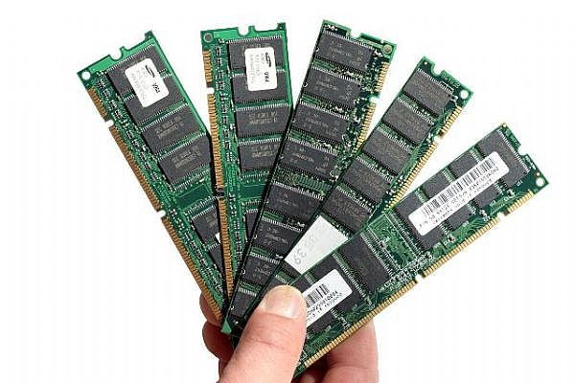
RAM – Random Access Memory
RAM helps with the normal processes of the computer, it helps with holding small bits of information for the CPU.
It is expensive and comes in smaller amounts.
All of the data stored on the RAM disappears when the computer is switched off.
RAM stands for Random Access Memory, as any part of the RAM can be accessed at anytime (a tape cassette is the opposite to this as it can only be accessed via a linear way)

Slide 19
Access Speed gets Slower
Access
Speeds
Cache
Get
Main Memory/RAM
Slower
Processor
Virtual Memory (on Hard Drive)

Slide 20
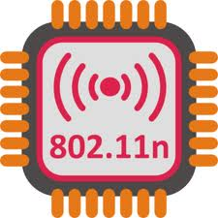
ROM – Read Only Memory
ROM is a chip on your motherboard. It holds essential data to load up the computer
It is an unchangeable piece of memory, it therefore is very hard to change the data on it
ROM is therefore used on storage devices where it is not easy to change the data like a CD-ROM

Slide 21
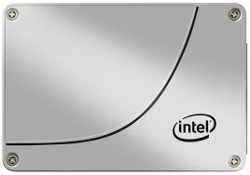
Hard Drive (HDD) and Solid State Drive (SSD)
Think of a hard drive as a filing cabinet, it is easy to take stuff out, delete files and modify them.
The size of the hard drives have consistently gone up and become smaller
Why should you never just turn a computer straight off and remove disks safely?
Link here to YouTube video
Difference between SSD and HDD

Slide 22
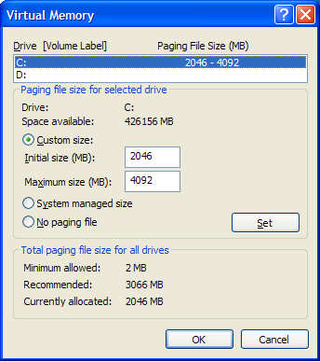
Virtual Memory
Sometimes the main memory is just not enough (think about how many programs may be running at one time!)
Part of the hard drive can be assigned to be behave like the main memory
The access speed of the hard drive is a lot slower than the main memory
Sometimes this does not always work out well, it can take a long time to access the virtual memory, sometimes longer than doing the fetch, decode and execute cycle

Slide 23
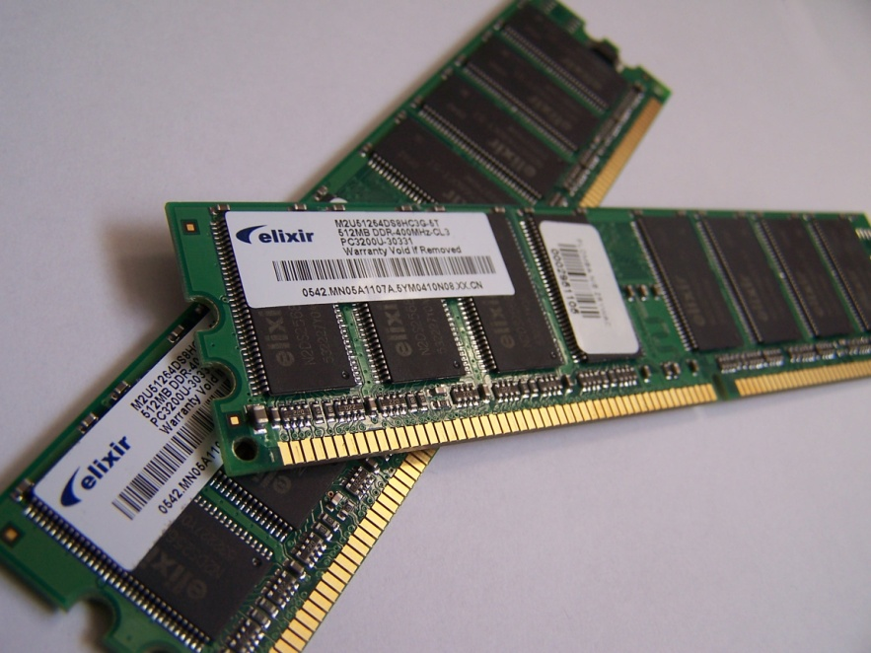
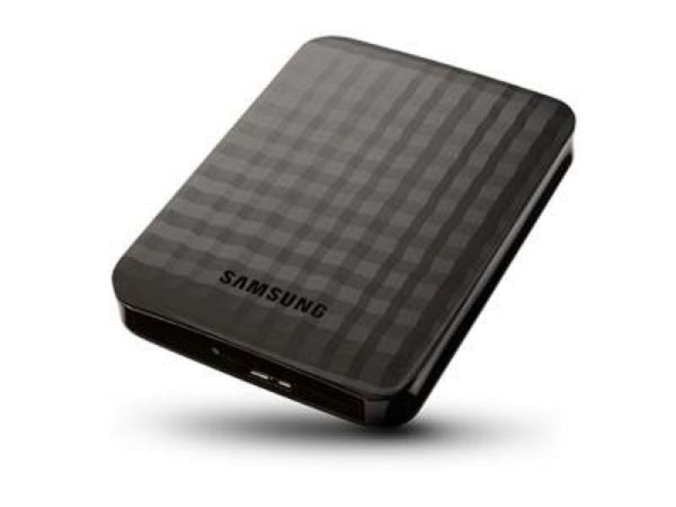
Volatility
When you are in the middle of some work and the computer gets turned off then you lose your work.
This is because the recent copy is saved into the RAM, the previous saved version is on the hard drive

Slide 24
Difference between RAM and Rom

Slide 25
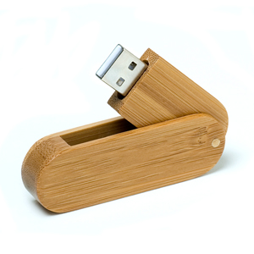
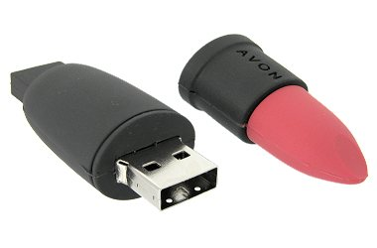
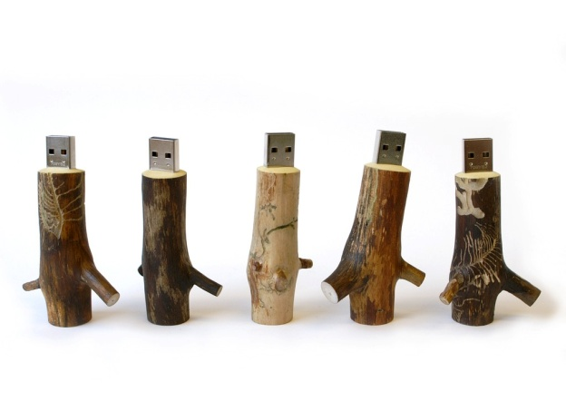
Secondary Storage
Look into your books – Page 28, answer the following questions:
Explain the need for secondary storage
Describe the different storages such as optical, magnetic and solid state
Describe Flash Memory
Compare the capacity of the storage media

Slide 26
Secondary Storage
Look into your books – Page 28, answer the following questions:
Explain the need for secondary storage
Describe the different storages such as optical, magnetic and solid state
Describe Flash Memory
Compare the capacity of the storage media

Slide 27
Secondary Storage
We all want to store files over a long period of time like photographs, music, films, documents
Secondary memory or storage is much larger than primary storage. It needs to be non-volatile, robust, cheap and reliable.
Has your memory stick been through the washing machine?
There are three different storage technologies: Magnetic, Optical and Solid State

Slide 28
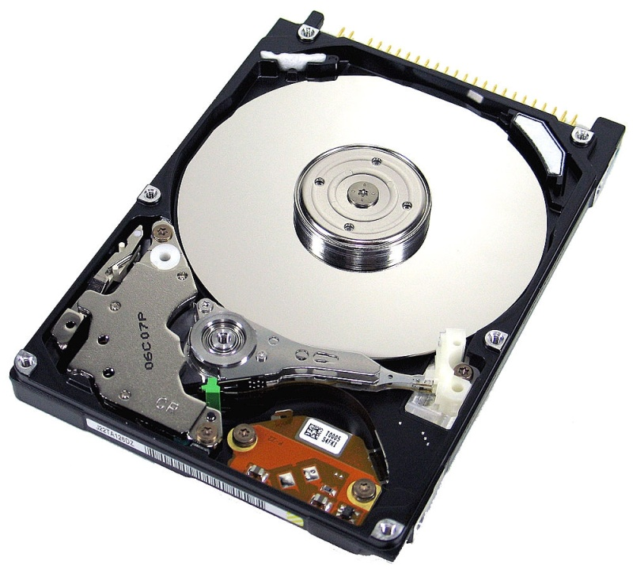
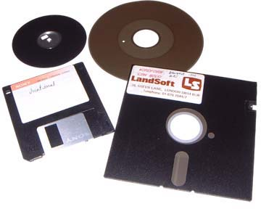
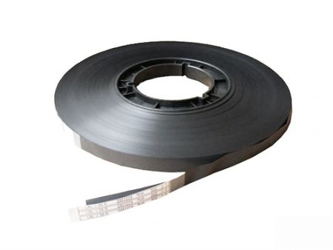
Magnetic Storage
This is the oldest technology and used in tapes/floppy disks/Hard Drives (although was expensive initially)
Read using a moving head, slow to write to but vulnerable to damage
Large capacity, good for backups and archiving
The preferred hard drive of the X-Men’s nemesis Magneto

Slide 29
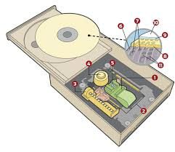
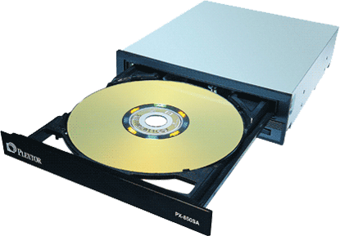
Optical Storage
An optical disk drive uses light sabres to strike down the evil of the dark side.
The laser light read/writes the information of the CD/DVD
The discs and the drives are very cheap, good for medium term use but degrade over time. They cane be slow to load.

Slide 30
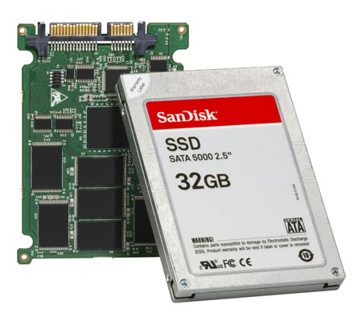
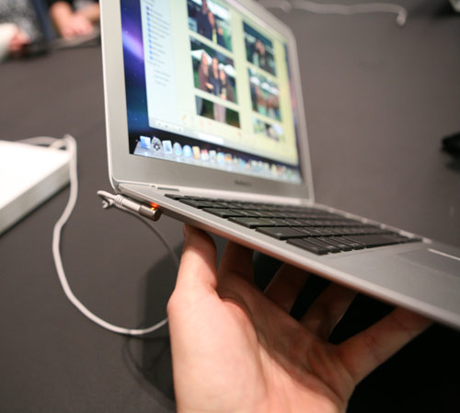
Flash/Solid State Storage
These methods of storage have no moveable parts.
Therefore there accessible speeds are good (not as fast as RAM though) and more reliable (moving parts often break).
These drives cost more money and are typical used in notebooks, tablets, slim laptops and cameras.

Slide 31
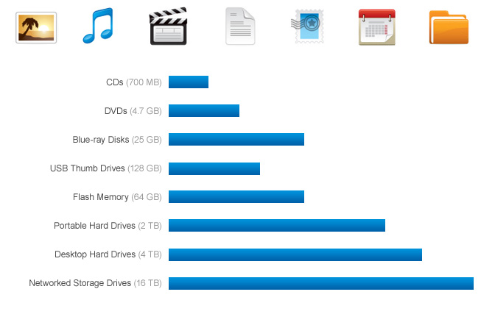
Storage Capacity

Slide 32
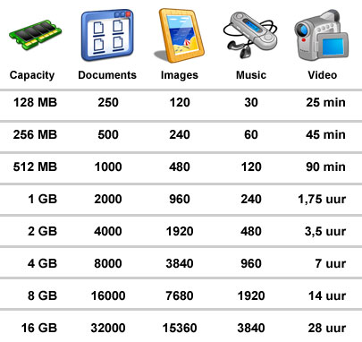
Storage Capacity

Slide 33
Computer Specs
Bought a computer, confused by the specs?
Notes:
1min Q&A

Slide 34
Looking at specifications of a PC
Below are some links to some PC sales website.
Get familiar with the specifications
In particular to the processor speeds and types. What are the clock speeds?
http://www.dabs.com/
http://www.ebuyer.com/
http://www.pcworld.co.uk

Slide 35
Examples
These are 2 different main types of CPU/Processor manufacturer
 | Computer 1 | Computer 2
Processor | AMD | Intel Xeon
Processor speed | 1.7 GHz | 3.4GHz
Cores | 2-Cores | 6-Cores
Cache Memory | 1MB | 15MB
RAM | 4GB (8GB Max) | 8 GB (64GB Max)
Hard Drive | 500GB | 2TB
Price
This is how many billons of processes it can run second.
This essentially means the amount of processing circuits/CPUs that can run at one time
Cache (“Cash”) memory is built into the CPU and is therefore SUPER fast but SUPER expensive
RAM is quick memory which is used to run applications and programs
£279.59
The hard drive is the amount of physical data which can be stored.
£2,199.99
Notes:
2min Q&A Class answer what each of them mean so we have a basic grounding.

Slide 36
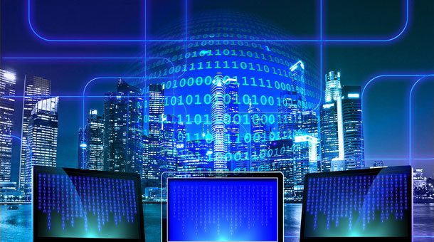
Types of Computer Systems
Desktop/server
Tablet/hybrid
Smartphone
Embedded system/Internet of Things (e.g. cars, home appliances, etc.)
Mainframe
Quantum
Uses (e.g. tablet device can be used when travelling due to physical properties)
Benefits (e.g. desktop computer can have a large screen which can improve productivity)
Limitations (e.g. mainframes can be expensive to purchase and maintain)

Slide 37
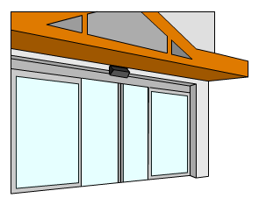
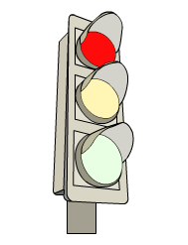
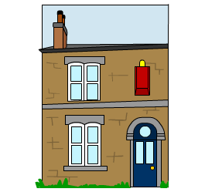
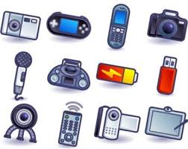
Computer systems are part of everyday life. They are all around us.
Any device that has a chip or computing electronic device within it is called a “Computer System”

Slide 38
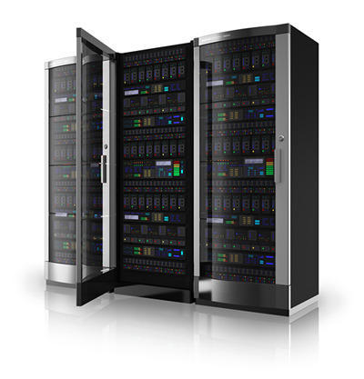
Desktop/Server
Use:
In a technical sense, a server is an instance of a computer program that accepts and responds to requests made by another program, known as a client.
Benefits:
All files are stored in a central location
Network peripherals are controlled centrally
User can access shared data
Limitations:
A specialist network OS is needed
The server is expensive to purchase
Specialist staff are required such as a network manager
If any part of the network fails, a lot of disruption can occur
Notes:
2min Q&A Class answer what each of them mean so we have a basic grounding.

Slide 39
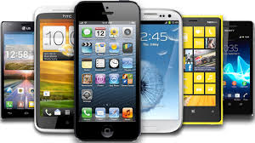
Smartphone
Use:
A mobile phone that performs many of the functions of a computer, typically having a touchscreen interface, Internet access, and an operating system capable of running downloaded apps.
Benefits:
Easy to use
Easy to communicate with friends, family and co-workers
Constant internet access
Applications and all in one device
Limitations:
Hinders real human interaction
Lead to some pretty serious accidents
Breaches of privacy and security
Poor battery life

Slide 40
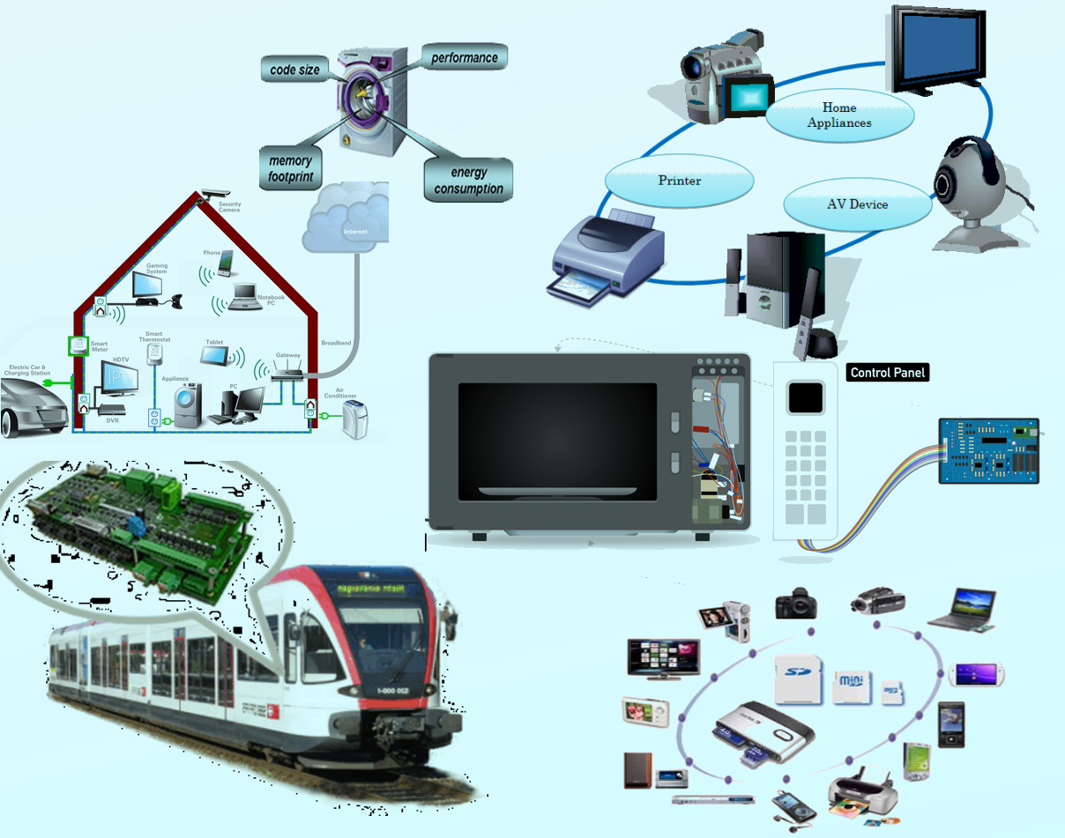
Embedded Systems
Use:
The interconnection via the Internet of computing devices embedded in everyday objects, enabling them to send and receive data.
Benefits:
Data: Knowing what to get from the grocery while you are out, without having to check on your own, not only saves time but is convenient as well.
Time: The amount of time saved in monitoring and the number of trips done otherwise would be tremendous.
Money: The financial aspect is the best advantage. This technology could replace humans who are in charge of monitoring and maintaining supplies.
Limitations:
Compatibility: As of now, there is no standard for tagging and monitoring with sensors. A uniform concept like the USB or Bluetooth is required which should not be that difficult to do.
Complexity: There are several opportunities for failure with complex systems. For example, both you and your spouse may receive messages that the milk is over and both of you may end up buying the same.
Privacy/Security: Privacy is a big issue with IoT. All the data must be encrypted so that data about your financial status or how much milk you consume isn’t common knowledge at the work place or with your friends.
Safety: There is a chance that the software can be hacked
Notes:
2min Q&A Class answer what each of them mean so we have a basic grounding.

Slide 41
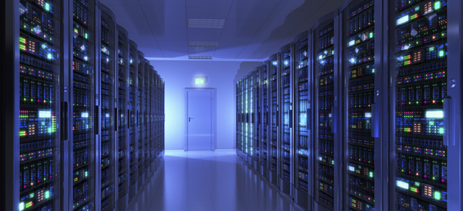
Mainframe
Use:
Mainframes are typically built by IBM and usually run z/OS. A server (when referred to in the hardware sense) is a PC with higher reliability / quality parts and runs usually a *NIX variant, or Windows Server.
Benefits:
The physical size and the hardware components of a mainframe computer are different than the ones of a regular computer, making mainframes more complicated to set up.
A major advantage of mainframes is that they are very stable compared to other types of computers.
Limitations:
One of the most noticeable disadvantages of a mainframe computer is its cost, which is significantly higher than the cost of a regular computer.

Slide 42
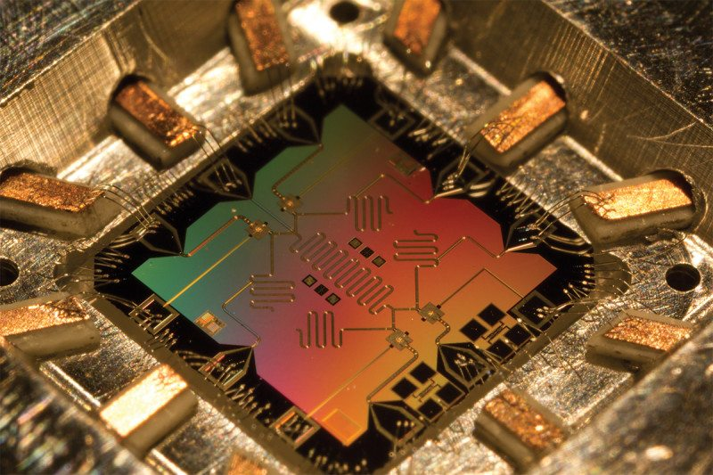
Quantum Computer
Use:
Quantum computers use the power of atoms to perform memory and processing tasks.
Benefits:
The main advantage of quantum computing is it can execute any task very faster when compared to the classical computer, generally the atoms changes very faster in case of the traditional computing whereas in quantum computing it changes even more faster.
Limitations:
The technology needed to build a quantum computer is currently beyond our reach.

Slide 43
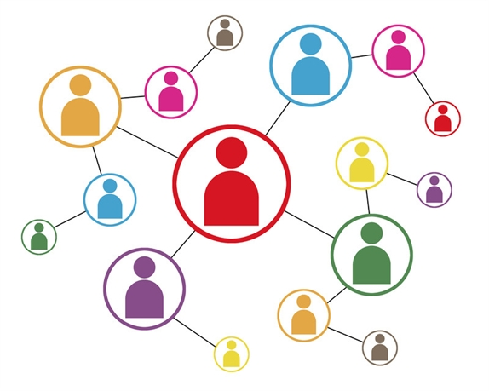
Connectivity Methods
Copper
Fibre
Wireless technologies (Bluetooth, WiFi, microwave, infrared, laser, Satellite, GSM, 3G/4G and future technologies)
You Tube Video (DSL, Copper and Fibre) - https://www.youtube.com/watch?v=dYaB3Uqygoc
Different Wireless Technologies - https://www.youtube.com/watch?v=CYGm5nkTuFM

Slide 44
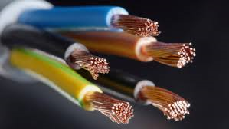
Copper Connections
Copper cable uses electrical signals to pass data between networks. There are three types of copper cable: coaxial, unshielded twisted pair and shielded twisted pair.
Advantages
a cabled telephone can be powered directly from the copper cable, so the phone will still work if there is a loss of power
copper can be cheaper to set up than fibre optic cabling
Disadvantages
degenerates over long distances

Slide 45
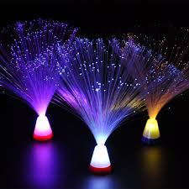
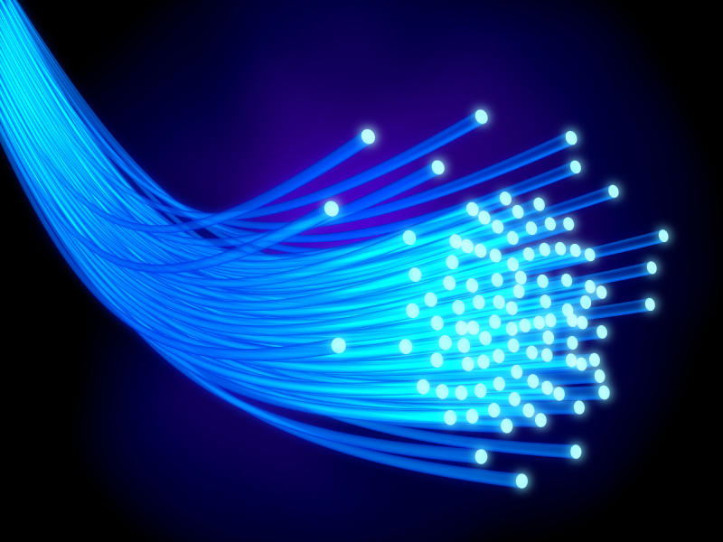
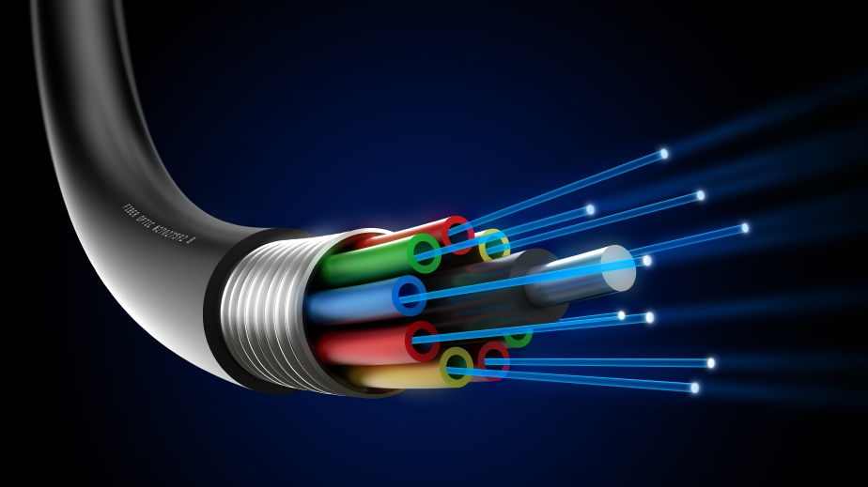
Fibre Connections
Fibre optic cable is widely used for larger LAN installations where cable runs exceed 100 metres or so, where copper cable would struggle with weakening signals. It is also widely used where extreme bandwidth is required for example cable television and high speed internet access.

Slide 46
Media Types: STP/Cat5/Coaxial/UTP/FibreOptic
CABLE: | Stp (Sheilded twisted pair) | Utp (Unshielded twisted pair) | CAT5e | CO-AXIAL | FIBRE-OPTIC
SPEED: | 1000mb/s | 100 mb/s | 1000 mb/s | 100 mb/s | Up to 10 GB’s per second.
COST: | Cheap. (though more costly than unshielded) | Cheap. | Industry standard (reasonable price) | V.Cheap. | Expensive per meter.

Slide 47
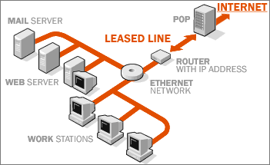
Leased Lines/Dedicated Line
SPEED: Leased lines where a customer leases time/download speed. Similar to home broadband/ADSL. Shared with other customers.
COST: Leased lines vary in cost, though are always less than a dedicated line.
SPEED: Dedicated lines are where the customer pays the ownership of the communication and line. The benefit is that it’s more secure (no need for VPN).
COST: This is more expensive.

Slide 48
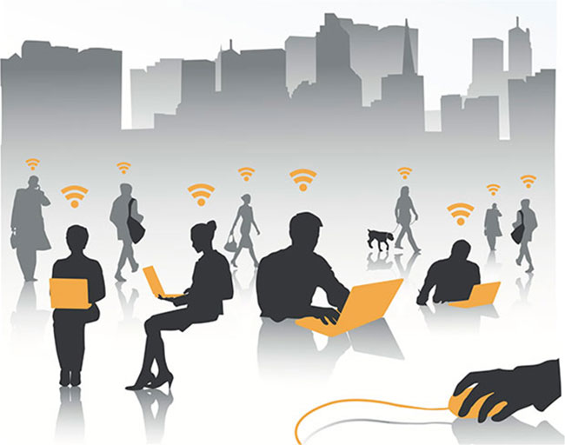
Wireless Connection
Wireless networks rely on high frequency radio communication up to 100m. They can be affected by to noise/interference which can cause limitations. A good network has a WAP (Wireless access) a bridge and ensures devices such as laptops have a connection. SPEED’s & Costs: Vary based on the devices used. N standard wifi is 450mb/s.
3G and 4G: 3g is 6.1 Mb/s and 4G is 15.1 Mb/s. It is communicated by satellite data transmission to transfer data at high speed. It is used in small businesses and has become cheaper over the last 10 years. They operate using microwaves which are used in both WIFI and 3G.

Slide 49
Cable/Connection Standards
Cable/Connection Standard | Description
802.3 | 10mb/s co-axial
802.3E | 1 mb/s (unshielded twisted pair)
802.3I | 10 mb/s over twisted pair.
802.3AK | 10 GB over unshielded twisted paid
802.3AN | 10 GB over unshielded twisted pair
802.3AQ | 10 GB over multi-mode fibre (fibre optic)

Slide 50
Communication Hardware
Router
Forwards data packets to the appropriate parts of the network.
Allows the Internet connection to be shared by multiple devices
Modem
Converts between digital and analogue signals.
Must be used so that computers (digital) can connect to the Internet through telephone lines (analogue).

Slide 51
Communication Hardware
Hub
A hub is typically the least expensive, least intelligent, and least complicated of the three. Its job is very simple – anything that comes in one port is sent out to the others.
Switch
A switch does essentially what a hub does, but more efficiently. By paying attention to the traffic that comes across it, it can “learn” where particular addresses are.

Slide 52
File Sizes – The differences
Find examples through online research of files which would be no bigger than each example:
No bigger than a KB
No bigger than a MB
No bigger than a GB
No bigger than a TB
Add images of the file types.
When done, write a reminder in your book to help you convert between each.
Notes:
10mins hand out A4 sheets.

Slide 53
How many? Bits/Bytes?
How many? Bits in a byte etc.: Convert all using your notes.
Bit 1/0
Nibble 4bits
Byte: 8bits
Kilobyte: 1000bits
Kibibit:1024bits
megabit:1000 kilobits
GB=1000mbs
Tb=1000GB’s
Petabit=1000Tb’s

Slide 54
Converting Binary and Denary

Slide 55
Denary to Binary
Convert to Denary using the subtraction method
Is it >=128?
Subtract and do the same.
Complete the sheet once done.

Slide 56
Denary to Binary
You already know about base 10 (Decimal/Denary)
Base 2: Binary
x10
x10
x10
1000
100
10
1
1
2
3
4
x2
x2
x2
8
4
2
1
1
0
1
1

Slide 57
Why do we need binary numbers?
Because computers work on the principle of 2 states, that something is either ON/TRUE or OFF/FALSE.
This can only be done with base 2 (binary)
If it was done with decimal/base 10 there would be 10 different states!
Real life example: colour codes

Slide 58
The problem with binary…
There is one big problem with binary…numbers can become VERY long!
In order to make it easier for a human programmers to work with binary numbers, they use the hexadecimal system (like a binary shortcut)
F0
Not
11110000

Slide 59
Hex, Binary and Decimal

Slide 60
Hexadecimal numbers
Programmers often write numbers down in hexadecimal (hex) form.
Hexadecimal numbers are based on the number 16.
They have 16 different digits: 0, 1, 2, 3, 4, 5, 6, 7, 8, 9, A, B, C, D, E, F

Slide 61
You convert denary to hex in the same was as binary
Convert the denary number 45 into a hex number
Step 1: How many times does 16 go into 45?
45 / 16 = 2 (with 13 remaining)
Step 2: How many times does 13 go into 1?
13! 13 in hex is D
16 | 1

Slide 62
Hexadecimal Numbers
We can convert denary numbers to hexadecimal by repeated division just as we did to get binary numbers.
Take the denary number 141.
We have the hexadecimal values 8 and 13 as remainders.
13 in hexadecimal is D.
So, reading from the bottom again (where necessary), 141 in hexadecimal is 8D.
 | Result | Remainder
141 ÷ 16 = | 8 | 13

Slide 63
Denary into Hex Example
Convert the denary number 199 into a hex number
Step 1: How many times does 16 go into 199?
199 / 16 = 12 (with 7 remaining)
Step 2: 12 in hex is C
Step 2: How many times does 7 go into 1?
7! 7 in hex is 7!
16 | 1

Slide 64
Hex to Binary Conversion
To convert from hexadecimal to binary treat each digit separately. It may be easier to go via denary to get a binary number.
So DB in hexadecimal is 11011011 in binary.
Hex | D |  |  |  |  | B
Denary | 13 |  |  |  |  | 11
Binary | 1 | 1 | 0 | 1 |  | 1 | 0 | 1 | 1

