Slide 1
What do each of these mean?
Open books, title ‘Business Systems’ (date 20-1-2017)
Match terms to the acronym
MIS –
CRM -
SOP –
Help Desk -
Operating, Relations, Standard, Management, System, Information, Procedure, Management, Customer… Help Desk?
Notes:
10min copy files and answer

Slide 2
What do each of these mean?
Open books, title ‘Business Systems’ (date 20-1-2017)
Match terms to the acronym
MIS – Management information system (LIKE SIMS)
CRM – Customer Relations management (customers stored details)
SOP – Standard operating procedure (HOW-To, for work)
Help Desk –To help with common issues.
Notes:
10min copy files and answer

Slide 3
Objectives
know a range a connectivity methods
Understand their characteristics
Know when each would be used
Complete a descriptive table of the key connectivity methods
Explain their characteristics and purpose
Complete an example exam question on the topic
Notes:
1min

Slide 4
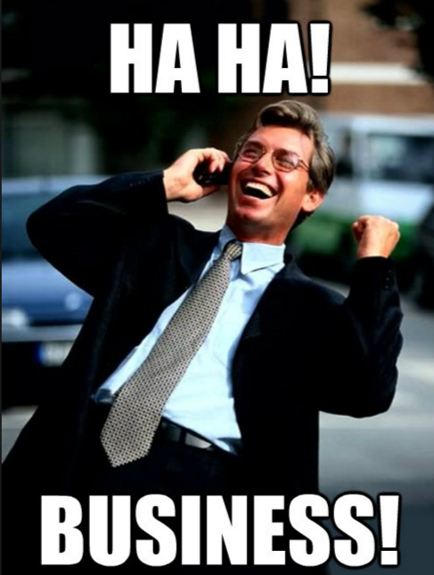
Mis
Software to gather data (Registers/Product sales)
Analyse that data (Who is absent?/What sells most)
Organises with access rights (Head-Teacher gets overall report Teachers get tutor reports Business Manager gets yearly sales Shop gets given targets based on last years report aiming for like-for-like improvement)

Slide 5
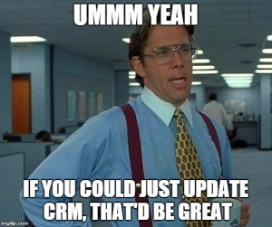
CRM – Customer relation manager
Tracks business interaction with customer
Holds records of meetings/calls.
Available to those with access rights.
Aimed at sales/customer support. EG: Phone calls for services (Phone contract update – noted if sold/not)
Pro: Creates new business.
Con: Limited by data storage size (if attaching files wont fit

Slide 6
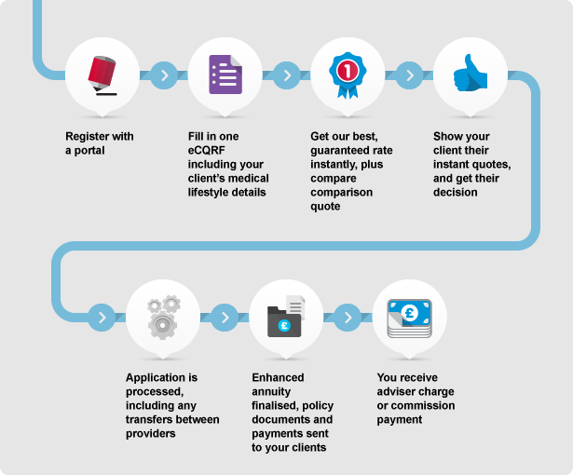
SOP – Standard operating procedure
Step-by-step guides to show how to carry out functions in a business.
Issues: Can impose restrictions which leads to inflexible practice.
Too much time spent on admin, not the job.

Slide 7
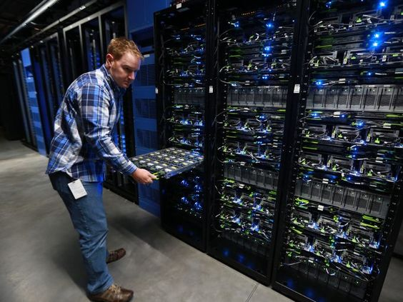
Help desk
Large computer system? Technical problem? Technicians needed to fix it. Either instructions to the user or actioned by technicians visiting.
Con, Costly to set up, hardware/ Staff needed.
Issues with avaliable, are they needed 24/7?
Loss of service if comms down

Slide 8
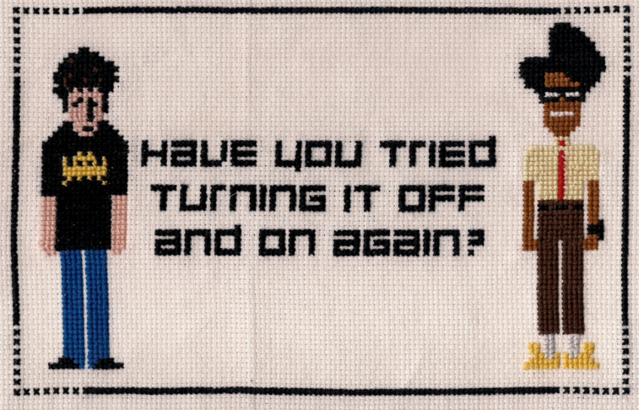
Main Task
Using the fact sheets to complete descriptions and pro’s/con’s.
Complete? Choose a topic to create a new poster on, emphising the pro’s. (Use Publisher, choose own pics from the web, include all pro’s) eg: New Helpdesk coming to Renham industries! Computer issues quickly solved! Expert Team

Slide 9
Exam question
Reynholm Industries are looking to set up a helpdesk. What issues must they consider? [4 marks]
Answer:
Cost of hardware/software to set up, cost of staff.
Cost of buying services from a third party.
Issues with availability, is it needed 24hrs?
Loss of service through breakdown of comms.

