Slide 1
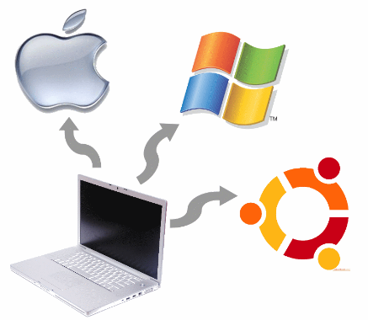
Technicals Level 3 Unit 1 Topic 2 Software
**YOUR NAME HERE**

Slide 2
1 Types of software (In books)
Open Source: Written by many programmers not for a company. Anyone can add to or change the code. For example, linux operating system.
Closed Source: Closely guarded and protected by intellectual property rights. When purchasing you have the right to use, but not edit the code. For example, Windows.
Off-the-shelf: purchasable software. Bespoke: Made for a specific purpose such as factory machines Shareware: Free for a period of time (trial software).
Freeware: Free to use software, such as iTunes, may be restrictions/no upgrade/warranty.
Embedded software: Software which is embedded into traditional PC’s or devices not considered computers, such as microwaves, GPS devices, smart watches etc.

Slide 3
2. Application Software
Purpose, Adv./Disadvantage of each: word processor, spreadsheet, database, email

Slide 4
3. Developer Software
Purpose, Adv./Dis of each:
compiler, debugger, translator, integrated design environment

Slide 5
4. Business Software
Purpose, Adv/Disadvantage of each:
MIS, multimedia, collaboration, project management, manufacturing, CAD/CAM, publishing, expert systems, healthcare

Slide 6
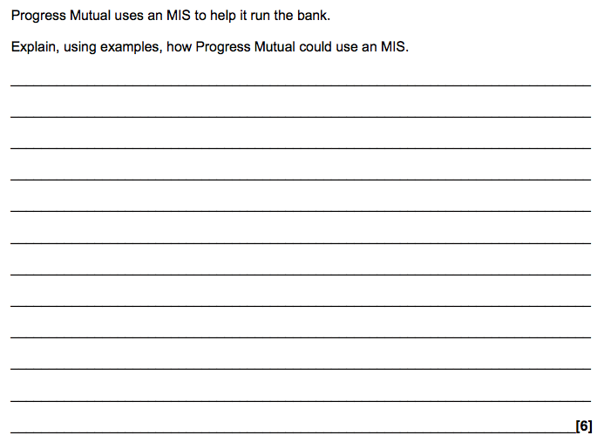
4. Business Software Exam Question

Slide 7
4. Business Software Exam Question
Answer (Move Shape)

Slide 8
5. Utility Software
Define these keywords:
Server:
Spyware:
Firewall:
Defragmentation:
Back-up: Anti-Virus:
Compression:

Slide 9
5. Utility Software
Security
Anti-Virus:
Define, Give Advantages & Disadvantages

Slide 10
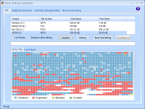
5. Utility Software
Disk Organisation (Compression)
Defragmentation: Give definition, advantage & Disadvantages
Disk cleanup: Give definition, advantage & Disadvantages

Slide 11
5. Utility Software
Back-ups
Give definition, advantages/disadvantages:

Slide 12
5. Utilities
Use the internet to find out about the “I love you” virus that wreaked havoc in 2000 and inspired a film in 2011.
How did it infect PCs around the world so quickly?
Who did it affect?
What solutions were there to prevent it?

Slide 13
6 Operating systems question
State what is meant by the term software.
Describe what is meant by the term operating system.

Slide 14
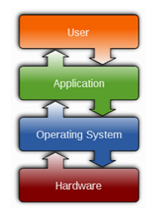
6 Operating system
Describe the follow functions of an OS:
File management:
Multi-tasking:
Security:
Connectivity of portable media:

Slide 15
Try a command line interface
Google: Linux Command line emulator & try the following commands: what do they do?
Type in ‘ls’ & Enter (That’s L in lower-cAsE)
Type in ‘ls –l’ & Enter
Type in ‘mkdir MyFirstFolder’ & Enter
Type in ls & Enter again.
Whats happened?
Type in ‘cd MyFirstFolder’ & Enter
Type in ‘ls’
Type in ‘touch bob’ – what does this do?
Notes:
2mins Big Picture. Comparing.

Slide 16
6 Operating Systems
For Linux, Windows and MacOS describe each or their abilites regarding: >Single Users/MultiUsers >Single Processor/Multiprocessor >Off the shelf/open-source/bespoke >Functions >Benefits/Limitations

Slide 17
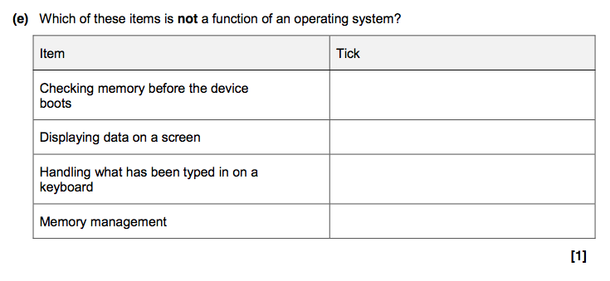
6 Functions of OS EXAM Q

Slide 18
7 Operating Systems
For Linux, Windows and MacOS give adv/disadvantages based on: >Single Users/MultiUsers >Single Processor/Multiprocessor >Off the shelf/open-source/bespoke >Functions >Benefits/Limitations

Slide 19
8. Mid Unit Test
Write down the meaning of each of these Keywords, to do with computing software. (Use the book to help)
Software:
Application:
Platform:
Program Language:
Multi-tasking:
Command Line: Graphical User Interface:
Device Driver:
Embedded System:
Utility:
Firewall:
Custom Written: Off the shelf:

Slide 20
8. First Test
Based on Types of Software
Application Software
Developer Software
Utility Software
Operating Systems & Functions
Highlight the topic you were least sure on, complete the lesson ppt’s and create a revision page in your book on this topic.

Slide 21
9. Communication Methods
Think What ways your devices at home connect and send/receive information with each other: Can you name 5 different ways? :
Check by moving this box
Wifi, Blutooth, Ethernet, Infra-Red, Cellular.

Slide 22
9 Communication methods
Give purpose, adv./disadvantages for each:
• SMS
• email
• messaging software
• social networking
• VoIP
• personal assistants (e.g. Siri, Cortana)
• teleconference
• video conference
• cellular/satellite
• instant messaging

Slide 23
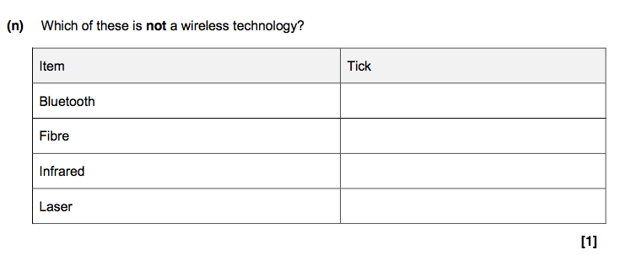
9. Communication Methods Exam Question

Slide 24
10. Software troubleshooting
Investigate each, and explain why different tools are used in different contexts, justifying their use. • common faults (e.g. unexpected software
behaviour, software freeze, unexpected rebooting)
• troubleshooting tools to investigate a problem (e.g.
logs, installable tools, baselines)
• documentation (e.g. types of documentation)

Slide 25
11.Protocols
How does a computer know to send website info back to your computer when you request it?
Answer
Answer: It knows your IP Address, (this stands for internet protocol) it was sent along with your computers request for the website. The website then sends information back to this address.
Protocols are the codes/conventions for sending information. It is like a language.

Slide 26
11. Protocols
For each of the protocols explain what the acronym means, & what the protocol purpose is: IP TCP UDP SMTP FTP HTTP SNMP ICMP POP

Slide 27
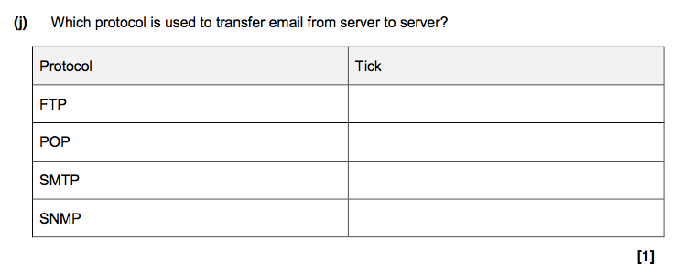
11. Protocol EXAM Question

Slide 28
11 Protocols
In networking they standardise the way different devices talk to one another – sometimes known as a handshake.
The internet uses a model called TCP/IP (Transmission Control Protocol / Internet Protocol), which contains a number of different sets of rules to control different types of communication – the rule sets are known as a protocol suite.
The TCP part deals with communicating between applications in your computer – e.g. web browser to OS to NIC driver,
The IP part controls communication between different devices.

Slide 29
11 TCP/IP Model
The TCP/IP (transport control protocol / internet protocol) has 4 different layers,
Source Device
Destination Device
Application
Application
Transport
Transport
Internet
Internet
Link
Link

Slide 30
11. TCP/IP
Describe each Layer & Its purpose: Application: Transport: Internet: Link:

Slide 31
13. Unit Review
Score each out of 10 for confidence to know where to start when revising.
Types of Software
Application Software
Developer Software
Business Software
Utility Software
Operating Systems & Pro’s/Con’s
Communication Methods
Software Troubleshooting
Protocol & TCP/IP Model

