Slide 1
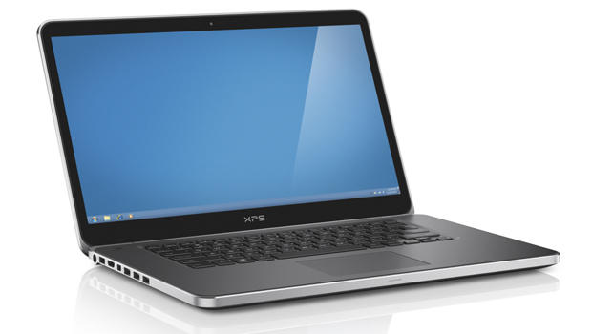
Year 12 Induction
Unit 1 insight – Hardware and software of a computer

Slide 2
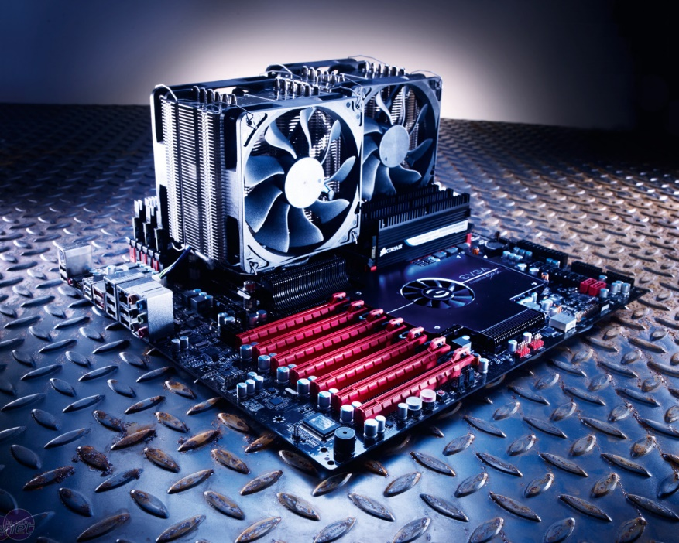
Computer Hardware
input devices
output devices
communications devices
benefits (e.g. integrated devices make portable devices simpler to use)
limitations (e.g. voice recognition performs poorly in noisy environments)
uses (e.g. membrane keyboard)

Slide 3
Learning Objectives
Learners should know about the different types of computer hardware required for a variety of computer systems.
This should lead into learners developing their understanding of their benefits, limitations and uses.

Slide 4
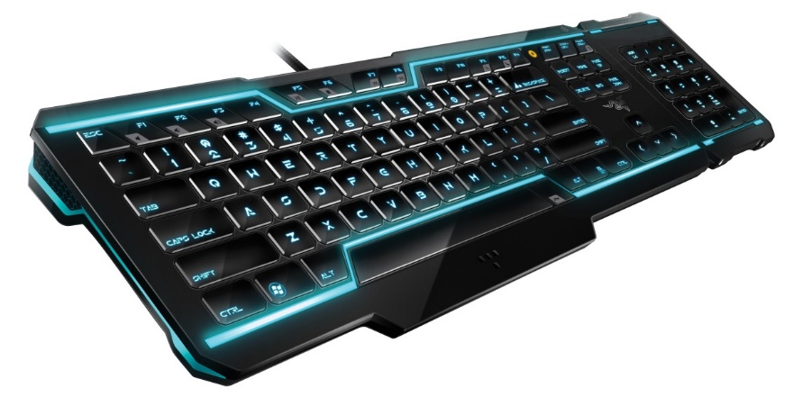
Input/Output
What is an input devices?
Input devices allow us to enter raw data into a computer. The computer processes the data and then produces outputs that we can understand using an output device. Input devices can be manual or automatic.
The processing is mainly handled by the Central Processing Unit (CPU).
Manual input devices
Automatic input devices
Central Processing Unit
Output devices

Slide 5
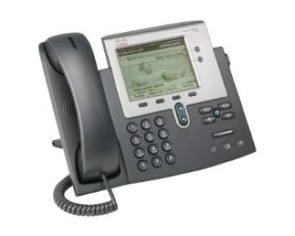
Communication Devices
A communication device is piece of equipment or hardware designed to move information or data from one place to another, in other words, allowing one computer device to communicate with another. There are many examples of communication devices and we will look at a few below.
Network interface card (NIC) or Network connector
Wi-fi cards
Router
Modem
What is the difference between a router and a modem?

Slide 6
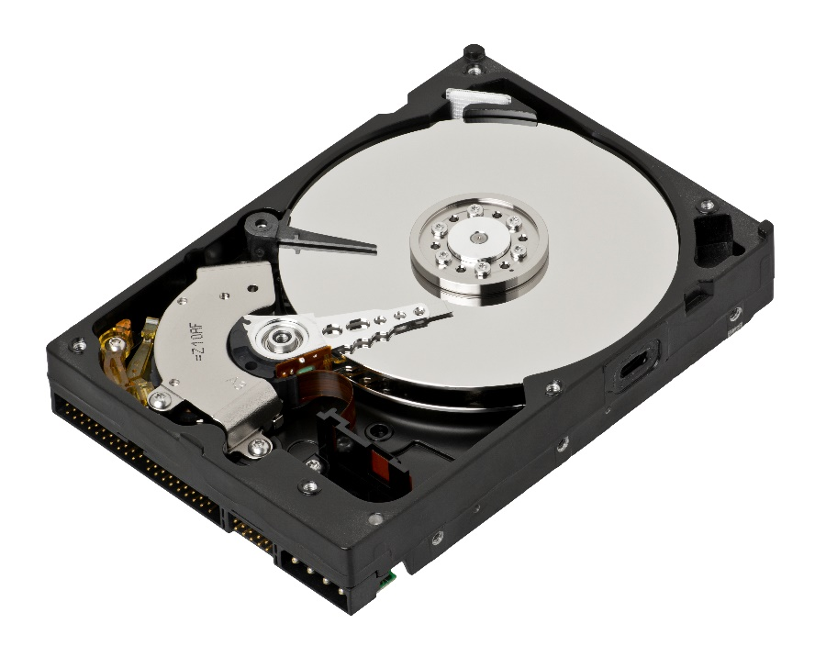
Storage Devices
Once data has been entered into a computer and processed, it needs to be stored. It may only need to be stored temporarily, i.e. whilst it is being used or it might need to be stored permanently so that it is available for use at a later date.
A storage device is any media which is used to store data. For example, the photo opposite shows the platters and reading head inside a hard disk.
hard disk
DVDs
CDs
magnetic tape
flash memory (USB memory sticks)

Slide 7
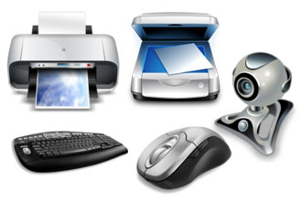
Peripheral Devices
A peripheral is any hardware device which connects to the computer and is controlled by the Central Processing Unit (CPU) - with the exception of memory.
When you are trying to think of examples of peripherals, think of things which plug into the back of the computer casing, for example:
monitor
keyboard
mouse
printer
scanner
speakers
external hard drive

Slide 8
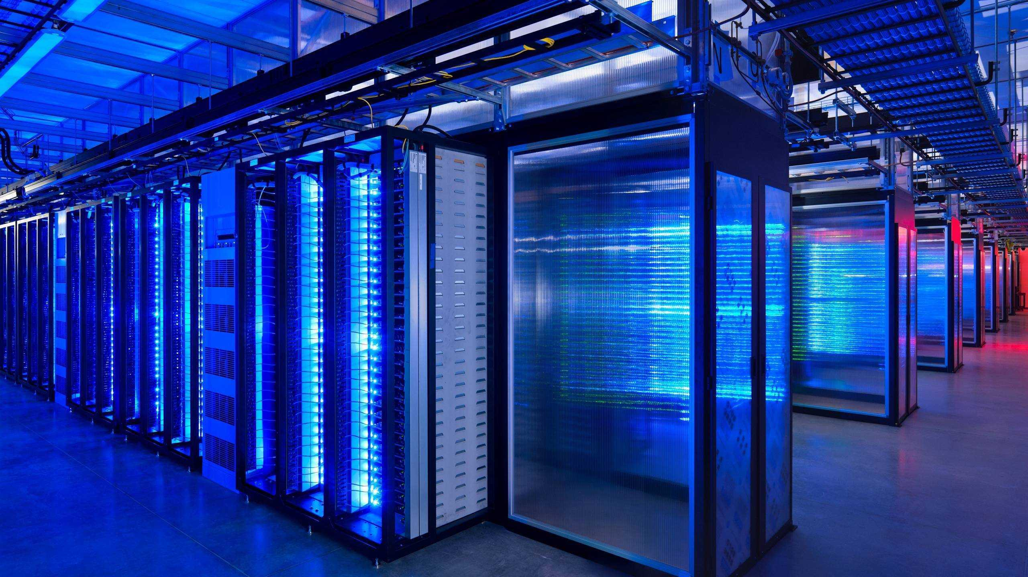
Different Hardware for different systems
Get images for the following and write out some comments about how the hardware changes for each of these different systems.
Personal Computer
Laptop
Mobile Phone
Server
Supercomputer
Mini Computer
Mainframe computer

Slide 9
What are the benefits and limitations of hardware? How can these limitations be overcome?
Integrated devices (graphics card and sound card all in one)
Smaller, more powerful devices
Touchscreens and flexible screens
Speakers and microphones
Peripheral devices like printers and scanners#
Input and output devices
Central processing unit
Secondary storage devices like hard drives
Screens and monitors

