Slide 1
Cambridge Technicals Level 3 It unit 1 Fundamentals of It Student booklet
**YOUR NAME HERE**

Slide 2
1 Input Devices
Device | Purpose | Benefit | Limitations

Slide 3
1 Output Devices
Device | Purpose | Benefit | Limitations

Slide 4
1 Communication Devices
Device | Purpose | Benefit | Limitations
VoIP Phone (Skype)
Tablet
Mobile Phone
Braille Keyboard

Slide 5
1. Input/output
A supermarket self-checkout has a range of input and output devices.
Identify any input and output devices that the checkout might use, clearly stating which is an input, output or both
Describe the purpose of each device.
A patient in intensive care in a hospital will be connected to various sensors.
Identify some of the sensors that may be used and what they are used for.
There will also be various output devices. Identify some that may be used and explain their purpose
Hannah is an artist who is beginning to use computers for her drawings, what input device would you recommend and why?
Steve loves loud music but still lives at home with his mum and dad what output device would you recommend and why?
Explain how the “touchscreen” of a tablet pc can be both an input and an output device.

Slide 6
2. Computer Components
Component | Image | Description | Purpose
Processors
Motherboard
Storage ( EG. Hard Drive, Solid State, Flash, Internal, Removable, SAS, SCSI, Portable, Cloud)

Slide 7
2. Computer Components
Component | Image | Description | Purpose
Power Supply
Ports (USB, Firewire, SATA, Network, Fibre)
Memory (RAM, ROM, Cache)
Expansion Cards (Eg: Sound, network, graphics, storage controller, fibre channel)

Slide 8
2. Dream computer…
Processor:
Hard Drive:
Ram:
Drives:
Motherboard:
Additional:
Input Devices:
Output Devices:

Slide 9
3. Types of System
Explain where & how each are used giving a benefit and limitation of each:
desktop/server
• tablet/hybrid
• smartphone
• embedded system (e.g. cars, home appliances, etc.)
• mainframe
• quantum
uses (e.g. tablet device can be used when
travelling due to its small size and built in battery)
• benefits (e.g. desktop computer can have a large
screen which can improve productivity)
• limitations (e.g. mainframes can be expensive to purchase and maintain)
Complete the sheet given.

Slide 10
3. Justification
Q: Explain why a Bank may use a mainframe to process customer information (3marks)
Move me when done to check
My score:
Mainframes are reliable (1) and have been around for a long time (1). Customer expect to have access to their money (1).
It can process many transactions at the same time (1). The bank has a lot of customers (1) so mainframe will provide the performance needed (1).

Slide 11
4. Connectivity Methods
Explain the pro’s and con’s for the following internet connection methods:
Connection method | Characteristics (bandwidth, Cost, PING, leasable, secure?) | When you would use it and why?
Copper (ADSL)
Fibre Optic (CABLE)
Wireless : Wifi
Wireless: Bluetooth
Wireless: Microwave
Wireless: laser
Wireless: Satellite
Wireless: Infrared
Wireless: 3G/4G & GSM

Slide 12
4. Connectivity Methods
Exam Style Question:
A Bank could use ADSL or a leased line to create a network between its branches. Compare the use of ADSL with a leased line for connecting the two locations. (6 marks)
My score:
Move me when done to check
Leased line is a dedicated connection (1) while ADSL is not (1). Both ADSL and leased lines are high bandwidth (1).
Leased line is uncontended while ADSL is contended (2). ADSL will need a VPN for security while a leased line will not (1).
4-6 marks: for two complete comparisions. At the bottom of the band may be one complete comparision and a list of individual points.
1-3 marks: Has made one complete comparison or a list of individual points
0 marks: nothing worthy of credit.

Slide 13
5. Connectivity Hardware:
Match the descriptions with cut and paste (2 each):
Router -
Modem -
Forwards data packets to the appropriate parts of the network.
converts between digital and analogue signals. Must be used so that computers (digital)
Allows the Internet connection to be shared by multiple devices
can connect to the Internet through telephone lines (analogue).
Then research and describe a network adaptor and give an example:

Slide 14
5. Connectivity hardware
1. Create a publisher poster with images of each of the hardware elements. For each explain their characteristics, purpose and use as an advert for your chosen manufacture (eg. Linksy)
2. Explain clearly the difference between a hybrid device and individual devices (home hub Vs Router/Modem/Switch/WAP)
3. You could fill this table first to help.
Hardware | Characteristic | Purpose | Use
HUB
SWITCH
ROUTER
MODEM
WIRELESS ACCESS POINT
Combined/hybrid device

Slide 15
6. Troubleshooting
A computer _______ is a group of computers and other ________ devices that are linked together through communication channels e.g. ______ or______.
A ______ area network is one that connects computers in a limited area or on a single site such as a house, _____ or office building.
cables
school
network
hardware
Wi-Fi
local

Slide 16
6. Troubleshooting
Write these three in your book:
What issues could happen on a network:
What tools are available to help troubleshoot:
Why is it important for companies to document faults:

Slide 17
6. Troubleshooting
For each scenario write in word a series of troubleshooting steps to fix the issue:
Internet connection is not working on any device in the home.
Internet connection is not working on a single wired device.
Internet connection is not working on a wireless device.

Slide 18
7. Nibbles and bits
Help
Define these words
Bit: Nibble: Byte: Kilobyte: Megabyte: gigabyte: Terabyte: petabyte: Kibi: mebi: gibi: tebi: pebi: Place in order when done. How many bits in a Kilobyte?

Slide 19
7. Examples
Give examples & images of files which would most likely be in:
Kilobytes: Megabytes: Gigabytes: Terabytes:

Slide 20
7. How many?
Bits in byte?
Bytes in a kilobyte?
Bits in a kilobyte?
Bytes in a Petabyte?
Nibbles in megabyte?

Slide 21
Mid unit Test
Write down the meaning of each of these Keywords, then add others to do with computing hardware.
Processors: RAM: Cache Memory: RAM: ROM: Solid State: Storage: Quad-Core: Bit: Byte: Kilobyte: Switch: HUB: Input: Output:
Monitor: Actuator:

Slide 22
8. Converting 8bit Binary to Denary & back
Help
Fill in the red. (USE HELP)
128 | 64 | 32 | 16 | 8 | 4 | 2 | 1
0 | 0 | 0 | 0 | 0 | 1 | 1 | 1
= 7 (Denary)
00000111 (8Bit Binary)
128 | 64 | 32 | 16 | 8 | 4 | 2 | 1
0 | 0 | 0 | 1 | 1 | 0 | 0 | 0
= ? (Denary)
00011000 (8bit Binary)

Slide 24
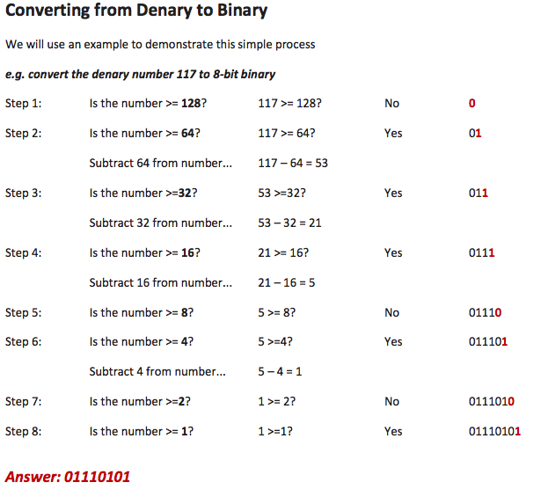

Slide 25
8. Denary to binary
Use the method on the previous slide to convert these numbers to their binary counterpart:
123 =
96 =
83 =
42 =
128 | 64 | 32 | 16 | 8 | 4 | 2 | 1
0 | 1 | 1 | 1 | 1 | 0 | 1 | 1
= 01111011
128 | 64 | 32 | 16 | 8 | 4 | 2 | 1
= 00000000
128 | 64 | 32 | 16 | 8 | 4 | 2 | 1
= 00000000
128 | 64 | 32 | 16 | 8 | 4 | 2 | 1
= 00000000

Slide 26
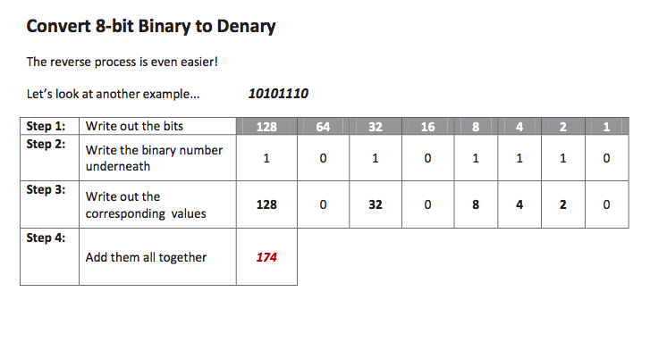
8. Converting binary to denary

Slide 27
8. Binary to Denary
Convert these binary numbers to their denary counterpart:
128 | 64 | 32 | 16 | 8 | 4 | 2 | 1
0 | 1 | 0 | 1 | 0 | 1 | 0 | 1
Denary:
01010101
= 85
128 | 64 | 32 | 16 | 8 | 4 | 2 | 1
 | 1 | 1 | 1 |  | 1 |  | 1
01110101
=
128 | 64 | 32 | 16 | 8 | 4 | 2 | 1
10010110
=
128 | 64 | 32 | 16 | 8 | 4 | 2 | 1
=
11100100

Slide 28
9. Hexadecimal
Help
Click on the help to see how HEX codes work.
In your exam you will have to convert 2 digit hex numbers into denary, and vice versa
Converting from Denary to HEX
Den | Hex | Den | Hex
0 | 0 | 8 | 8
1 | 1 | 9 | 9
2 | 2 | 10 | A
3 | 3 | 11 | B
4 | 4 | 12 | C
5 | 5 | 13 | D
6 | 6 | 14 | E
7 | 7 | 15 | F
Hex | D |  |  |  |  | B
Denary | 13 |  |  |  |  | 11
Binary | 1 | 1 | 0 | 1 |  | 1 | 0 | 1 | 1
24=
45
199
16 | 1
16 | 1

Slide 29
9. Hexadecimal
Convert Denary to HEX/Vice-Versa.
Den | Hex
45 | 2d
78 | 4e
26 | 1a
201 | c9
20 | 14
138 | 8A
187 | BB
159 | 9F
11 | 0B
69 | 45
Den | Hex
32
54
18
36
76
 | A3
 | 3B
 | D1
 | 03
255 | FF
Den | Hex
16
108
255
18
126
 | B2
 | 1F
 | AA
 | 8A
44 | 2C
Key
Den | 0 | 1 | 2 | 3 | 4 | 5 | 6 | 7 | 8 | 9 | 10 | 11 | 12 | 13 | 14 | 15
Hex | 0 | 1 | 2 | 3 | 4 | 5 | 6 | 7 | 8 | 9 | A | B | C | D | E | F

Slide 30
9. Hexadecimal
Convert HEX to Binary/Denary & Vice Versa
Hexadecimal | Binary | Denary
A | 1010 | 10
7 | 111
2F | 101111
4C | 1001100
D1 | 11010001 | 209
9 | 1001 | 9
11 | 00010001 | 17
 | 11011 | 27
 | 10001100 | 140
 |  | 212
 | 10011110
 | 11110010
 |  | 162
 |  | 99
Key
Den | 0 | 1 | 2 | 3 | 4 | 5 | 6 | 7 | 8 | 9 | 10 | 11 | 12 | 13 | 14 | 15
Hex | 0 | 1 | 2 | 3 | 4 | 5 | 6 | 7 | 8 | 9 | A | B | C | D | E | F

Slide 31
9. Hexadecimal
Why use HEX
Use the help to explain the benefit of HEX over Binary.

Slide 32
9. Hexadecimal
Extension task: Complete this crossword. SOME ANSWERS ARE EXPRESSED IN DENARY, OTHERS IN HEXADECIMAL
0
0
0
0
0
0
0
0
0
0
0
0
0
0
0
0
0
0
0
0
0
0
0
0
0
0
0
0
0
0
0
0
0
0
0
0
0
0
0
0
0
0
0
0
0
0
0
0
0
0
0
0
0
0
0
0
0
0
0
0
0
0
0
0
0
0
0
0
0
0
0
0
0
0
0
0
0
0

