Slide 1
starter
Skim read the Skills booklet.
Think: Which skill would an IT Business most value in a new employee?
Open Publisher & Save as 4.1 Comm Skills (A4 landscape)
Notes:
10mins

Slide 2
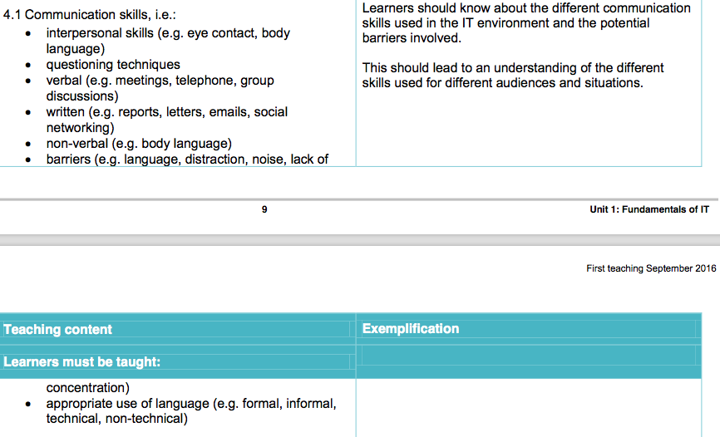
P2, each section an hour on:

Slide 3
New learning goals
All will: Understand a range of Comms Skills
Most will: Explain the communication skills
Some will: Give a detailed accounts with examples
By:
Reviewing example communication skills
Choosing three Explaining them in your leaflet
Lets see a good example then some skills….
Notes:
1mins

Slide 4
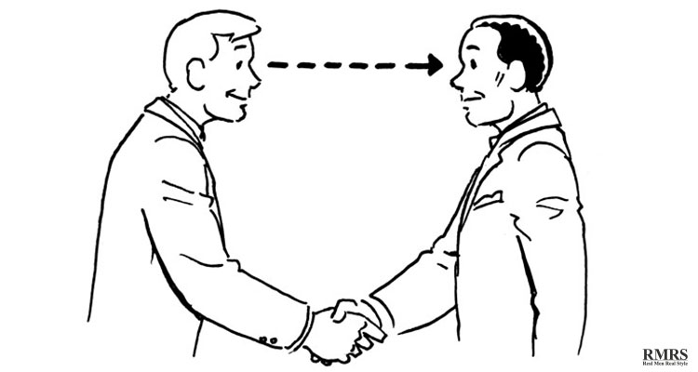
Interpersonal Skills
What skills are these?
Notes:
4mins demo, 20mins – create logo, then export together. 15mins – Add to PPT and Callout, show each others logos.

Slide 5
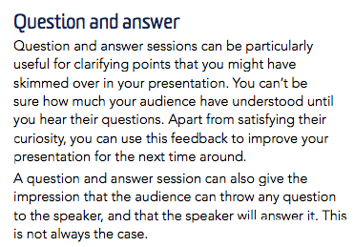
Communication Skills
Notes:
4mins demo, 20mins – create logo, then export together. 15mins – Add to PPT and Callout, show each others logos.

Slide 6
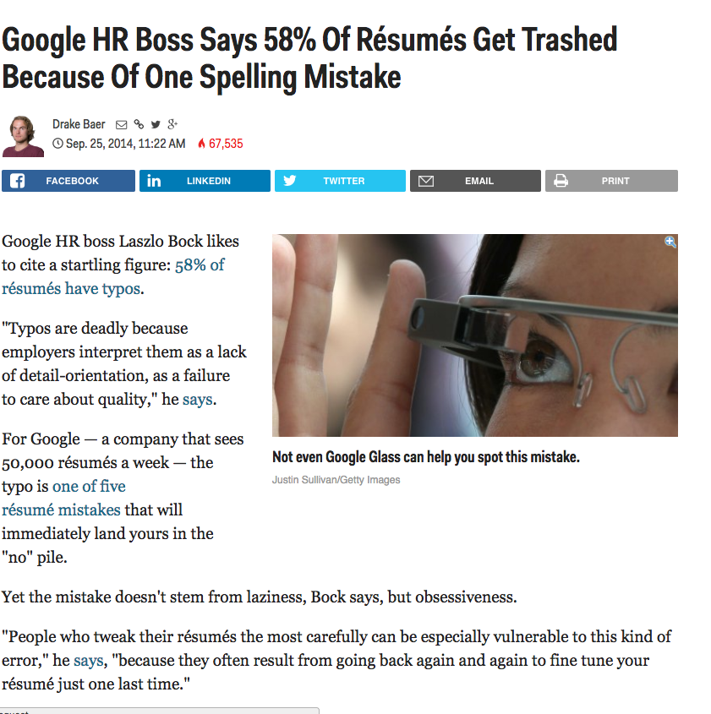
Written skills
Notes:
4mins demo, 20mins – create logo, then export together. 15mins – Add to PPT and Callout, show each others logos.

Slide 7
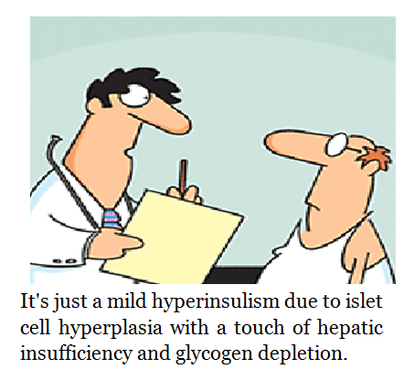
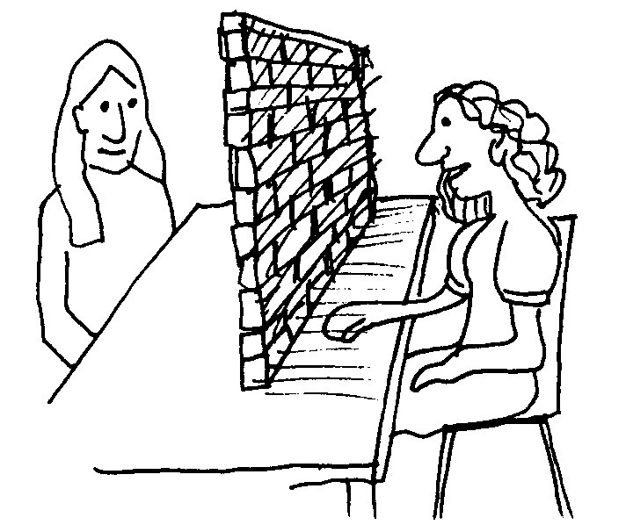
Barriers to Communication
What are these…
Noise
Language too complex or use of Jargon
Physical Barriers: Deafness/ Sign Language Requirements.

Slide 8
Task: Create a 3 sided leaflet
Using the sheet, create a guide for people writing a CV to Google
Discuss 3 Skills & One barrier.
EG: Google Values employs who have great nun-chuck skills
Verbal Communication.
Notes:
4mins demo, 20mins – create logo, then export together. 15mins – Add to PPT and Callout, show each others logos.

Slide 9
Mime a skill or Barrier….
Can you draw a cryptic clue to a barrier of your choice: Rest of the class guess…
= Interpersonal Skills

