Slide 1
How is climate change
impacting on children around the world?

Slide 2

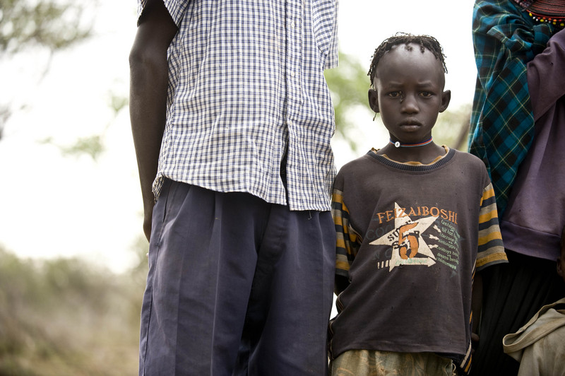
Meet Chelimo
Photo: © Des Willie/ActionAid
Chelimo is 9 years old. She lives in northern Kenya.
What do you think the climate is like here?

Slide 3
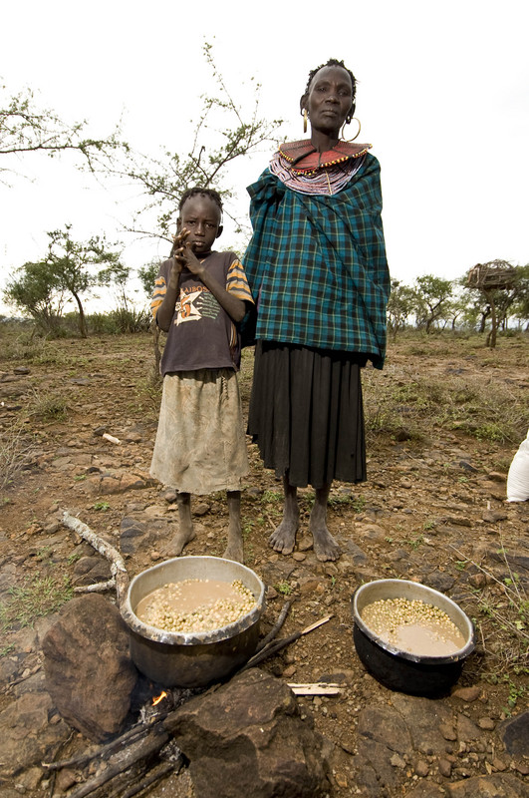
Photo: © Des Willie/ActionAid
The temperature here can reach 45°C and the land is very dry. It has not rained for the past two years. What happens to the crops when there is no rain?

Slide 4
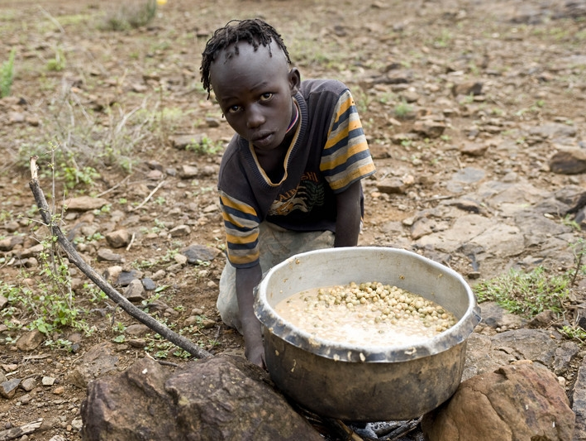
Photo: © Des Willie/ActionAid
The only plants that grow are Loma berries. Why is Chelimo cooking them in this pot?

Slide 5
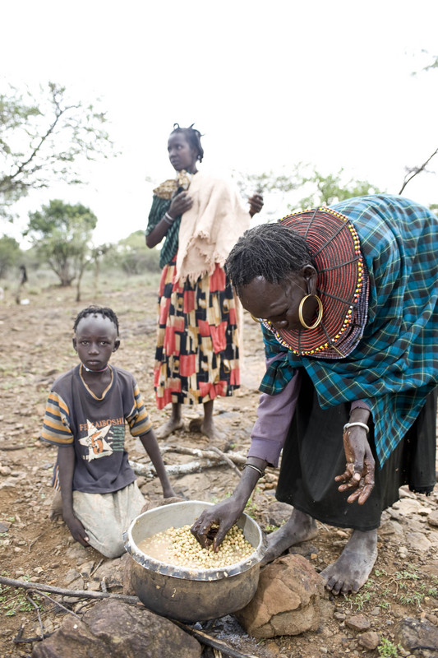
Photo: © Des Willie/ActionAid
Chelimo and her family have to walk a long way to pick the berries. They are poisonous so have to be boiled before they can be eaten.

Slide 6
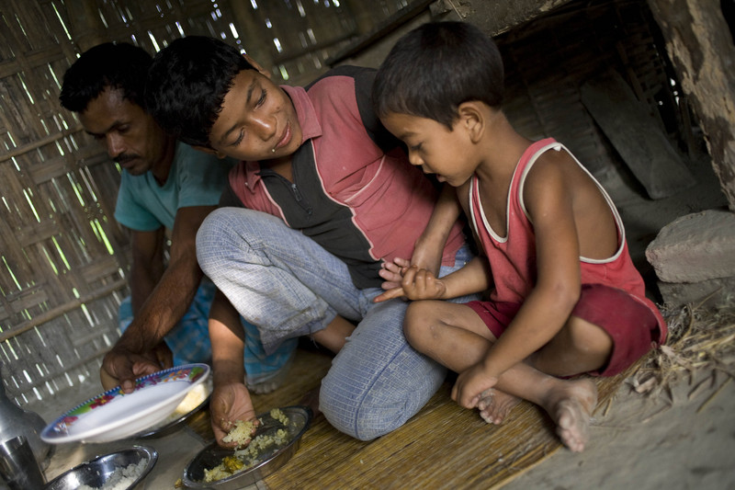
Meet Biplob and his family
Photos: © Tom Pietrasik/ActionAid
Biplob is 11 years old and lives in Bangladesh. What do you think he is telling his younger brother?

Slide 7
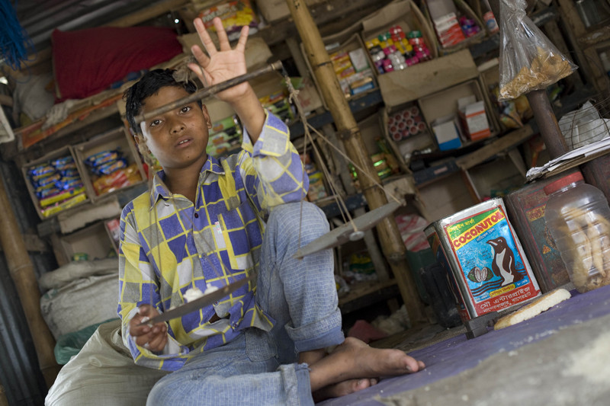
What work is Biplob doing here?

Slide 8
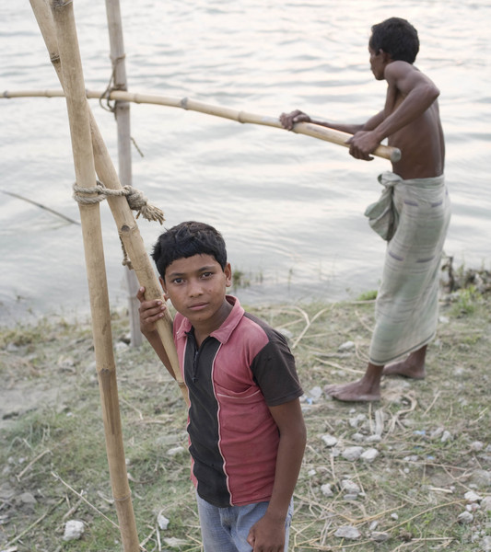
What is the land like where Biplob lives? How will it be affected by more rainfall?

Slide 9
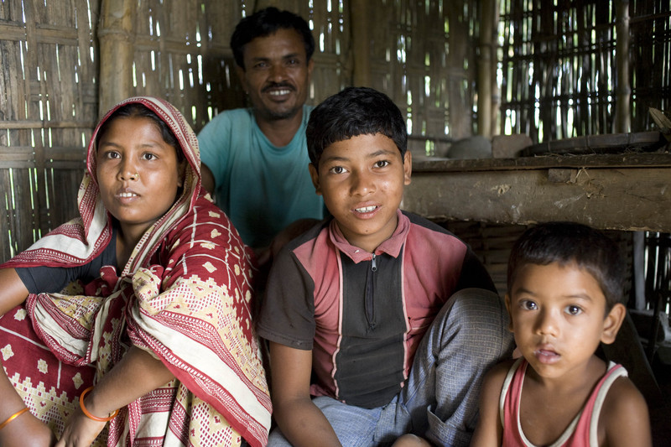
Did you notice…?
The land near the river is sandy. The land can be washed away easily in a flood or when it rains a lot
- Biplob has to work in a shop to help support his family
- Biplob helps to get food for the family by going fishing
Biplob lives in a hut with bamboo walls. It is not strong and falls apart during storms and floods
Photos: © Tom Pietrasik/ActionAid

Slide 10

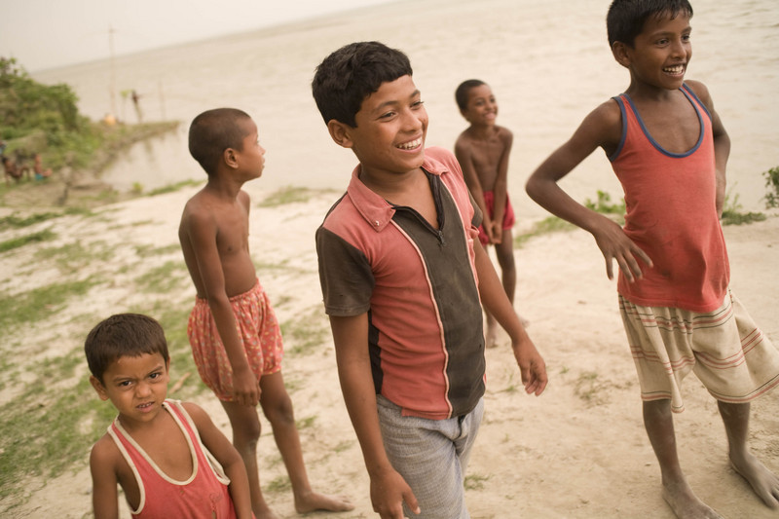
Two children impacted by climate change
Chelimo lives in northern Kenya
and is being impacted by climate change through drought.
In northern Kenya a prolonged drought has led to 10 million people in search of food.
Photo: © Des Willie/ActionAid
Biplob lives in Bangladesh
and is being impacted by climate change through floods and storms.
In 2007 floods and storms displaced more than 7 million people in Bangladesh.
Photo: © Tom Pietrasik/ActionAid

Slide 11
Climate Change in numbers…
Between 2000 and 2004 there were 262 million people impacted by climate disasters each year. Over 98% of them in the developing world.
One person in 19 living in the world’s poorest countries is at risk from climate change compared to one person in 1,500 in the richest countries.

Slide 12
The reality of climate change
Climate change is affecting the world’s poorest people right now:
droughts are lasting longer
floods and severe storms are more frequent
many people have lost their land and crops
Poor families cope with climate change disasters by:
moving to live in safer places
taking children out of school
cutting their spending on essential items like food and medicine

Slide 13
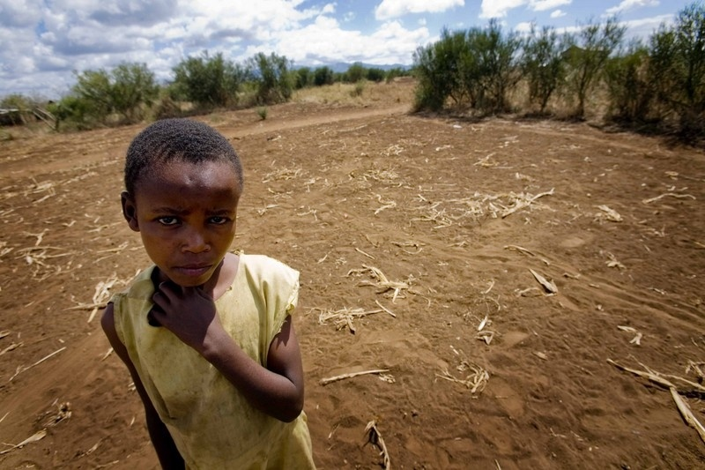
What does this mean?
In dry places land is getting drier and drier, there is drought, and people cannot grow food
In places that flood there are more floods each year and when the land is washed away people cannot grow food
Maua, aged seven from Tanzania
Photo: © Kate Holt/Shoot the Earth/ActionAid
Around the world climate change is affecting more and more of the world’s poorest people by stopping them from growing food and causing extreme hunger

